Slide 1
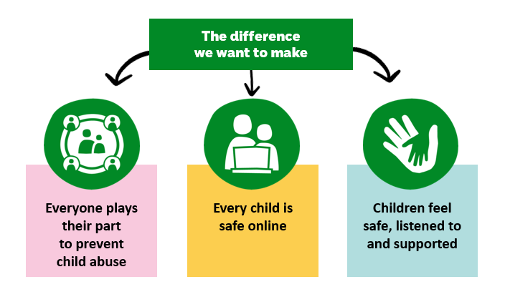
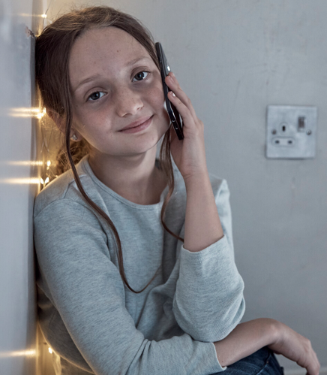


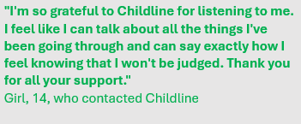
Purpose of the NSPCC

Slide 2



Schools and Academies
School Service Programmes
Speak Out. Stay safe
Talk Relationships
Pants
“The content, pitch & delivery of the Speak out Stay safe workshop was age-appropriate and engaging for children and staff valued the independence & expertise of the NSPCC, which helped engage children with the core messages.”
Bina Chauhan, Knighton Mead Safeguarding Lead

Slide 3





School Fundraising – how you can help
3 x termly products
Nursery and Secondary
DIY

Slide 4
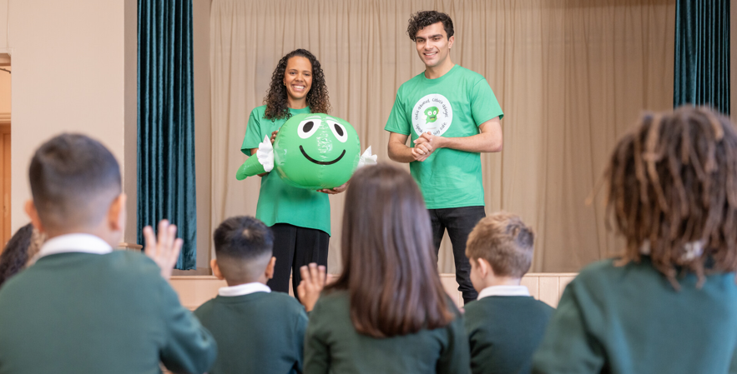
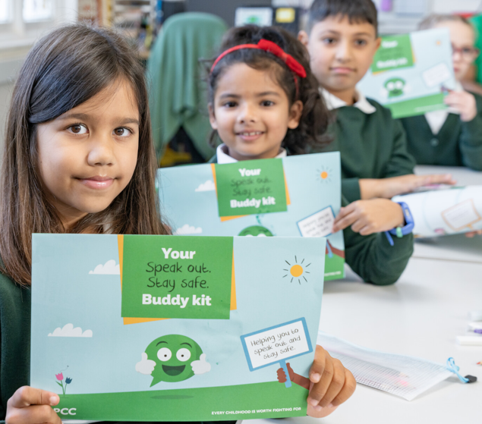

School Fundraising – helping each other

