Slide 1
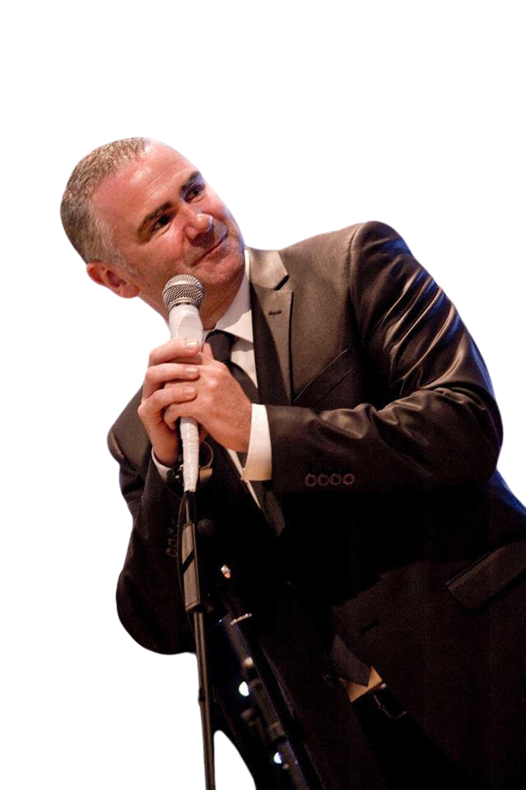

Nick Bowen
Belonging – Dignity - Fulfilment
Conferences, Events & After Dinner
Keynote Speaker
nickbowen.co.uk
+44 (0) 7930 363 720

Slide 2
Belonging
Dignity
Fulfilment

Slide 3


Slide 4
Belonging
Dignity
Fulfilment

Slide 6
The Power
of
Belonging

Slide 7
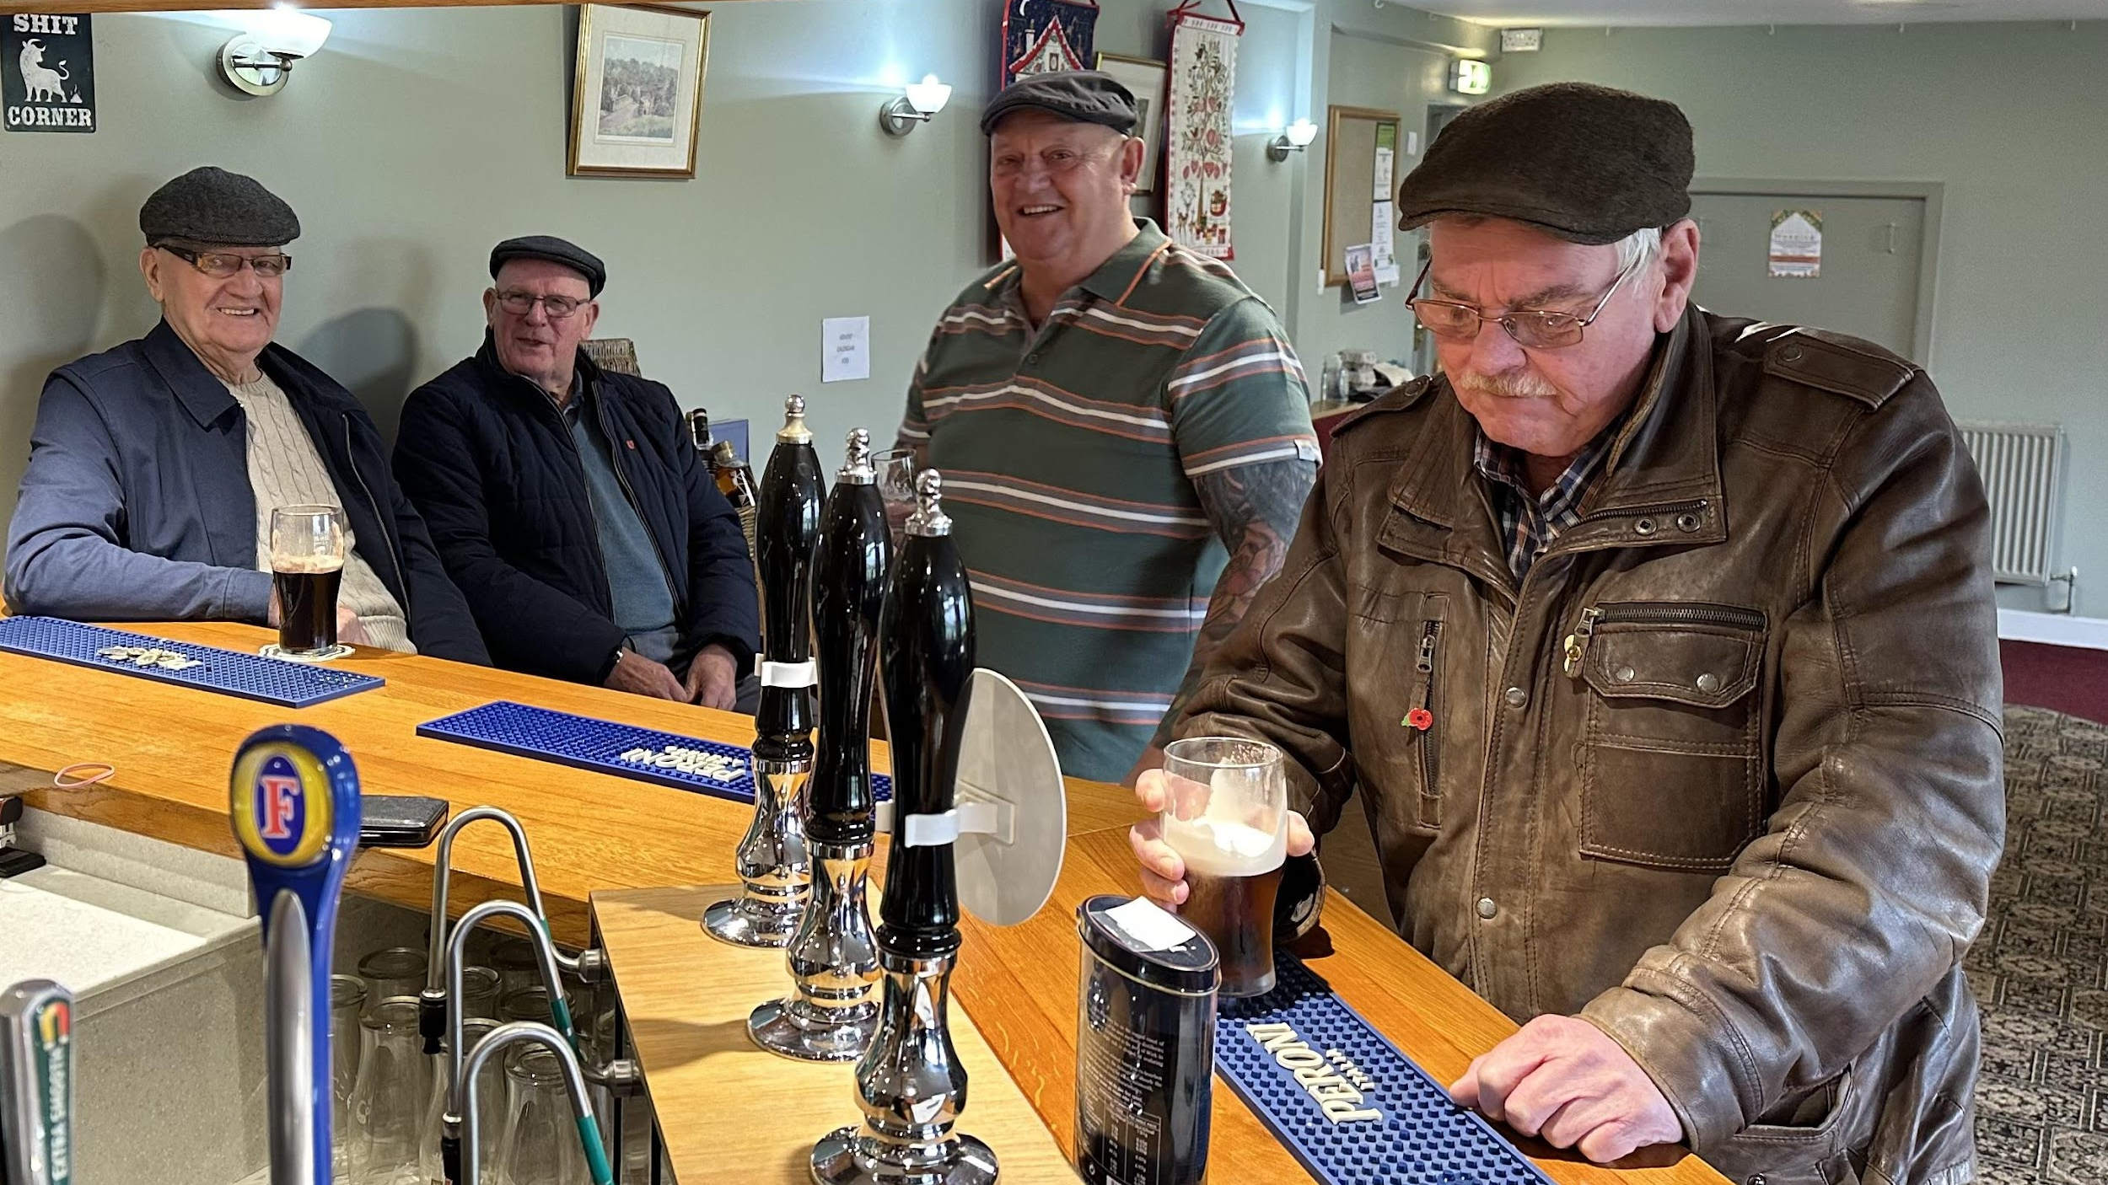

Slide 9
A strong sense
of Belonging
Fans the flames of
Dignity

Slide 10
Dignity
gives birth to
Fulfilment

Slide 11
Belonging
Dignity
Fulfilment

Slide 12
A culture of Belonging, Dignity and Fulfilment provides the platform for the perfect balance of Empowerment and
Accountability to work its magic

Slide 13
The perfect balance of Empowerment
and
Accountability

Slide 14
Accountability
Empowerment

Slide 15

Stereotypical
DOG
Milo
Accountability
Empowerment

Slide 16

Stereotypical
DOG
Milo
Accountability
Stereotypical
CAT
Bobby
Empowerment

Slide 17
Stereotypical
DOG
Milo
Accountability
WORST traits of
Bobby & Milo
Stereotypical
CAT
Bobby
Empowerment

Slide 18
Stereotypical
DOG
Milo
BEST traits of
Bobby & Milo
Accountability
WORST traits of
Bobby & Milo
Stereotypical
CAT
Bobby
Empowerment

Slide 19
To get the balance right an Authentic Leader will:
Ask the right questions
Hold people to account
Empower people to deliver
Celebrate and reward success
Take responsibility for organisational failures

Slide 20
Belonging, Dignity and Fulfilment enable the perfect balance of Empowerment and
Accountability to create Transformational Success

Slide 21

Oscar Romero

Slide 22
1. The Power of Belonging
2. Fans the flames of Dignity
Gives birth to Fulfilment
3. The perfect balance of Empowerment and Accountability leads to transformational success

Slide 23
Nick Bowen
Belonging – Dignity - Fulfilment
Conferences, Events & After Dinner
Keynote Speaker
nickbowen.co.uk
+44 (0) 7930 363 720

