Slide 1





Clare Wilson
Head of Digital Traded Services
Education Data Hub
Artificial Intelligence:
essential compliance considerations

Slide 2













2024
Notes:
Well I am delighted to be able to tell you that we won that awards and are now the Piccaso European Data Privacy Team of the Year, as well as being the Cyber Public Service of the Year and having the Cyber Consultant of the Year as one of our colleagues.
Furthermore, anther colleague has been shortlisted as Damar Apprentice of the year and…..the Team has been shortlisted in the FOI Awards and 2 colleagues shortlisted as Rising Stars

Slide 3


Agenda
Why do we need to think about this?
What is AI
Regulation
The regulators
Why schools need AI governance
Principles and Policy
Personal data collected by AI
But…..
Where to get started
Open v Closed
DPIAs
DfE Position Statement
Cyber Security
Online Safety

Slide 4
Why is compliance important?

Slide 5
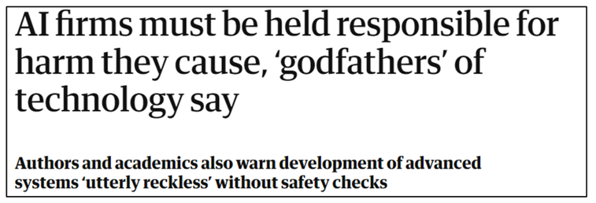
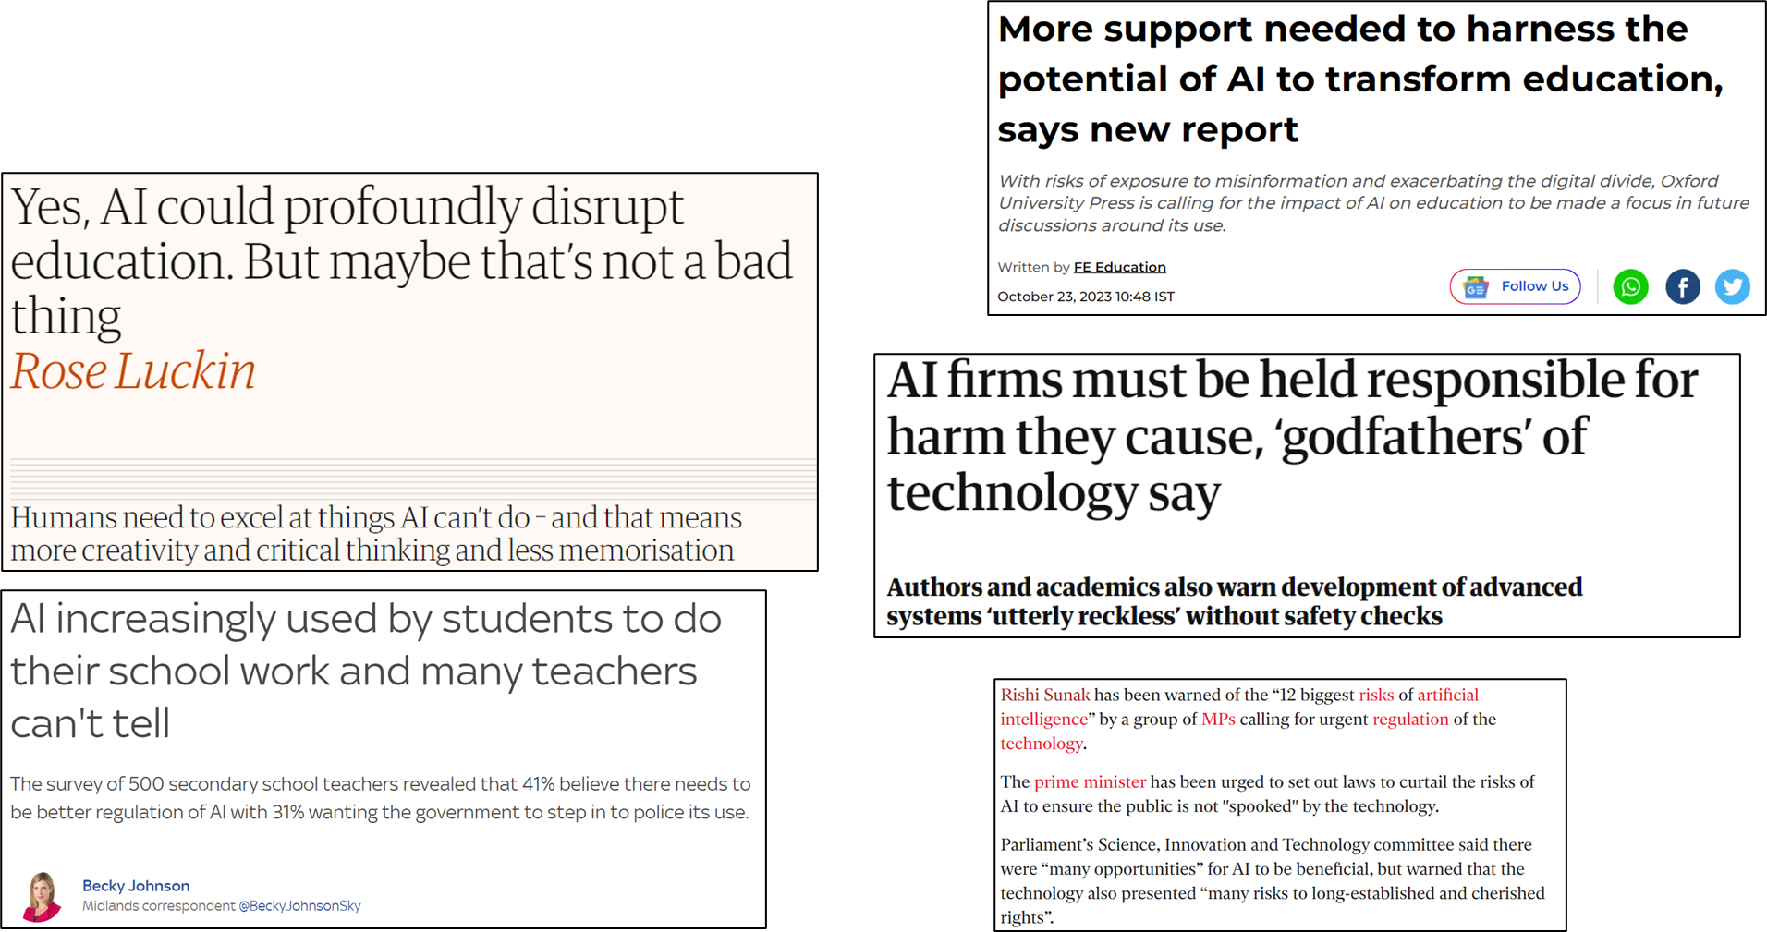





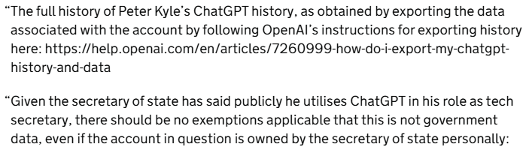



Slide 6
Did you know your work was uploaded to a machine?
You’re a student. Sixteen. You write a very personal assignment that includes self evaluation.
Your teacher checks it for plagiarism using AI, then pastes it into an AI system to get feedback suggestions and a probable grade; to help ease the teacher workload.
At no point were you asked.
And yet, your ideas, your expression, your personal data are now stored and processed by a system trained on the world.
You don’t know where the data is, or if it can ever be deleted.
What do transparency & accountability mean in a world where your work can be uploaded without your knowledge and processed in seconds?
Credit Clara Hawking: LinkedIn

Slide 7
Here’s what it doesn’t mean:
It doesn’t mean a privacy notice buried in small print.
It doesn’t mean “Well, everyone else is doing it.”
And it definitely doesn’t mean retroactive justification.
In the age of generative AI, transparency & accountability are not a ticklist. Getting them right is a legal requirement, a practice, a process, a responsibility. It is data protection by design.
But legality is only the floor. The ceiling is ethics.
And the weight of that sits with the professionals who choose to use these tools.
Credit Clara Hawking: LinkedIn

Slide 8

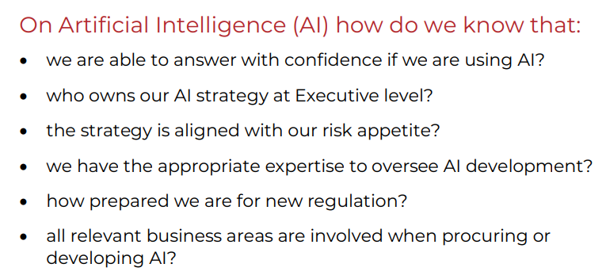
ARAC_Handbook.pdf
https://assets.publishing.service.gov.uk/media/68b05263b430435c669c1760/ARAC_Handbook.pdf

Slide 9

Get to know your DPO
Senior Leader
Strategist
Data Protection Officer
Advisor & facilitator

Slide 10
What is AI?

Slide 11

What is Artificial Intelligence (AI)?
“A branch of computer science aimed at creating machines that mimic human intelligence”
Understands and predicts language
Recognises patterns
Makes decisions
Can be reactive (Alexa, Roomba), predictive (Netflix) or generative (ChatGPT)
More than an algorithm:
Algorithms will always generate the same output for a given input- a fixed set of instructions for a computer to follow
AI creates algorithms that allow computers to learn from unpredictable/unstructured data and then autonomously build on that learning

Slide 12


Slide 13

What is Generative AI?
Generative AI models learn the patterns and structure of their input training data and then generate new data that has similar characteristics
Text
Code
Images
Audio
Music
Video
Robotics
Design
stores and learns from the data it finds & is given

Slide 14


Slide 15
Regulation & Governance

Slide 16
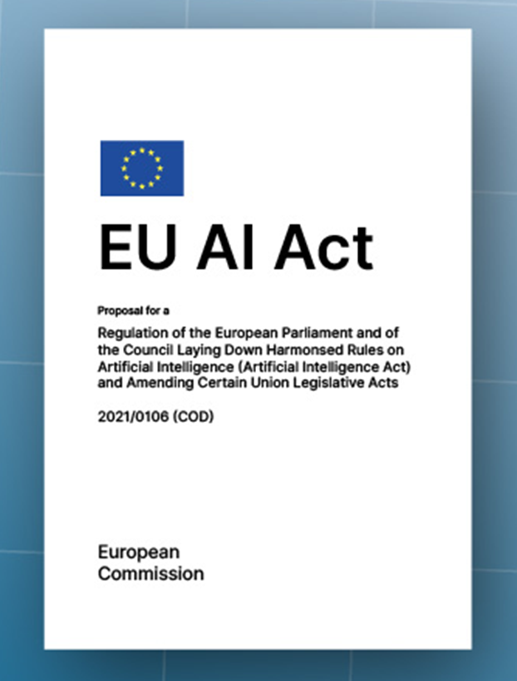
Regulation?
Unacceptable risk list – 2 Feb 2025:
Infers emotion
Distorts behaviour
Manipulative measures
Function & Technical Documents:
Requirement by Aug 2025
Will help in interrogating providers
Bigger fines than GDPR
EU Regulatory concerns have meant that Apple & Meta have decided not to launch all their AI features

Slide 17
Regulation? Italy’s new AI law! 10 areas stand out:
1. Respect for human autonomy:
"AI systems and models for general purposes must be developed and applied with respect for human autonomy and decision-making power, harm prevention, knowability, transparency, explainability, and the principles set out in paragraph 1, ensuring human oversight and intervention."
2. Freedom of expression:
"The use of AI systems in information occurs without compromising the freedom and pluralism of the media, freedom of expression, and the objectivity, completeness, impartiality, and fairness of information.""
3. Consent for minors:
"Access to AI technologies by minors under the age of 14 requires the consent of the person exercising parental responsibility"
4. Protection of sensitive data:
"AI systems intended for public use must be installed on servers located within the national territory, in order to guarantee the privacy and security of citizens' sensitive data."
5. AI in healthcare:
"The introduction of AI systems in the healthcare system cannot select and condition access to healthcare services according to discriminatory criteria."
6. AI in the public administration:
"The use of AI is supportive of the administrative activity, respecting the autonomy and decision-making power of the person who remains solely responsible for the measures and procedures in which AI has been used."
7. Professional ethics:
"To ensure the relationship of trust between the professional and the client, information relating to the AI systems used by the professional is communicated to the recipient of the intellectual service in clear, simple, and comprehensive language."
8. Non-consensual AI deepfakes:
"Anyone who causes unjust harm to a person by providing, publishing, or otherwise disseminating, without their consent, images, videos, or voices falsified or altered through the use of AI systems and capable of misleading as to their authenticity, is punishable by imprisonment for one to five years."
9. Copyrightability:
"even when created with the aid of AI tools, provided they constitute the result of the intellectual work of the author."
10. AI in the judicial system:
“The judge always retains all decisions regarding the interpretation and application of the law, the assessment of facts and evidence, and the adoption of measures."

Slide 18
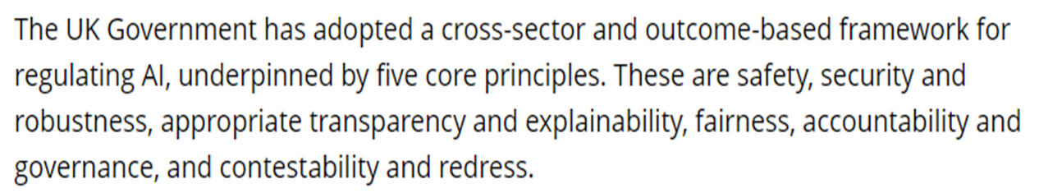
Regulation?
Laws relating to:
Data Protection
Intellectual Property

Slide 19

Regulation
Governance

Slide 20


Slide 21
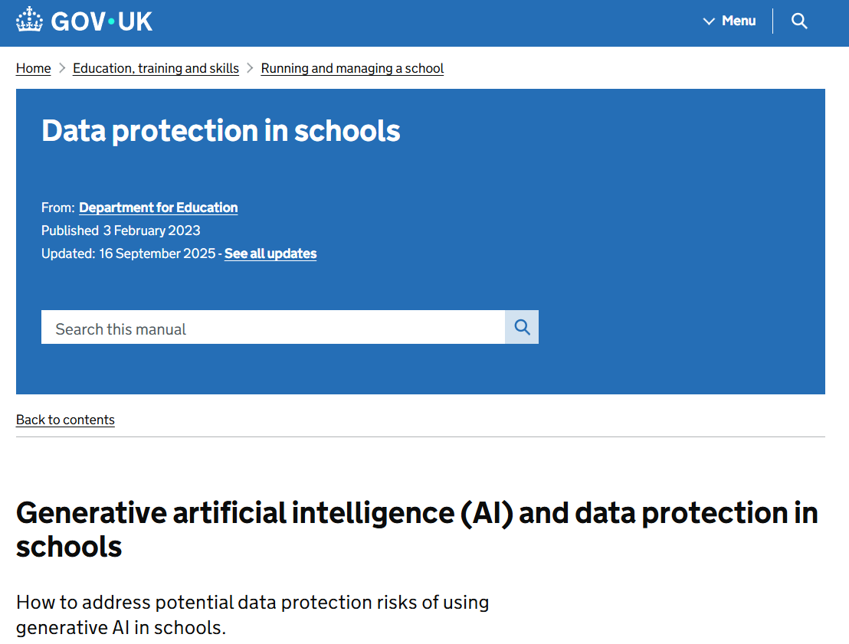
Notes:
AI-Use-in-Assessments_Apr25_FINAL.pdf - updated link to JCQ guidance

Slide 22
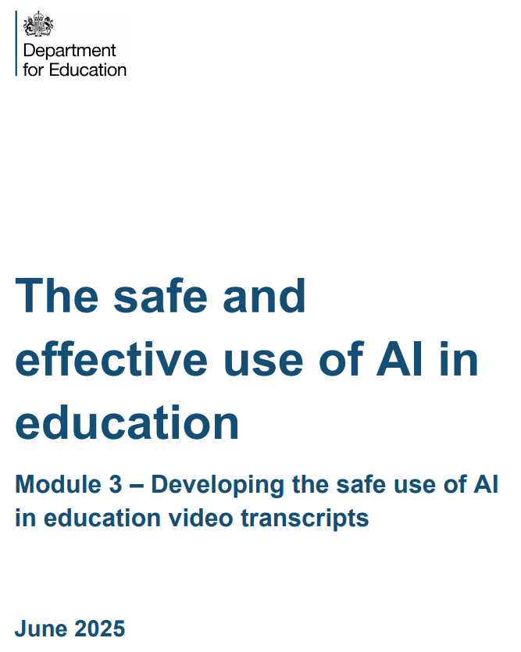

Slide 23
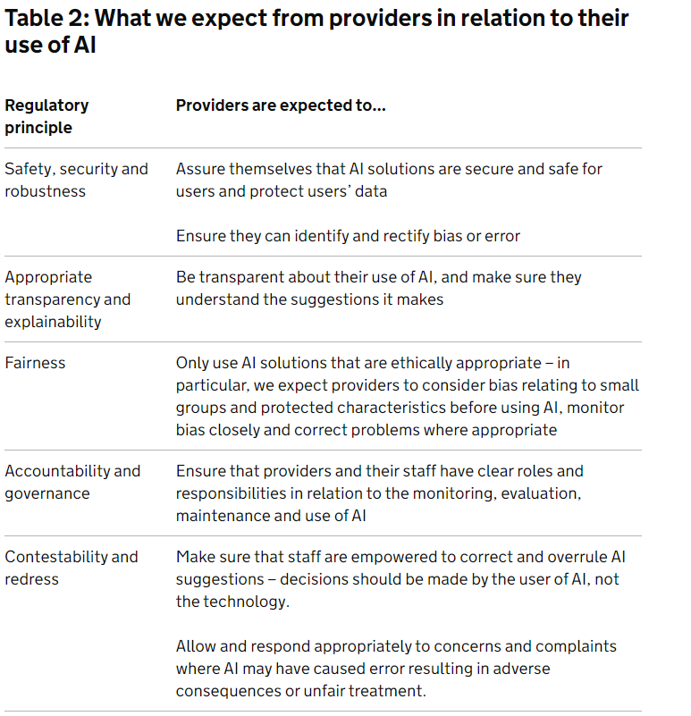
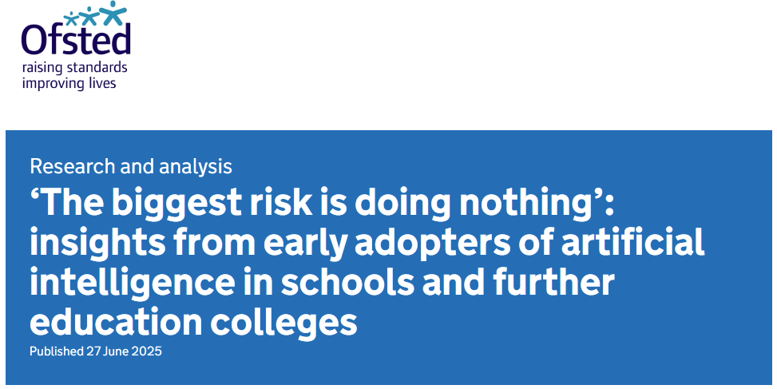

Slide 24
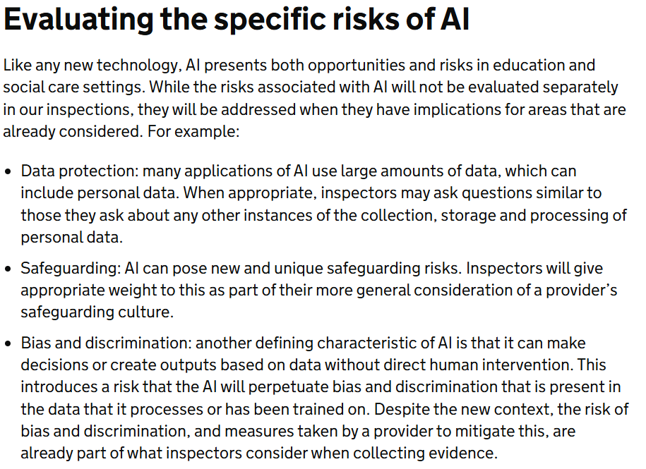

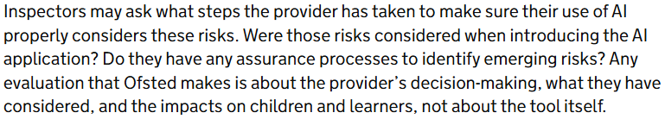

Slide 25
Where to get started

Slide 26

The principles
Lawful, fair and transparent
Security
Purpose limitation
The Data Protection Principles
Accountability
Data Subject Rights
Storage Limitation
Data minimisation
You must have appropriate measures and records to demonstrate your compliance with data protection law
You must ensure that data subjects are able to exercise their rights
Right to be Informed (Privacy Notice)
Right of Access (Subject Access Request)
Right to withdraw consent
Also other Rights e.g. Erasure, Restrict, Object
Accuracy

Slide 27

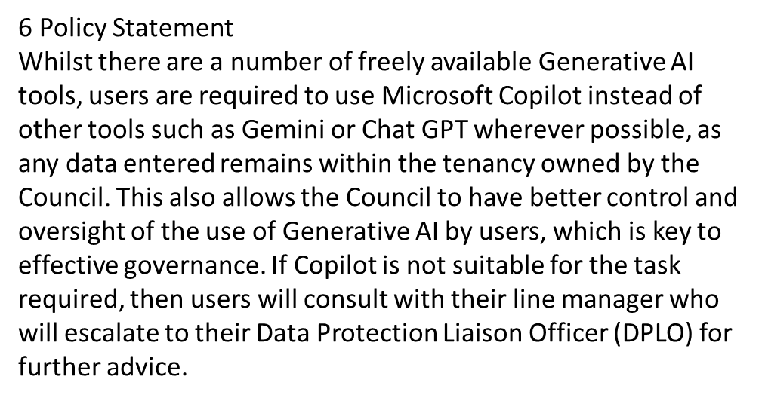

Slide 28

Where to get started
1. Zero trust model – no AI
2. Amnesty – what has been used, by whom, for what?
3. Cyber Hygiene
4. Data Protection governance in place
5. Establish an AI Governance structure

Slide 29
Can we trust it?

Slide 30


Slide 31
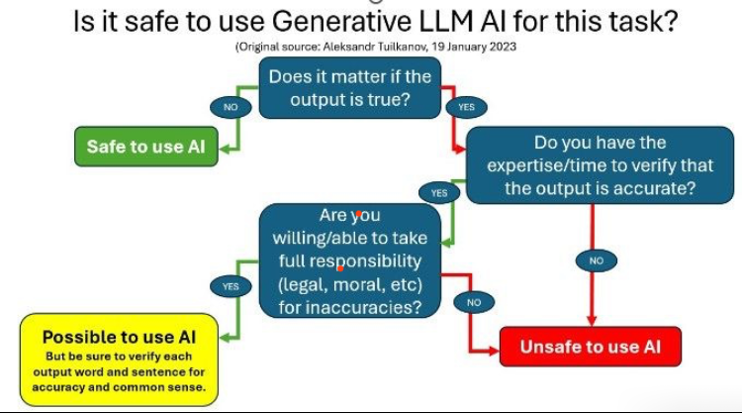

Slide 32
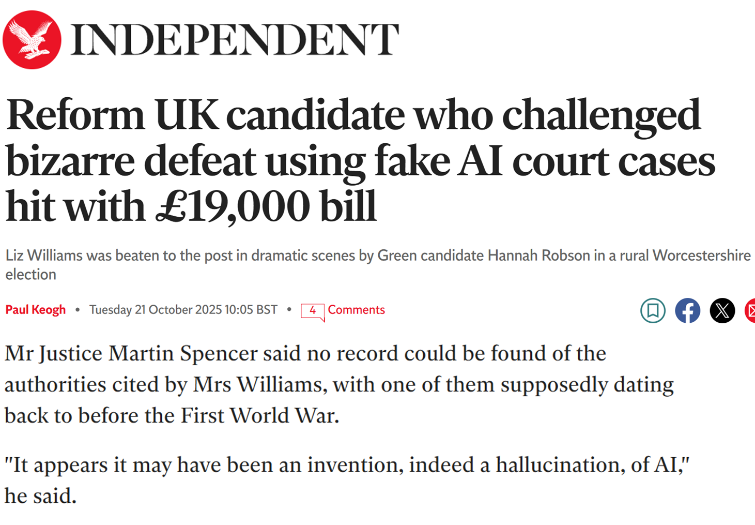

Slide 33
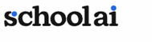

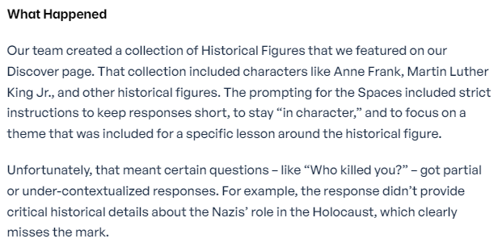
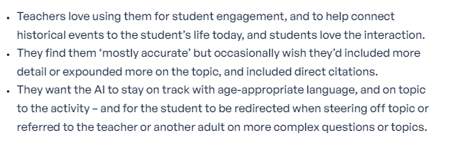
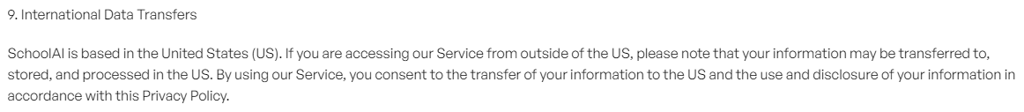

Slide 34
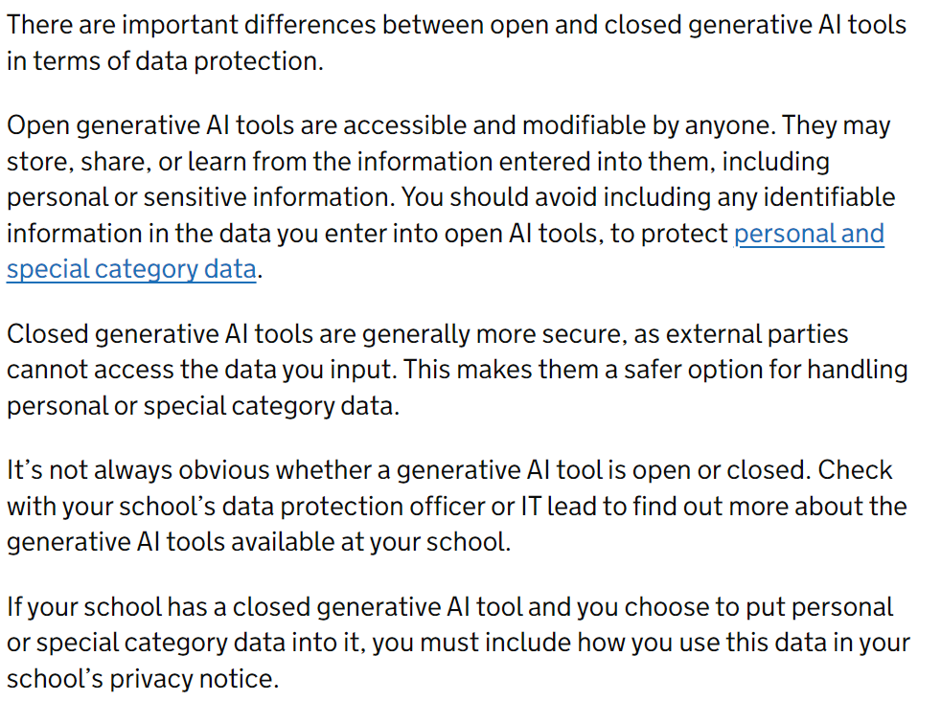
DfE - Open & Closed AI

Slide 35
Types of AI for school compliance
Open
Closed
ChatGPT
❌ Compliance Concerns:
No Formal Data Processing Agreement
Lack of Control Over Data Storage Schools can't guarantee where or how student data is stored or processed.
No Age Verification
Grammarly
❌ Compliance Concerns:
Collects user input to improve its models, which may include student PII.
No Education-Specific DPA
concerns about data residency and control.
Limited visibility into how data is used for training.
Freely available
Century Tech
❌ Compliance Concerns:
Builds detailed learner profiles which may raise issues around automated decision making
✅
Licensed and marketed as GDPR-compliant.
M/S Copilot
✅Compliance Strengths:
Licensed under Microsoft’s enterprise agreement, often already in place
Microsoft provides Data Processing Agreements aligned with UK GDPR.
Schools can configure data residency and access controls.
Licenced

Slide 36

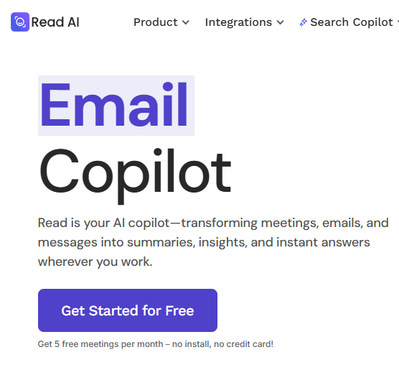
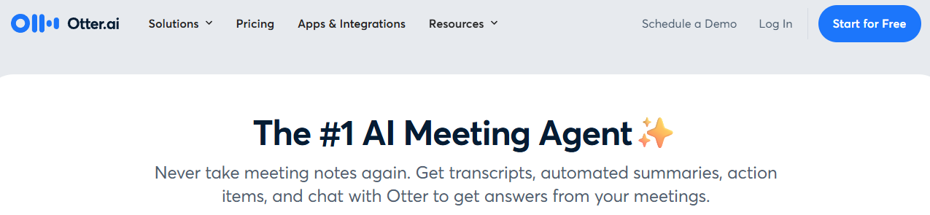
AI Agents / Assistants
Avoid AI agents and assistants at all costs – if you accept them, they then have access to everything in your email, calendar and online meeting content even if the meeting is NOT recorded!

Slide 37
DPIA & ‘Authorising’ AI use

Slide 38
DPIA
“Under the UK GDPR, controllers are required to carry out Data Protection Impact Assessments for 'high risk processing'. The use of AI technologies is likely to trigger the requirement to carry out a DPIA in many contexts and are a key part of the accountability principle.
Embedding AI tools is a huge undertaking, and you need to be confident that the external company understands their responsibility and compliance with the GDPR.”

Slide 39
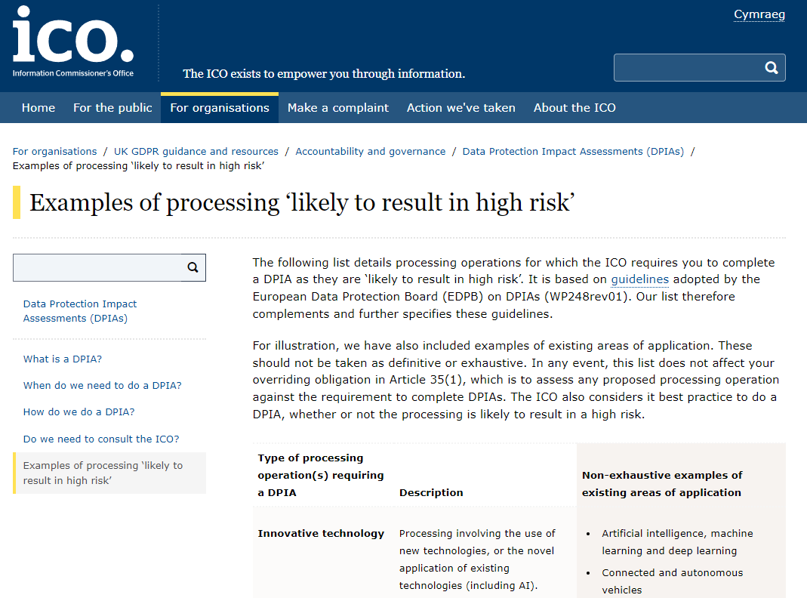
DPIA

Slide 40

DPIA – the agreement
1 Contract for Services. Standard T&Cs (often referred to as Boilerplate). Look out for these being changed once signed – scope creep into AI
2 Service Level Agreement. Sets the parameters of the service you can expect.
3 Data Sharing / Processing Agreement. Identifies the roles and obligations of the parties in respect of the data shared under the contract for services. May be drawn up by the DPO.
4 Data Schedule. Outlines the categories of data which need to be shared for the service to be delivered. Ensure you review all data sets before they are fed into any AI model
PLUS if EU based – Functional & technical docs from Aug 2025

Slide 41
DfE Position Statement-key messages for the sector,
including some lines in the sand “the sector must…”
You must:
Only use the authorised AI tools, documented in your AI Policy
Get to know your DPO
Talk to staff and governors about risks / benefits – have a no blame AI amnesty conversation
Ensure they understand the types of AI and their own respective obligations
Provide them with a guidance document and a signed off policy
Ensure you have a lawful basis for all processing
Ensure a signed off DPIA is in place wherever required
Ensure RoPA / Data Maps and Privacy Notices are constantly updated to reflect new processing
Prepare for data subjects to exercise their rights
Prepare for FOIs
Update your online safety training to include the risks to children from AI
Reconsider your website content – AI is learning from this
Strengthen all Cyber Security measures

Slide 42
DfE Position Statement-key messages for the sector,
including some lines in the sand “the sector must…”
You must not:
Permit the use of open AI models with any sensitive material
Use ChatGPT to sense check safeguarding entries
Permit staff to undertake trials of software (especially if they are free) without consulting with the DPO
Engage other AI bots or note takers in on-line meetings
Permit automated decision making by edtech – keep a human in the loop
Enter the following into an open, unlicensed AI models:
Personal data – info about pupils, families and staff,
Commercially sensitive information – for example about plans involving school buildings, academisation, redundancies
Intellectual property – including resources you own, pupil work

Slide 43
‘Authorised’ means…..
A designated person from the school has attended AI Compliance training (recommended at least every 12months given the pace of change)
The AI policy template has been adapted and approved
Staff have been briefed on its contents
A DPIA has been carried out and approved on the relevant system
This has been added to the ‘authorised’ list in the policy (and possibly in the quick guide for notice boards)
The school’s Record of Processing Activity (RoPA or Data Map) has been updated to reflect this processing
The school’s Privacy Notices have been updated to reflect this processing

Slide 44
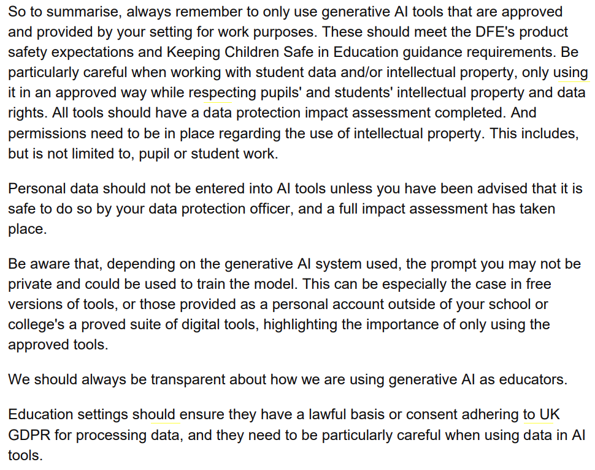

Slide 45

Cyber Security

Slide 46
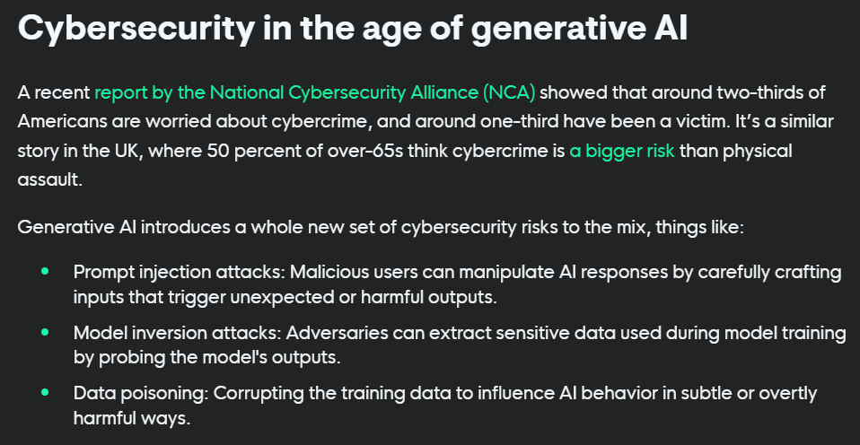


Slide 47

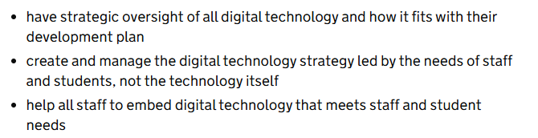

Slide 48
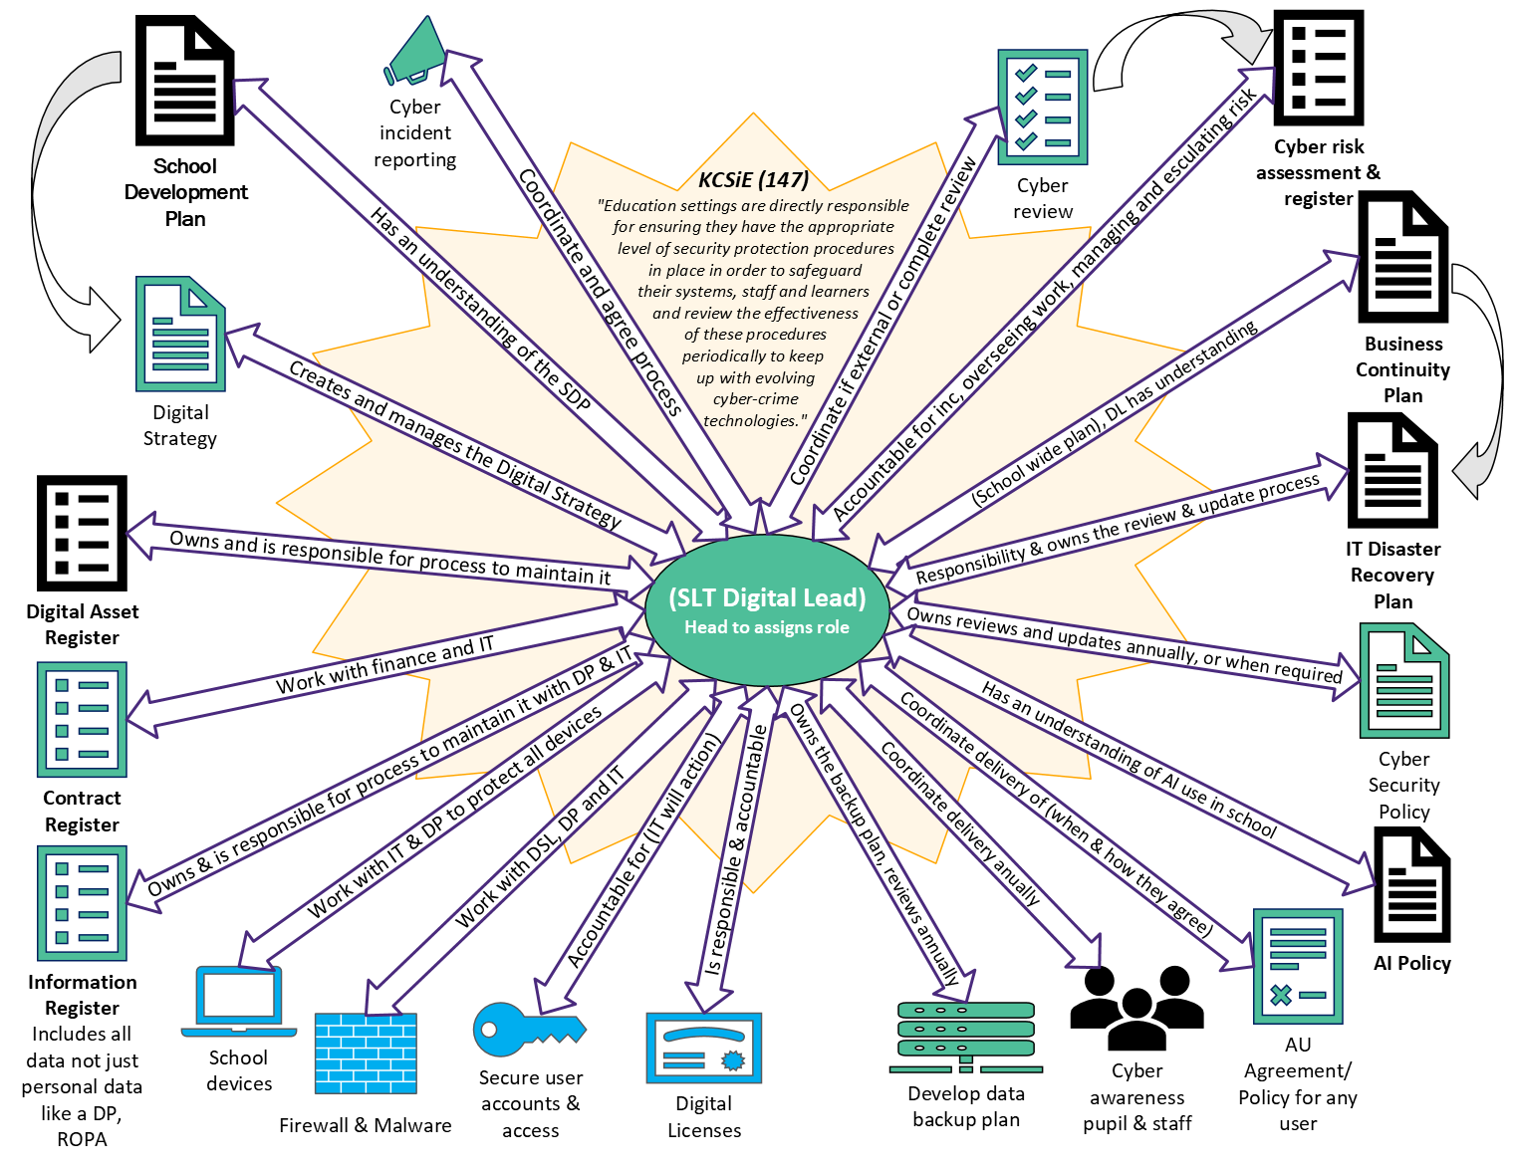
Note: F&M is not on here as at time of writing this is the responsibility of the DSL

Slide 49

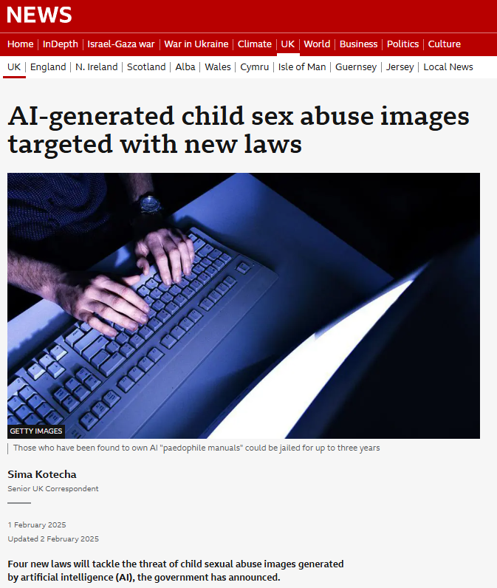
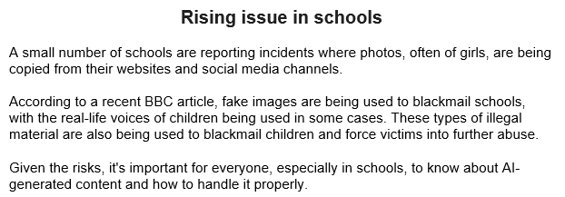
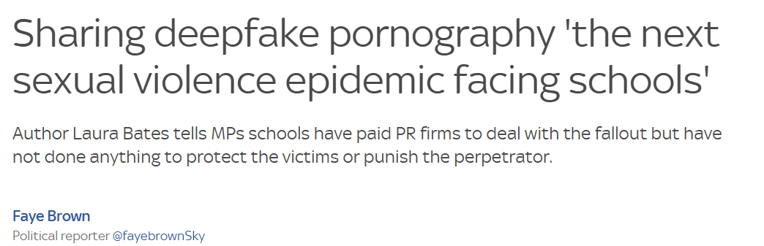
Online Safety

Slide 50
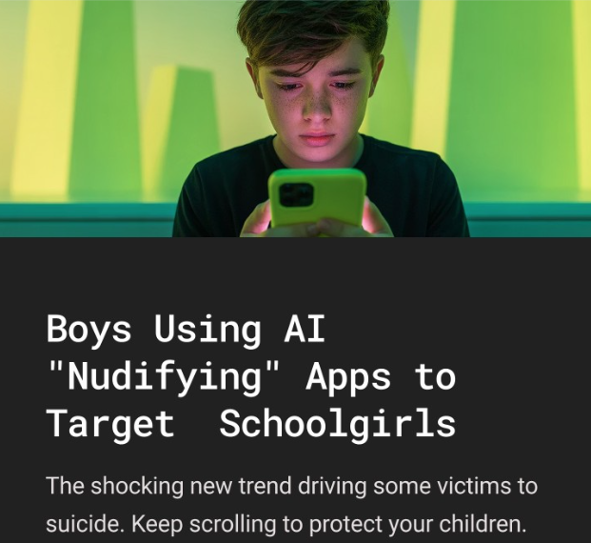
Online Safety
Derek Ray-Hill, CEO of the Internet Watch Foundation (IWF) warns:
"This is nude and sexual imagery of real children often incredibly lifelike –which we see increasingly falling into the hands of online criminals with the very worst intentions."
Legal consequences children and parents don’t realise:
1. Investigation by police or school safeguarding officers
2.Inclusion on the sex offenders register
3.Long-term consequences affecting education, travel, and employment
Many children and parents are unaware of the gravity of this until it’s too late.

Slide 51
Resources

Slide 52
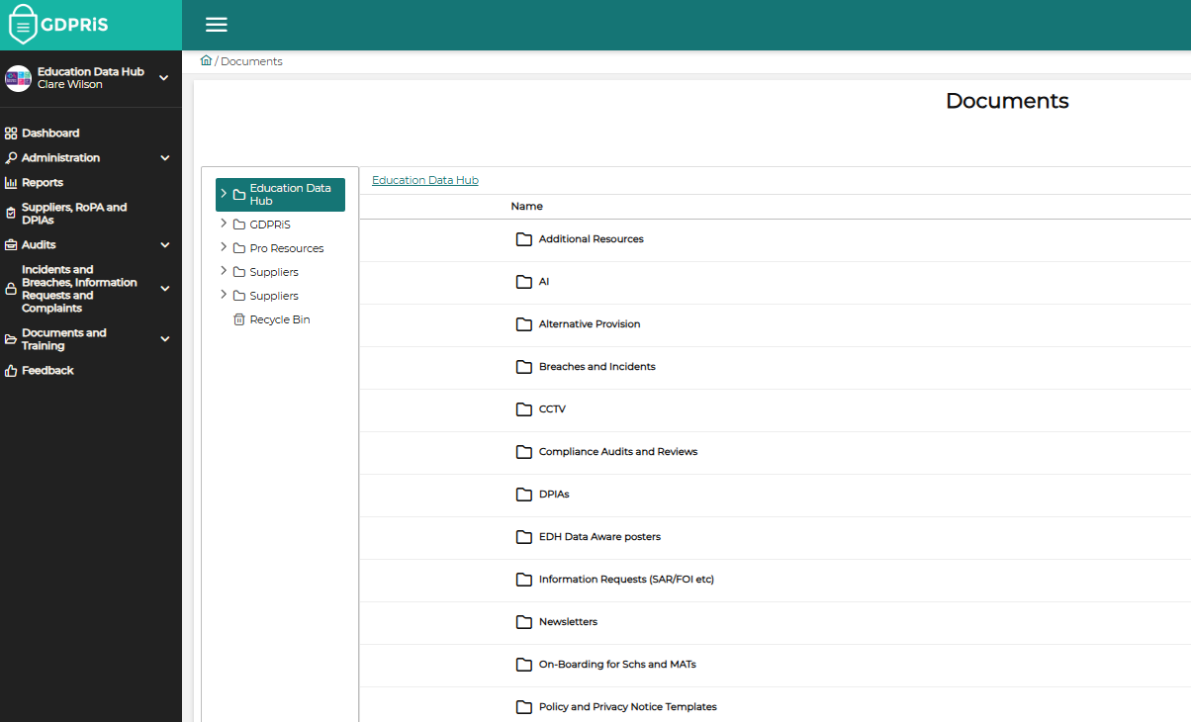

Resources

Slide 53
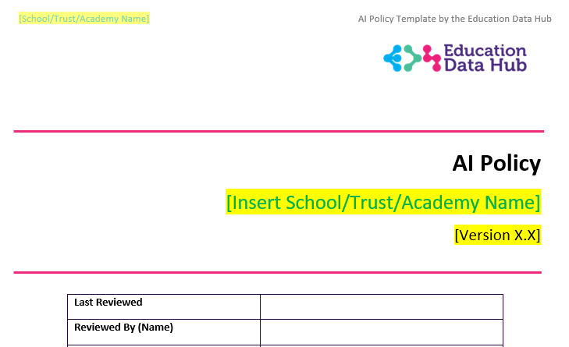
Policy

Slide 54
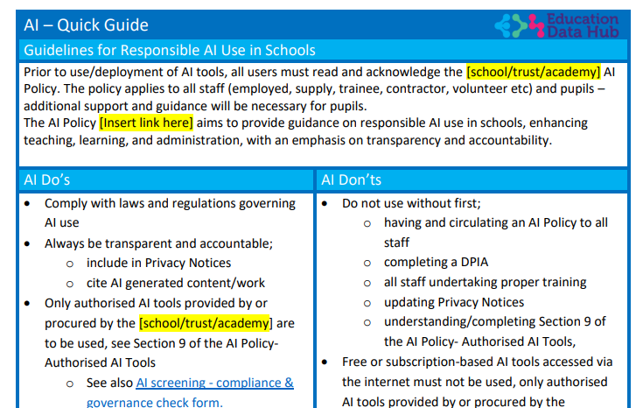
Quick guide

Slide 55
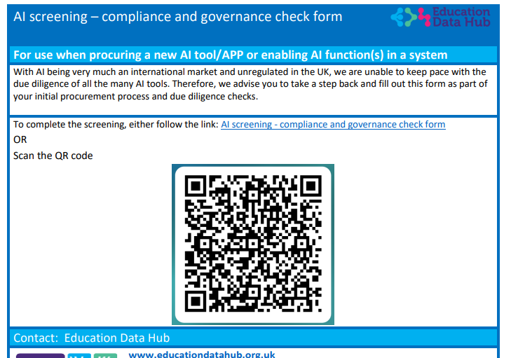
Screening tool

Slide 56
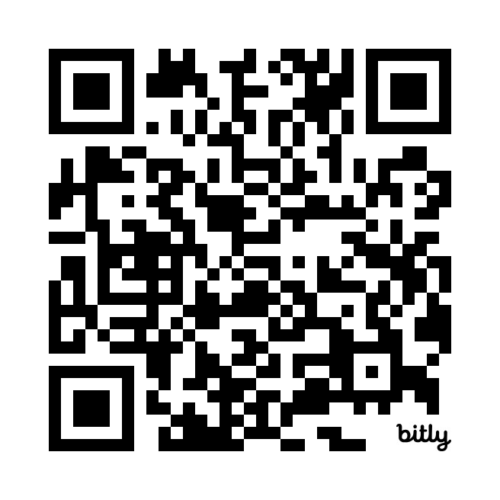
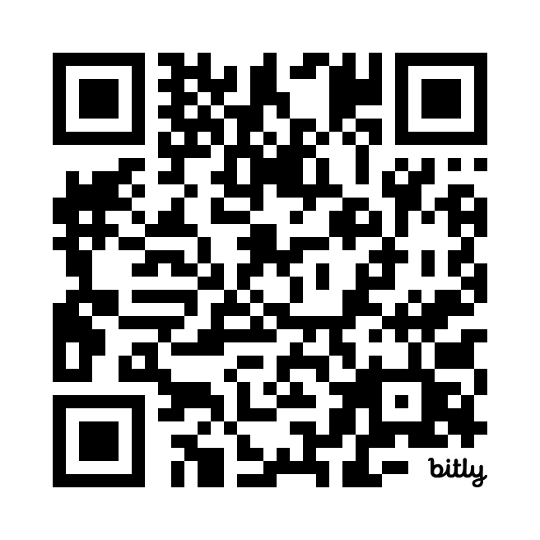
EDH Policy Framework
AI Policy template

Slide 57




Essential training
What | Who
Data Protection training | All staff (book direct with the DP team)
Cyber Security | All staff (book direct with the Cyber team)
DP for DSLs | DSLs & SENDCos / Safeguarding Gov
F&M Training | SLT / DSL / Safeguarding Gov
AI Compliance | SLT / Digital lead / Govs
Online Safety | DSLs / Safeguarding Gov
Alternative Provision – info flows | SLT & DSLs / Govs
Notes:
Essential training that EDH deliver which is essential for DSL’s so please make sure you look at this, you can book on S4S or contact us and we will help you book this.
F&M is filtering and Monitoring.

Slide 58







www.educationdatahub.org.uk
Thank you
General Enquiries educationdatahub@derbyshire.gov.uk
Data Protection DPforschools@derbyshire.gov.uk
Cyber Security cybersupport@derbyshire.gov.uk
Online Safety onlinesafety@derbyshire.gov.uk
Arbor & Integris MIS Support datamanagement@derbyshire.gov.uk
IT for Schools ITschoolsupport@derbyshire.gov.uk

