Slide 1
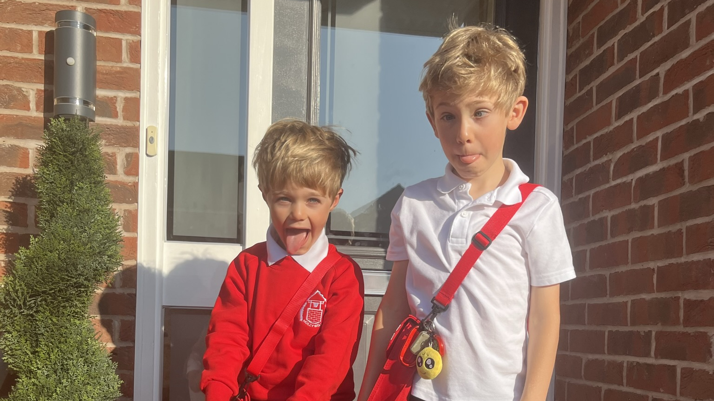
Notes:
It’s a real privilege to be here today… I know I’m from corporate, I have a double-barreled name and might sound a bit posh but I can assure you I’m a local Nottm girl - born and bred, it’s grass and bath with me - and these two cheeky monkeys are mine.
In fact one of the reasons it’s so special to be here with you today is because these two are at a school whose Trust is represented in the room. And, albeit from a parent’s perspective, I do get a glimpse of how much you do, and I’m so grateful for it - Thank you.

Slide 2


Notes:
Without getting too heavy, on some level we are all aware of the increasingly uncertain and fast-changing world we’re living in.
The human population has increased more in the last 50 years than in the last 2000!
Climate change, war, increasing prices - £40! For 4 pork cobs at an air show the other weekend!
And if that’s the broader context, there are the challenges and changes we’re dealing with in our own lives in our organisations - it can feel overwhelming.
Many of my clients are being asked to adapt to changes more quickly and to do more with less.
Unfortunately, I can’t magic anyone more time or resources, but I do help people achieve more with less and stay connected to themselves and what matters so they can show up at their best in challenge and change.
Qs…
Would you like to learn how to feel less stressed, more focused and even more in control?
I’ve got 4R’s that help you thrive in challenge and change. Great framework. Work with Professor Chris Beedie The best I’ve found in my 20 years of being healthily obsessed with this stuff and also some lived experience.

Slide 3
RECOGNISE
RESTORE
RESOLVE
REGULATE

Slide 4
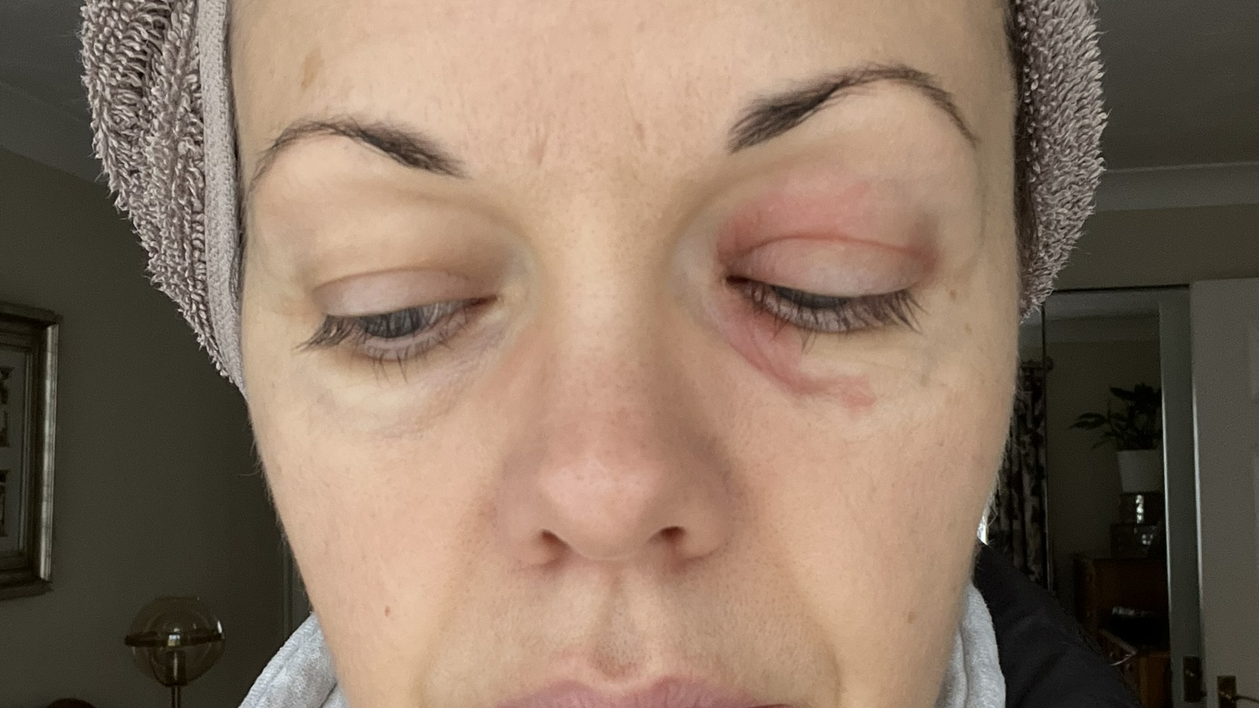
Notes:
RECOGNISE
Story: Burnout

Slide 5
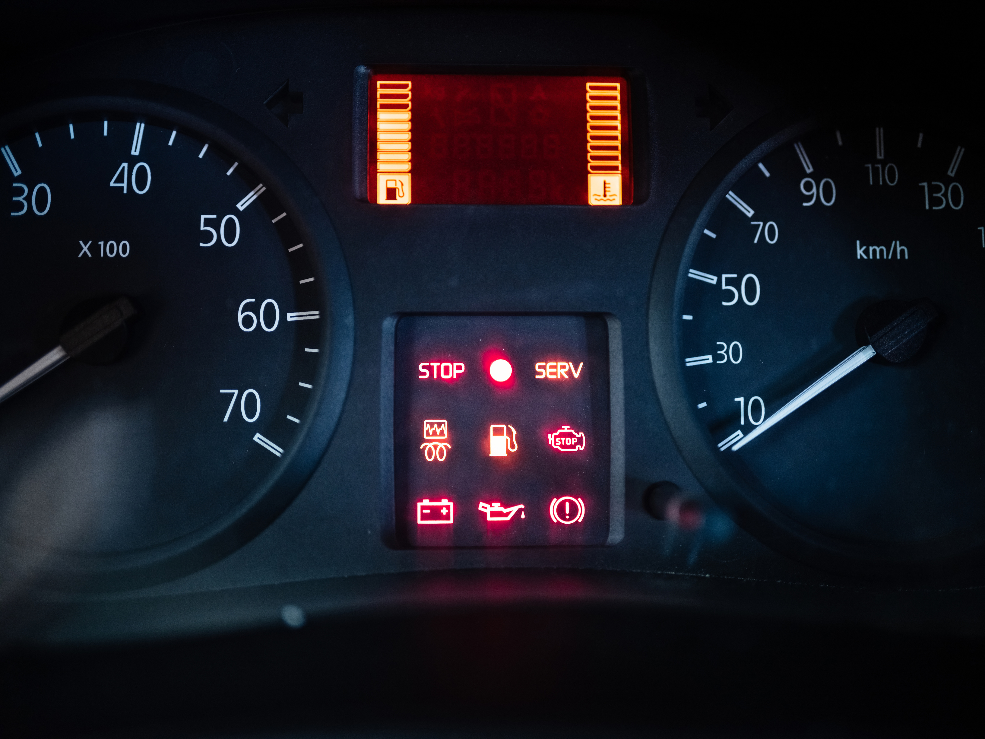
RECOGNISE
Notes:
Teach: Feelings aren’t flaws, useful signals. Be aware and RECOGNISE them.
Think of them like the indicators on your dashboard – are your cruising - full steam ahead – all ok- or are you running on empty – is there a warning light?
Recognition is a skill. Build your awareness with practice. It's about tuning in and being aware.

Slide 6
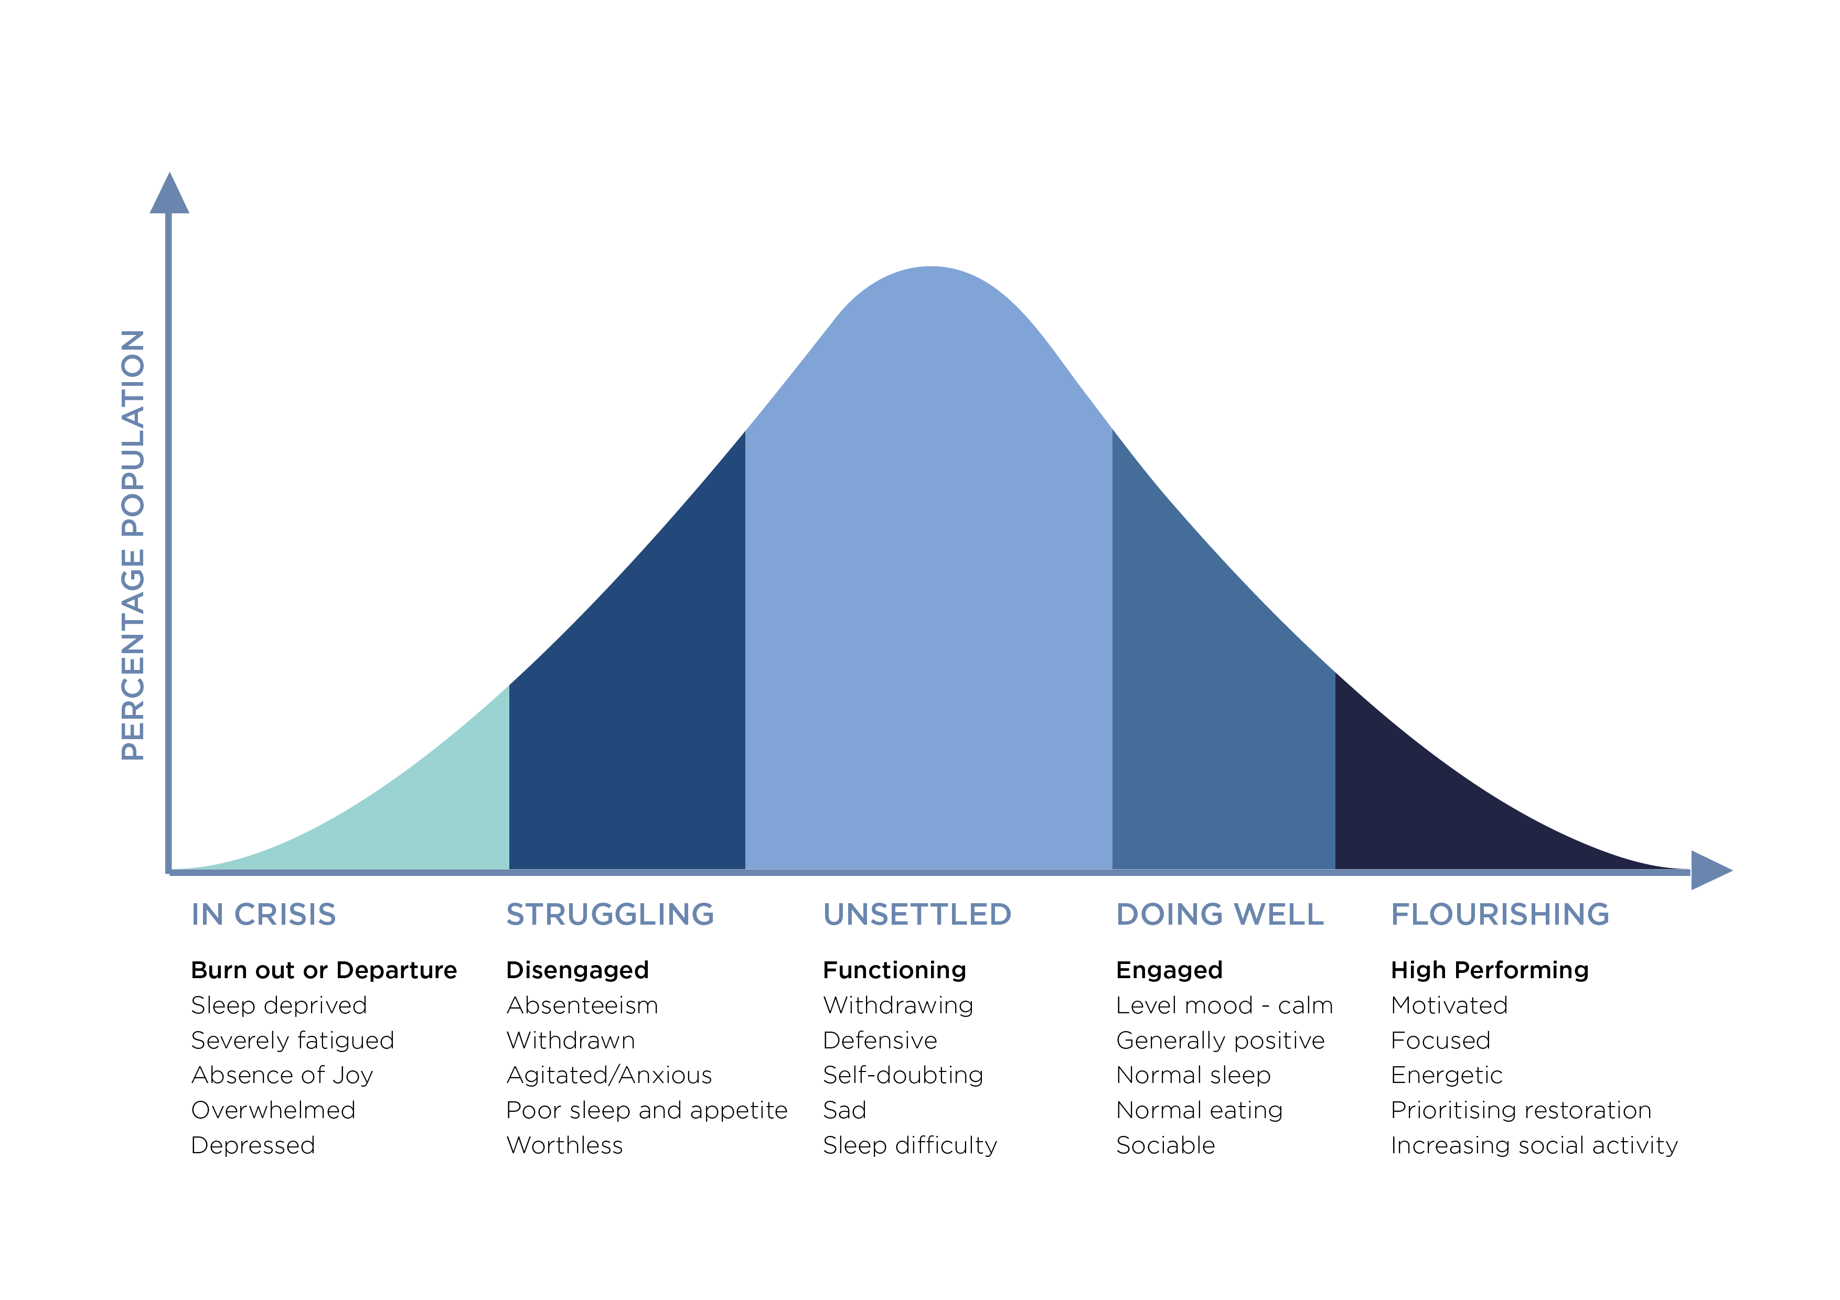
RECOGNISE
Notes:
We all have mental health – same way we all have physical health
But unlike a lot physical health challenges, mental health and it’s connection to performance can sometimes be a harder thing to identify and to have conversations about.
This continuum illustrates mental health and it’s impact on performance along the horizontal axis / and the typical distribution of where any given population is likely to be (on the vertical axis).
It’s not a static thing, again like physical health people will move along this at different times. Sometimes within a day!
We are all on this continuum somewhere
Useful, understanding where we are and it’s a good aid to start honest conversations with each other
Look at the percentage of the population – you can make a reasonable assumption this represents your team.
If you feel comfortable – have a chat to the person next to you
Can you identify where you are?
Where do you want to be? (Is there a difference?)
If there is, do you know what you can do that’s in your control to move you to where you want to be?
Link: Once you recognise it, what do you do about it.
Once we RECOGNISE it, next question is what do we do about it?
Helpful to distinguish if our feelings our mood and emotion driven for this – let me explain….

Slide 7
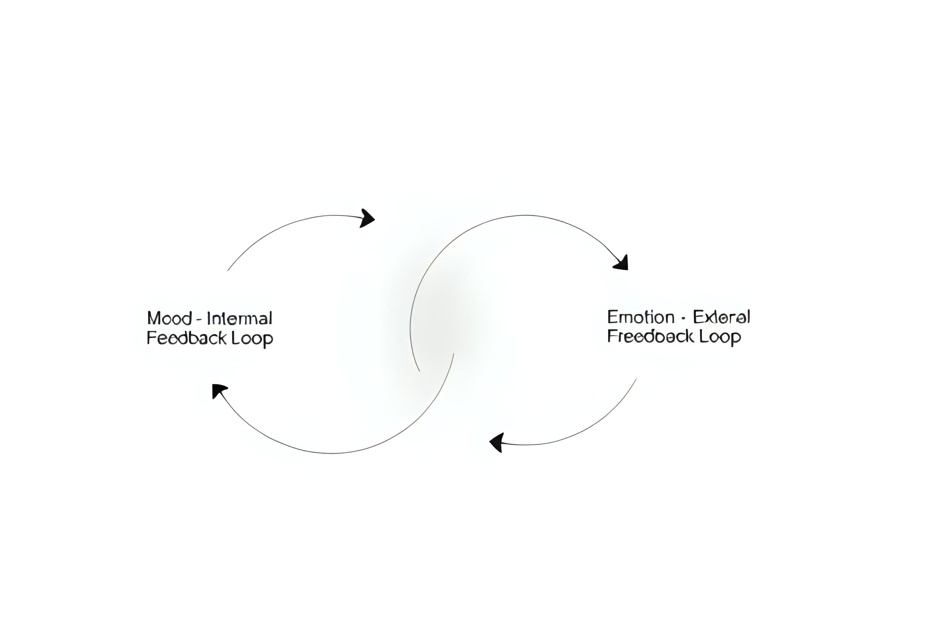
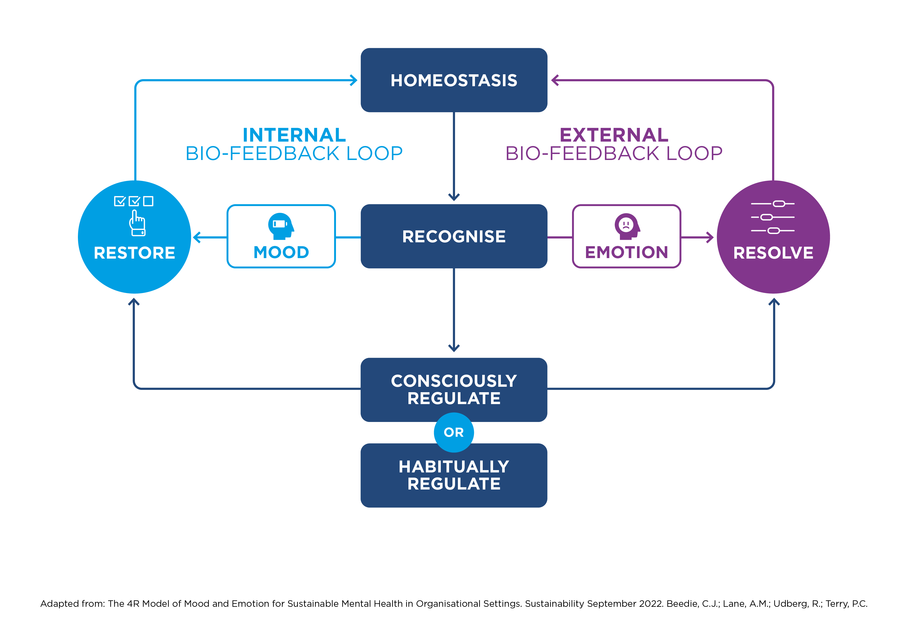


internal
feedback
external
feedback
RESOLVE
Notes:
MOOD - Internal signal of the energy and capacity you have to deal with the demands on you - do I have energy, and the capacity to deal with demands?
Things like eating well and getting enough sleep and your interaction with others make a big difference in how much energy you have and how well you handle stress and perform.
EMOTIONS – External signal - Are our responses to the social world
Mood signals internal biological resources, while emotion changes our biology in response to the external world.
Of course they are interrelated, simplifying things buts it’s useful to help us understand what to do next.
Start with mood - According to WHO - 80% of mental health issues relate to mood dysregulation.
Sometimes we’re the last to realise!
Story: Boys in the morning
Something they do one morning makes me laugh, another morning when I’ve had a bad night’s sleep makes me snap!
2 things at play - 1 - my under restored mood, lack of sleep and -2 - the boys behaviour
What do we do about it?

Slide 8
RESTORE
RESOLVE
Notes:
Before we engage with the world we have to take care of our physical and mental wellbeing - of you.
That means:
Adequate sleep
Nutrition
Daylight/Nature
Movement
Relationships with people you trust

Slide 9
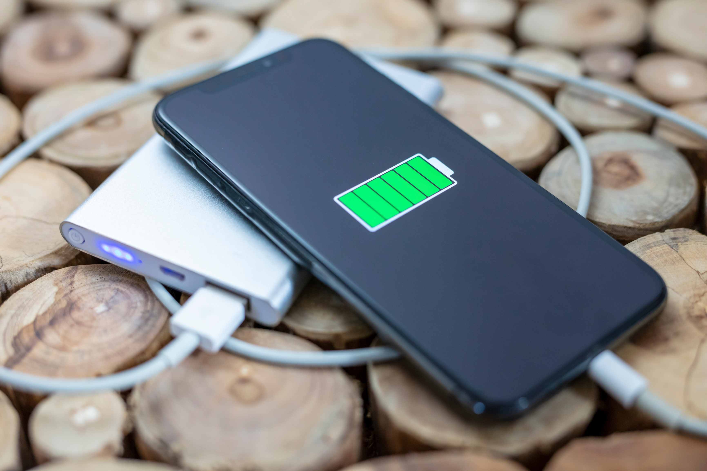
RESTORE
Notes:
Sometimes we pay more attention to making sure our phone batteries are charged than our own!

Slide 10



RESTORE
Notes:
3 environments that help restore our mood energy and ability to deal with stress:
1) Biological

Slide 11



RESTORE
Notes:
2) Physical

Slide 12

RESTORE
Notes:
3) Social

Slide 13
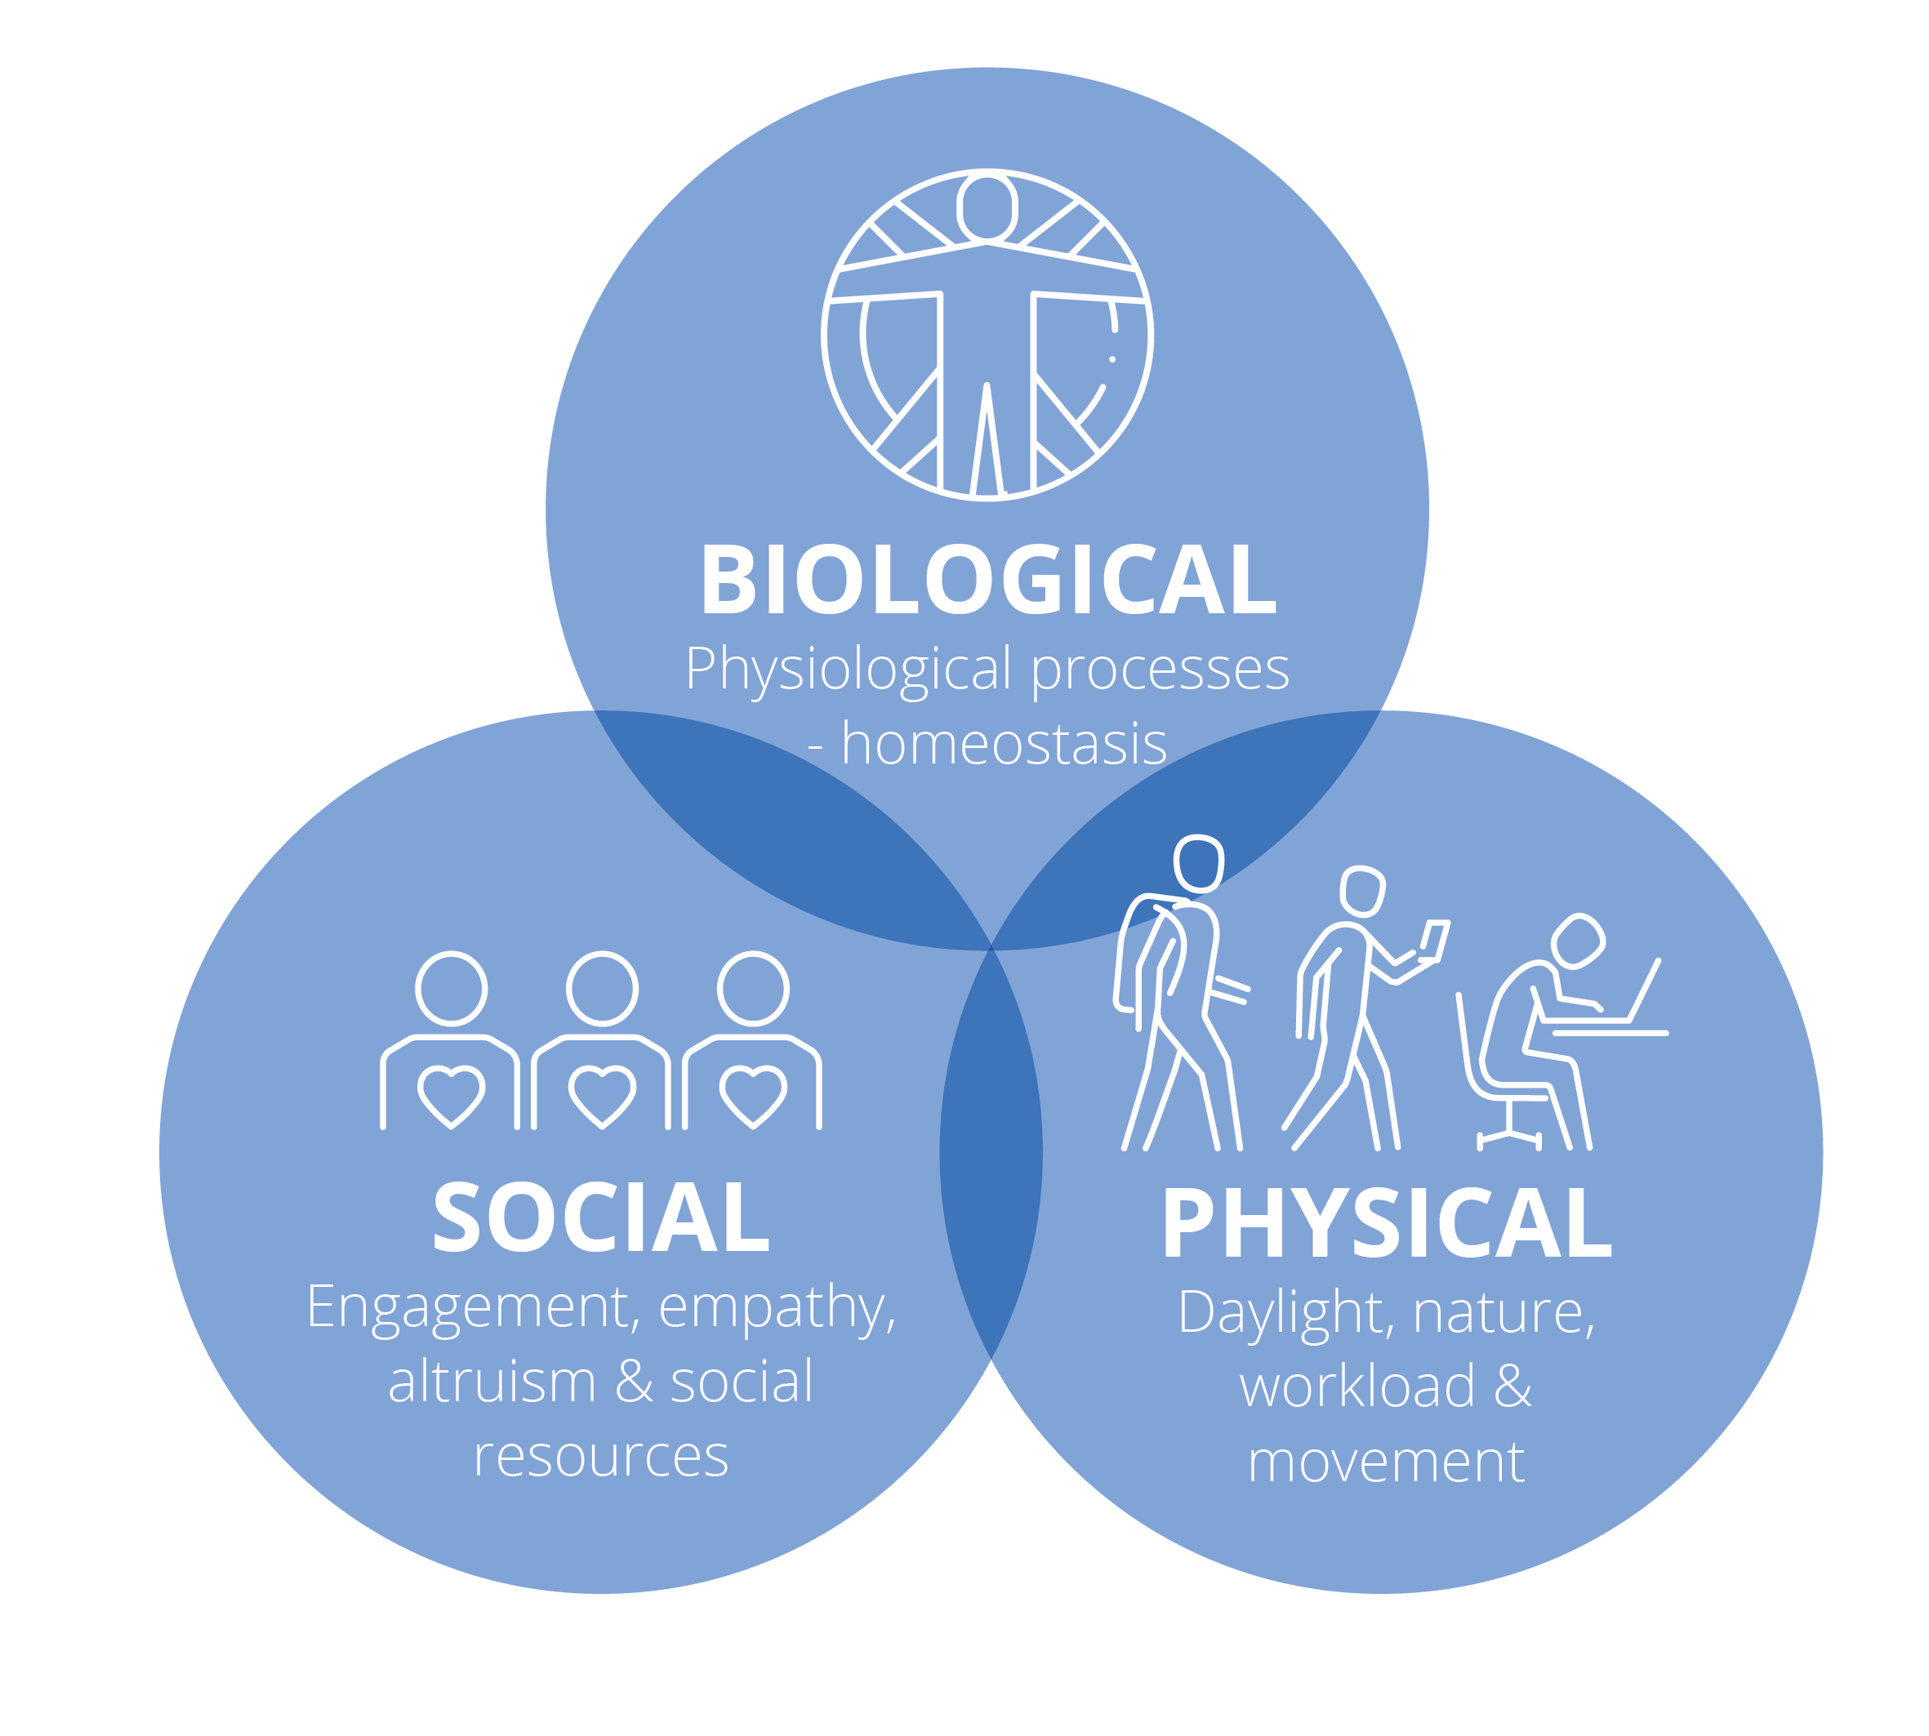
RESTORE
Notes:
Do all three at the same time :0)
Simple Habits Make a Big Difference:
Catching up as you walk around the building – take the meeting outside rather than to a meeting room (if you can).
If you know there’s a risk of lunch getting delayed or skipped – what healthly snacks can you have handy to see you through.
Eating well, sleeping enough, and staying active help keep your mood steady, energy high, and stress low.

Slide 14
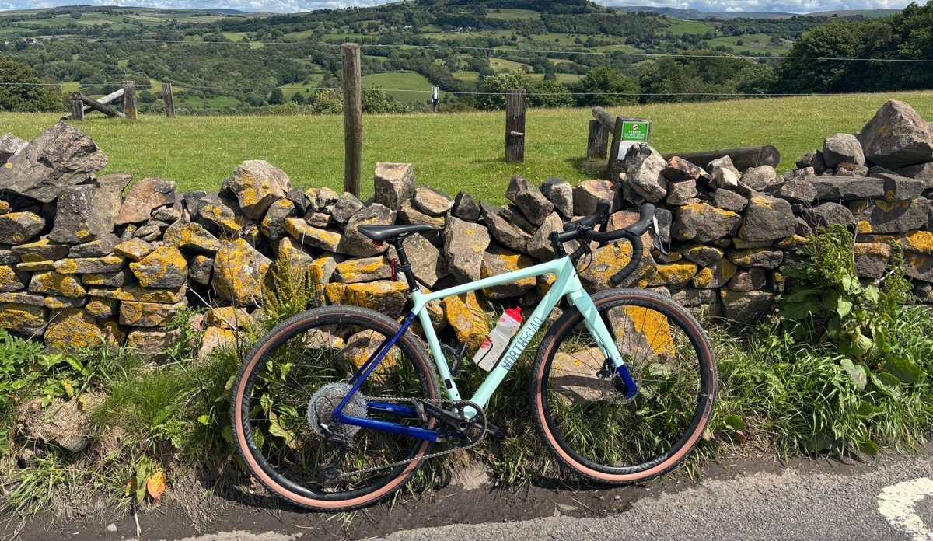
RESTORE
Notes:
Story client David Diggle – bike = business critical.
Rest and Restoration not reward

Slide 15

RESTORE
Notes:
I’m a certified Health Coach – one thing I learnt in my training was bio- individulaity – right for one person, not right for another
Most people intuitively know if there was one area you made a change, you know it would make a big difference.
Q: What’s one step you can take to ensure you’re regularly restored?
Link: Even if you respect the restoration, something external can still throw you off…

Slide 16
RESTORE
RESOLVE
Notes:
If it’s external – we need to resolve the issue.

Slide 17

RESOLVE
Notes:
Story of Steve:
Newly appointed as the head of his company and Chair of Board – very difficult…
I’m sure we’ve all had people we’ve found difficult to work with.
This guy, undermined Steve, kept information from him, challenged his decisions, made him question his sense of status and right to belong in his role.
This was impacting Steve’s confidence, his trust and belief in himself, it was making him depressed and wondering if he’d made the right move.
After some counsel with both me as his coach and his mentor, he made the decision it was time for this person to go – not an easy conversation, or one that went down well at first. But eventually they reached an agreement and this person stepped away.

Slide 18

Notes:
We all have fundamental social needs. When they get triggered, we will feel it. It’s your body's way of getting you to take action – if these social needs weren’t met by our ancestors it could mean increased risk to your life. While it often doesn’t mean that today it still affects us in the same way. Our wiring hasn’t changed.
And it’s simple to understand when you realise there’s just 5 of these needs and if any one gets triggered – your body wants you to resolve it so it’s no longer a threat.
So what are those needs to look out for and what do you do if one or more gets triggered?

Slide 19
Equity
Inclusion
Certainty
Autonomy
Attachment & Status
RESOLVE
Notes:
Equal access to resources to be successful (perceived and real)
Sense of being / feeling included
Confidence in the future
Ability to control resources to meet your goals
Sense of being valued or sense of status
So now you know what will trigger you (and others), what can we do about it? How do you Resolve?

Slide 20
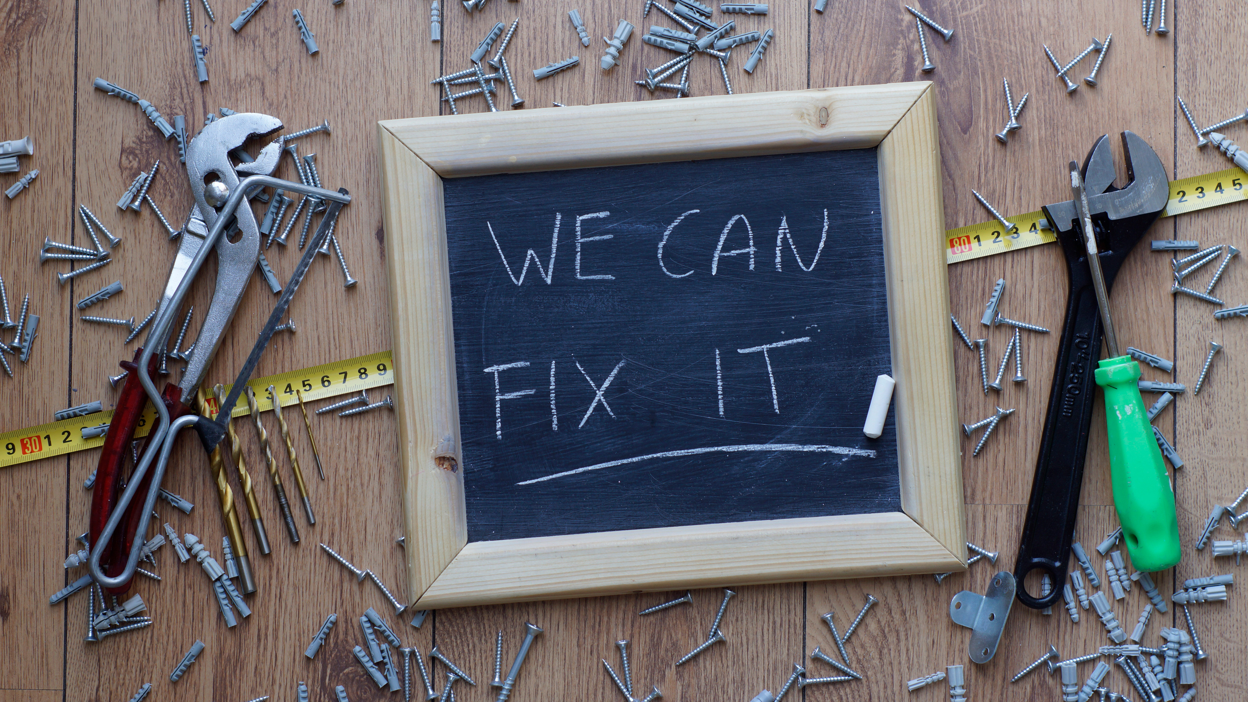
RESOLVE
Notes:
If it’s something – fix it

Slide 21

RESOLVE
Notes:
If it’s someone – can you talk to them to resolve the issue?
Proper resolution of emotions requires identifying their source and addressing the underlying issue.
You can’t always resolve straight away or at all in some cases…
That’s when we need to turn to regulation… to turn down the signal.
Some useful mind and body tips that help us reframe the situation and feel better about it.

Slide 22
REGULATE
Notes:
Remember Steve:
Although we know Steve did Resolve the situation with the Chair of the Board, it took time and during that time Steve deployed some helpful regulation techniques to get him through.
Lots of regulation strategies – share 3 that were immensely useful to Steve. Use these individually or use them together for really powerful impact…

Slide 23

3
regulation
strategies
Physiology
Motion is Emotion
Notes:
Choices we’re making moment to moment....
Felt frustrated or stuck, sad, low - bike, swim, walk, run
Someone made you laugh.
Steve used his breathing and posture.

Slide 24

Focus
What you focus on, you feel
3
regulation
strategies
Physiology
Motion is Emotion
Notes:
What you focus on you’ll feel
What you’re afraid of – Where you want to go
What’s right – What’s wrong
What’s in your control – What’s out of your control
Past, Present, Future
All choices we’re making – often unconsciously and it affects how we feel.
Want to stay resourceful? Focus on what you can control, on what you want to achieve, it might be helpful to look at what’s wrong but don’t stay stuck there. Turn your attention to what you have got, to who can help and how you get the outcome you want in the most enjoyable way!
Steve focused on the outcome he wanted, and what was ultimately in his control.

Slide 25

Focus
Language
What you focus on, you feel
The words you attach to your
experience become your experience
3
regulation
strategies
Physiology
Motion is Emotion
Notes:
What we say to ourselves and others. The words we attach to our experiences become our experience.
We can intensify or dissipate our feelings with our language.
Are my boys being a nightmare or age-appropriate?
Steve used language like and chose meanings such as –

Slide 26

Focus
Language
3
regulation
strategies
Physiology
Notes:
When you put these 3 together, it’s a powerful. But it takes practice.
Dumbbell training for the bench press!
The more that you use these steps, the better you will get at mastering your emotions.
Encourage to play with this! Test it out. Anything that you need to regulate and like some help – come and speak with me afterwards.

Slide 27

REGULATE
Notes:
This comes with a big caution sign.
Habitual regulation = long-term risks and outcomes

Slide 28
Notes:
Remember my story…
I kept ignoring my body’s needs to restore and the emotional triggers that were causing so much biological stress; I finally collapsed.
And what I now know is that it was clinically predictable.
Unconsciously regulating – working harder, going from coffee in the morning to wine at night, pushing myself through the week to the weekend and delaying holidays, even our wedding twice because I simply didn’t have time.

Slide 29
Outcomes
Reduce metabolic and cognitive capacity
Negative bias
Disengagement
Average work
Unempathetic
Notes:
I couldn’t think straight or creatively.
I felt threatened – like I’d be found out, let others down or that others we’re out to get me.
Harder to be empathic to my team.

Slide 30
Risks
Poor physical and mental health
Departure and/or burnout
Poor performance
Substance abuse
Dysfunctional teams
Notes:
My physical and mental health were shocking.
I burnt out for sure.
Relied on coffee to get me going and wine to help chill me out.
Whilst conscious, healthy regulation is a useful strategy get back to true restoration and resolution as much and as soon as you can to avoid this.
Regeneration, learning, and creativity arise only when the parasympathetic nervous system is active.
So self care in times of challenge and change is not a luxury it’s actually a neurobiological strategy.
Only when we sleep well, eat decently, move often and feel safe can we become agents of change.

Slide 31

Notes:
AND… Focusing on our feelings enables... Two parallel outcomes all too often perceived as mutually exclusive:
Sustained PERSONAL PERFORMANCE
metabolic, cognitive and emotional resources to show up at or best
Important CULTURAL OBJECTIVES
Are also met – people don’t think psychologically safe, trusted, engaged, included, they feel those things
When we prioritise feelings, we sustain people and performance.

Slide 32

RECOGNISE
RESTORE
RESOLVE
REGULATE
Notes:
Recognise, restore, resolve, and regulate.
That’s how you thrive in challenge and change and create the kind of culture where others can too.

Slide 33
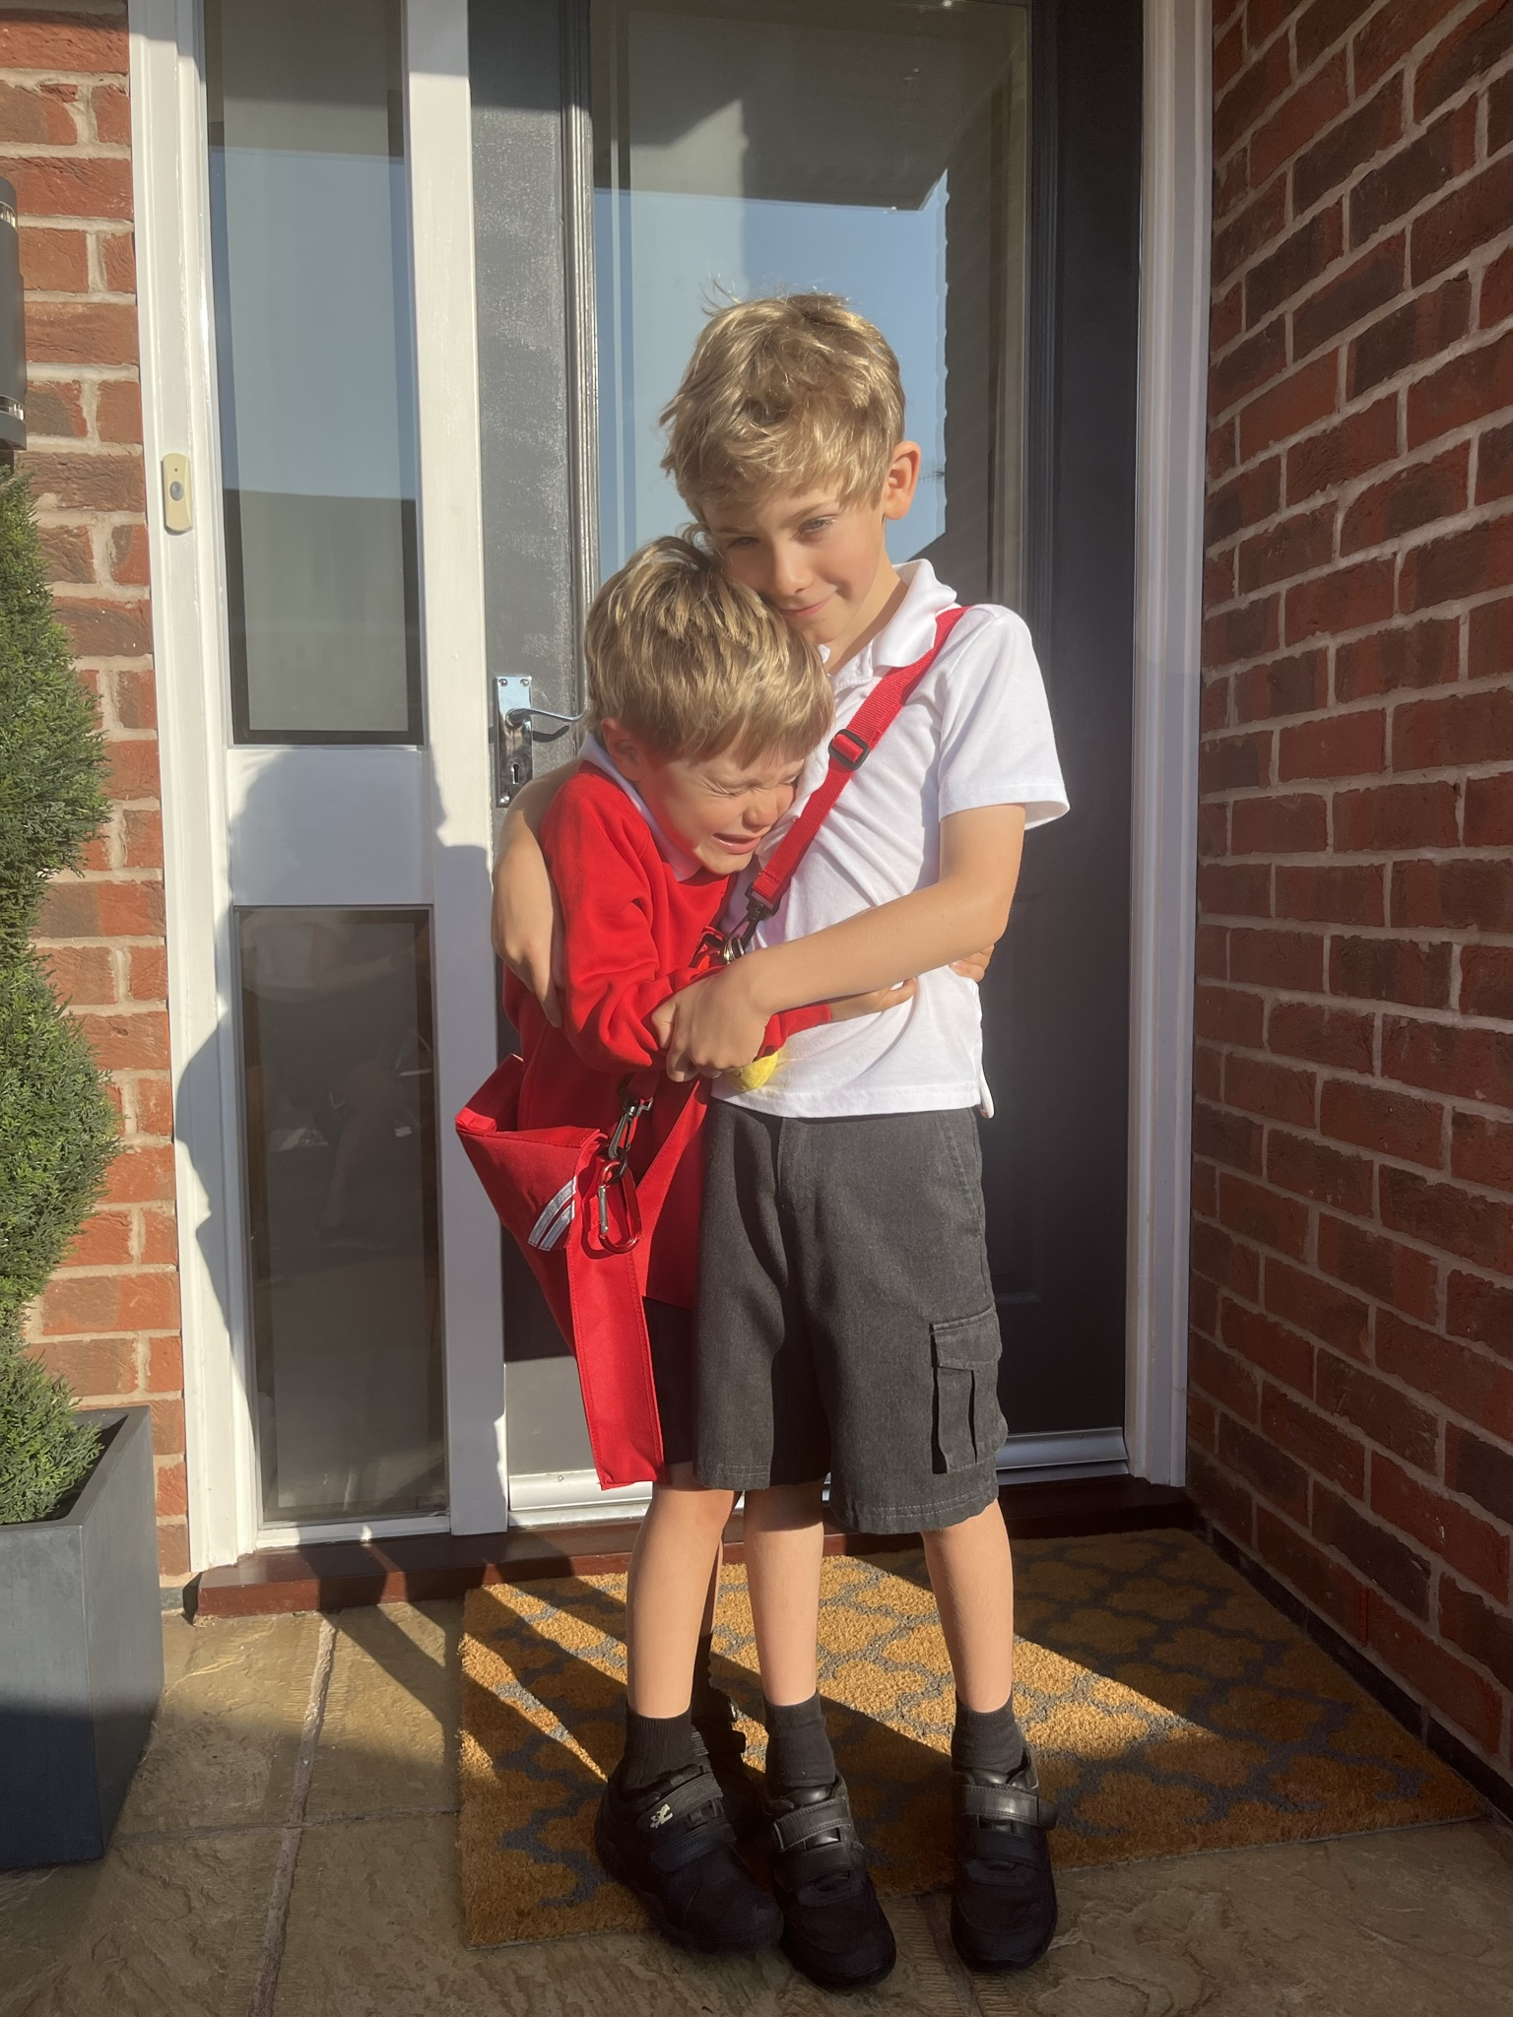
Notes:
Take care of you, for them.
Because when you’re steady, others will feel it. When you lead yourself well, others will follow.
If you’d like to go deeper, ask any questions. I look forward to either seeing you in the workshop or please do connect with me online.

