Slide 1
Emergency planning for Schools
June 2025
Andrea Gardner
Leicester, Leicestershire and
Rutland Resilience Forum

Slide 2
Aim:
To assist learning establishments with the tools to prepare for, respond to, and recover from an emergency
Objectives:
- to understand the Civil Contingencies Act and the statutory duties of Category 1 responders
- to develop knowledge on types of incidents and potential impacts to schools
- to have an awareness of the steps for preparedness
- to be able to respond to, and recover from an emergency using the information shared

Slide 3
What is an emergency?
An event or situation which threatens serious damage to human welfare;
An event or situation which threatens serious damage to the environment; or
War, or terrorism, which threatens serious damage to security.
Civil Contingencies Act 2024
What is an emergency planning?
Emergency planning is the process by which risks are identified, and planning is put in place to prevent emergencies occurring where possible, or to reduce, control and mitigate the effects should it happen

Slide 4





















The Civil Contingencies Act 2024
The Civil Contingencies Act 2004 places a legal duty on the council to plan for and respond to major emergencies along with other Category 1 Responders.
These include other Local Authorities, Police Forces; British Transport Police; Fire Authorities; Ambulance Services; Maritime and Coastguard Agency; NHS England; NHS Integrated Care Boards; UK Health Security Agency and the Environment Agency.

Slide 5
Statutory duties
• assess the risk of emergencies occurring and use this to inform contingency planning
• put in place emergency plans
• put in place business continuity management arrangements
• put communications arrangements in place to make information available to the public about civil protection matters and maintain arrangements to warn, inform and advise the public in the event of an emergency
• share information with other local responders to enhance coordination
• cooperate with other local responders to enhance coordination and efficiency
• provide advice and assistance to businesses and voluntary organisations about business continuity management (local authorities only)

Slide 6
What is a major incident?
The Civil Contingencies Act 2004 defines a Major Incident as any Emergency that requires the implementation of special arrangements by one or more emergency responders and meets one of the following two criteria:
1)The emergency is likely to seriously obstruct the organisation in the performance of its functions, or
2) It is likely that the organisation;
- would consider it necessary or desirable to take action to prevent the emergency, to reduce, control or mitigate its effects or otherwise in connection with it and
- would be unable to take that action without changing the deployment of resources or acquiring additional resources.

Slide 7
A major incident may require the:
- The initial treatment, rescue and transport of a large number of casualties.
- The handling of a large number of enquiries likely to be generated both from the public and the news media usually to the Police.
- The large-scale deployment of the combined resources of the Emergency Services.
- The mobilisation and organisation of the Emergency Services and supporting organisations, e.g. Local Authority, to cater for the threat of death, serious injury or homelessness to a large number of people.

Slide 8
Why is emergency planning crucial for schools?
- It protects pupils and staff
Ensures the safety of everyone during emergencies
- Minimises disruption
Reduces downtime and chaos in schools
- Legal and regulatory requirements
(e.g., Health and Safety, Ofsted, local authority requirements)
- Community confidence
Demonstrates that the school is prepared for emergencies, fostering trust with parents and the community.

Slide 9
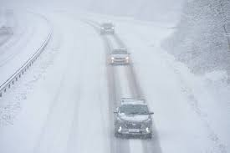
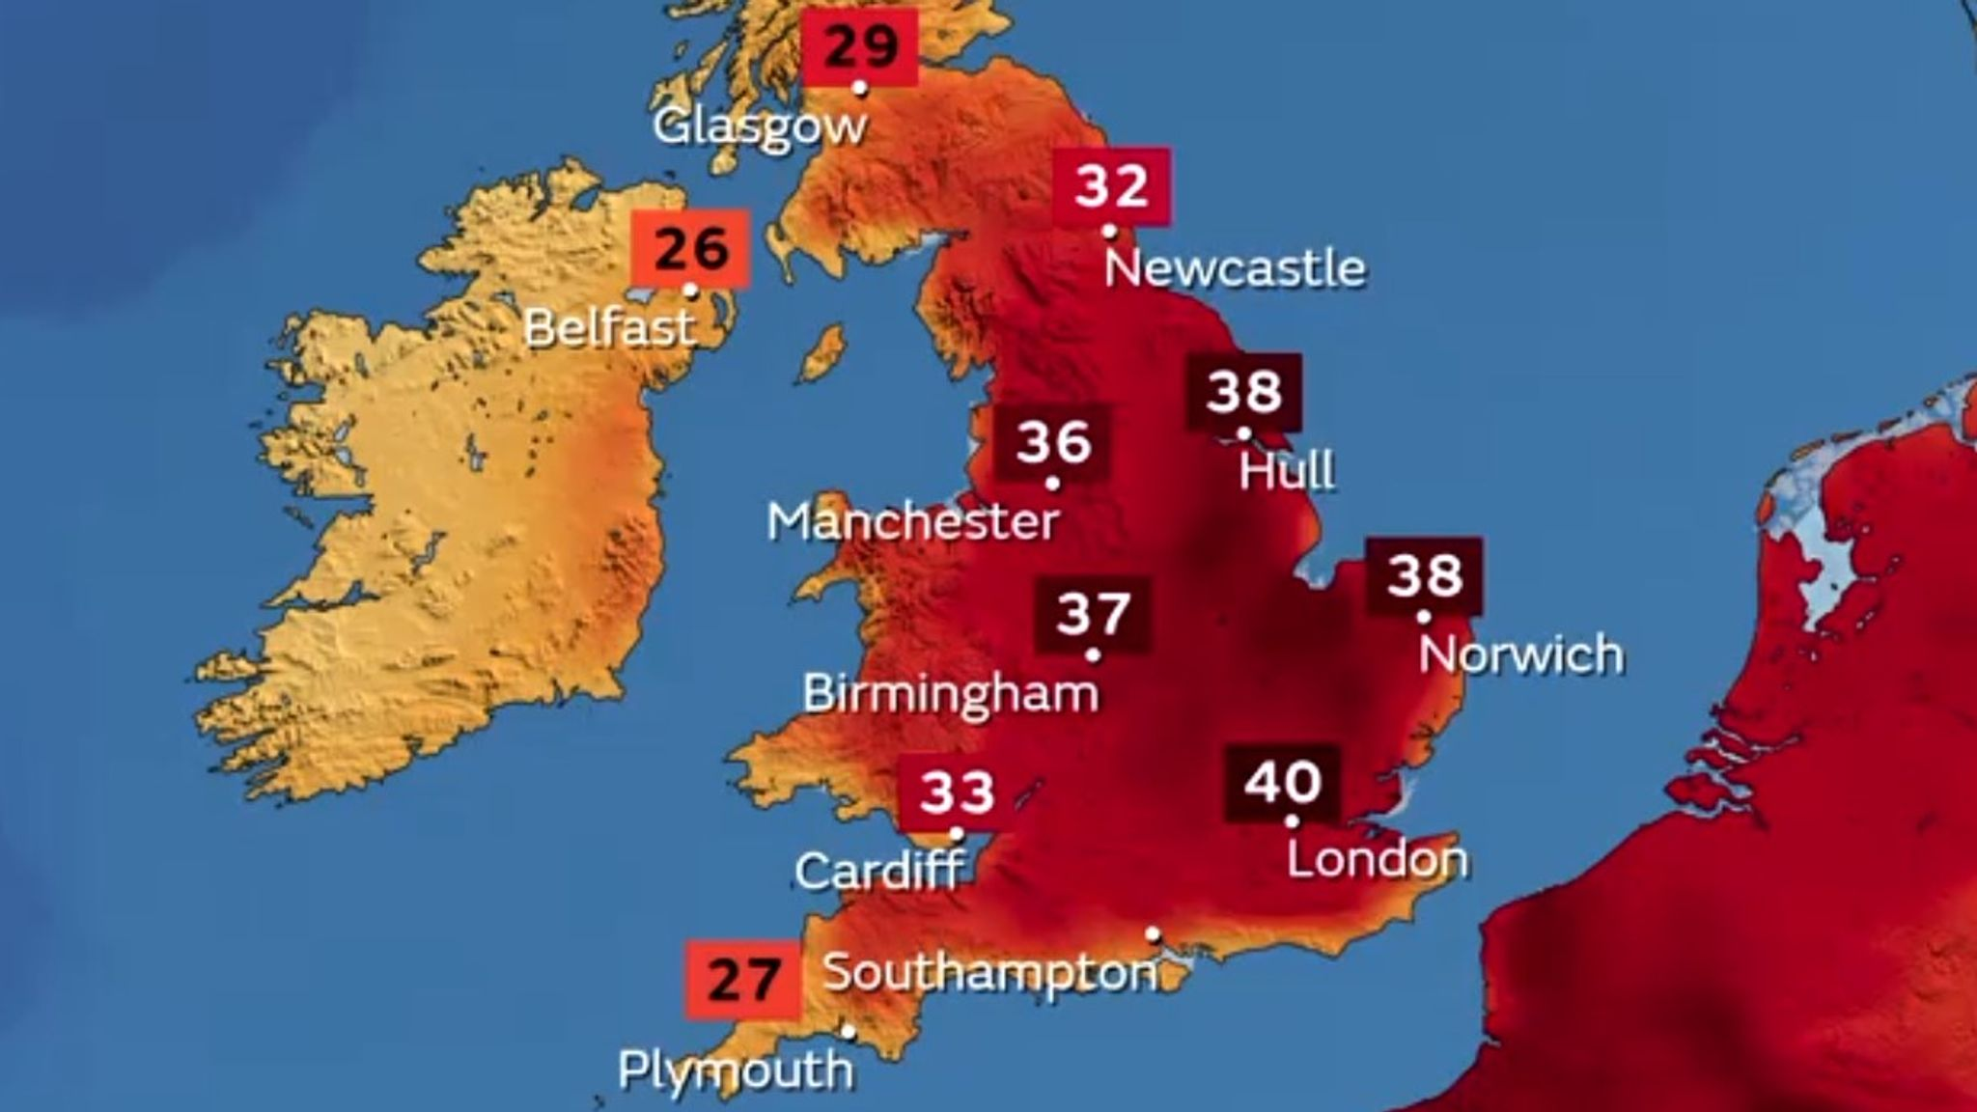
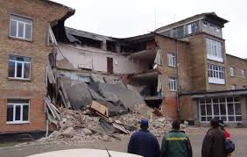
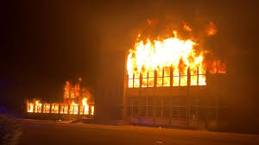
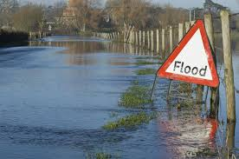
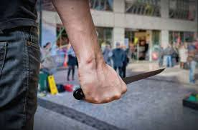


Types of emergencies that could affect schools

Slide 10
5 stages of emergency planning (Primer)
Plan – It is essential to have a plan, regularly update it and know where it is when you need it.
Rehearse – An emergency response works best if tested in advance, and doing this with partners can ensure you build important relationships in calmer times, i.e. tabletops
Implement – Getting it right from the start can be critical in saving lives
Maintain – Ensure your plan is reviewed and tested on a regular basis.
Evaluate – It is crucial to measure what is working and what needs amending (staff changes, new buildings, change in legislation etc)
Recover – Recovery has an important role in rebuilding trust and confidence

Slide 11
Key Aspects of an Emergency Plan
Risk Assessment​
Identify potential threats to the school (e.g., fire, severe weather, terrorism). ​
Assess the likelihood and impact of each risk.​
Roles & Responsibilities ​
Designate emergency management roles (e.g., headteacher, school business manager, safeguarding lead). ​
Define clear roles for staff, pupils, and external agencies (e.g., police, fire brigade).​
Communication Plan ​
Set up internal and external communication systems (e.g., automated calling system, email, text alerts). ​
Provide emergency contact lists and ensure redundancy.​
Evacuation & Shelter Plans ​
Design evacuation routes and assembly points (e.g., nearby park or field). ​
Determine locations for shelter-in-place (e.g., lockdown procedures).​
Training & Exercise​
Conduct regular training for staff. ​
Schedule practice drills (e.g., fire drill, lockdown drill) to test procedures.​
Recovery Plan ​
Plan for post-emergency recovery, including resuming normal activities and mental health support. ​

Slide 12
Risk assessments in detail
Natural Disasters​
Flooding, severe weather, storms, or snow. ​
Human Threats​
Intruder, terrorist threats, or active shooter incidents.
​
Medical Emergencies​
Outbreaks, injuries, allergies, mental health crises. ​
Technological Failures​
Cyber-attacks, power cuts, data breaches.​
​
Action​
Regularly review and update the risk assessment to reflect new risks or changes.

Slide 13
Things to consider
- Each plan needs to reflect specific risk – there should not be one generic plan to fit all types of emergencies
- How is the plan maintained, tested and validated?
- Who are your learners, and what specific needs do they have? How will SEND learners be affected? Is there anything that you need to do to tailor your plans so that these learners are kept safe?
- What is your communications strategy? How should you convey safety messages in a positive, reassuring way? Does this differ depending on audience? (pupils, stakeholders, parents/carers)
- how would you tailor your plan to suit external providers using the premises, e.g. after school activities?
- Who are your key stakeholders, both internally and externally?
- You should consider compiling a ‘grab kit’ comprised of key items that can assist during an incident; building plans, key contacts, first aid supplies etc

Slide 14
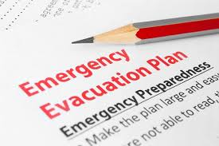
Testing plans
Until an emergency plan has been tested, it is impossible to be sure it will work effectively in the heat of an emergency.
Practising and testing all aspects of emergency plans is therefore a key part of emergency preparedness, not only to identify and address any weaknesses in advance, but also to help the organisation and its staff to become aware of and comfortable with their individual roles.
Types of testing:
Discussion-based exercises
Table tops
Live play exercises

Slide 15

Discussion based exercises
Discussion-based exercises are cheapest to run and easiest to prepare. They can be used at the policy formulation stage as a ‘talk-through’ of how to finalise the plan. More often, they are based on a completed plan and are used to develop awareness about the plan through discussion.
A discussion-based exercise can help clarify roles and responsibilities, ensuring that everyone knows what to do when faced with an incident.
A discussion-based exercise is also cost effective for settings with limited budgets, as it does not require the same resources but still delivers valuable insights and preparedness training.

Slide 16

Table-top exercises
Table-top exercises usually involve a realistic scenario where players are expected to know the plan and they are invited to test how the plan works as the scenario unfolds.
This type of exercise is particularly useful for validation purposes and for exploring gaps in procedures. Table-top exercises require careful preparation but are relatively cheap to run; the main cost being staff time.
It focuses on decision-making, communication, and coordination, rather than physical action and allows all participants an opportunity to understand their, and other roles in an emergency

Slide 17
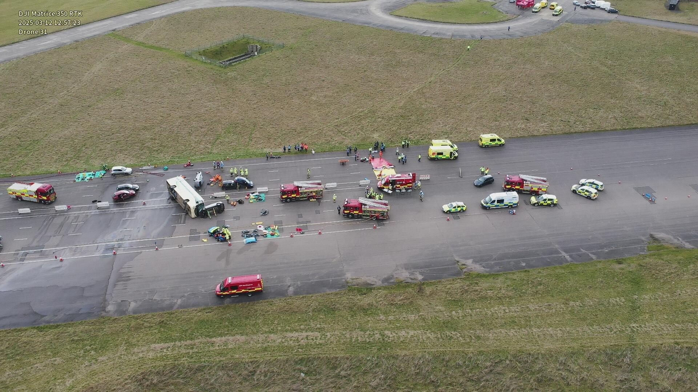
Live play exercises
Live exercises are realistic rehearsals for implementing a plan, using your normal site and facilities, and taking place in real time. Live exercises are particularly useful for testing logistics, communications, and physical capabilities.
They require more time, preparation, and budget than other exercises.
Live exercises also make excellent training events. They can help participants develop confidence in their skills and provide experience of what it would be like to use the procedures in a real event. For settings with young learners, such as childcare centres or youth clubs, the live plays help them to familiarise with what to do in emergencies. It reduces panic during an actual event, as they will have already experienced a simulation.

Slide 18
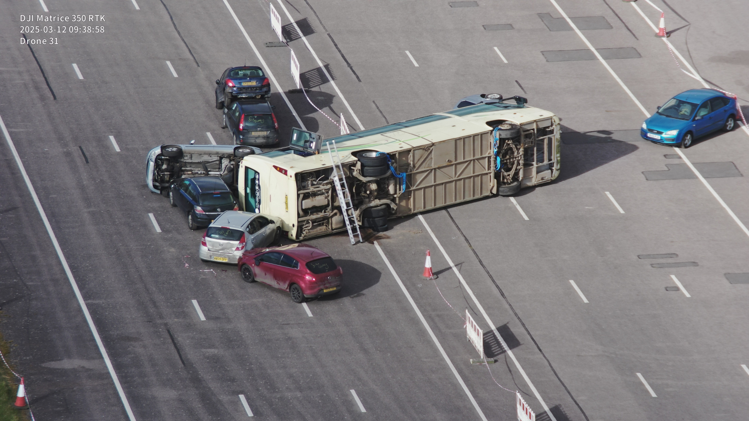
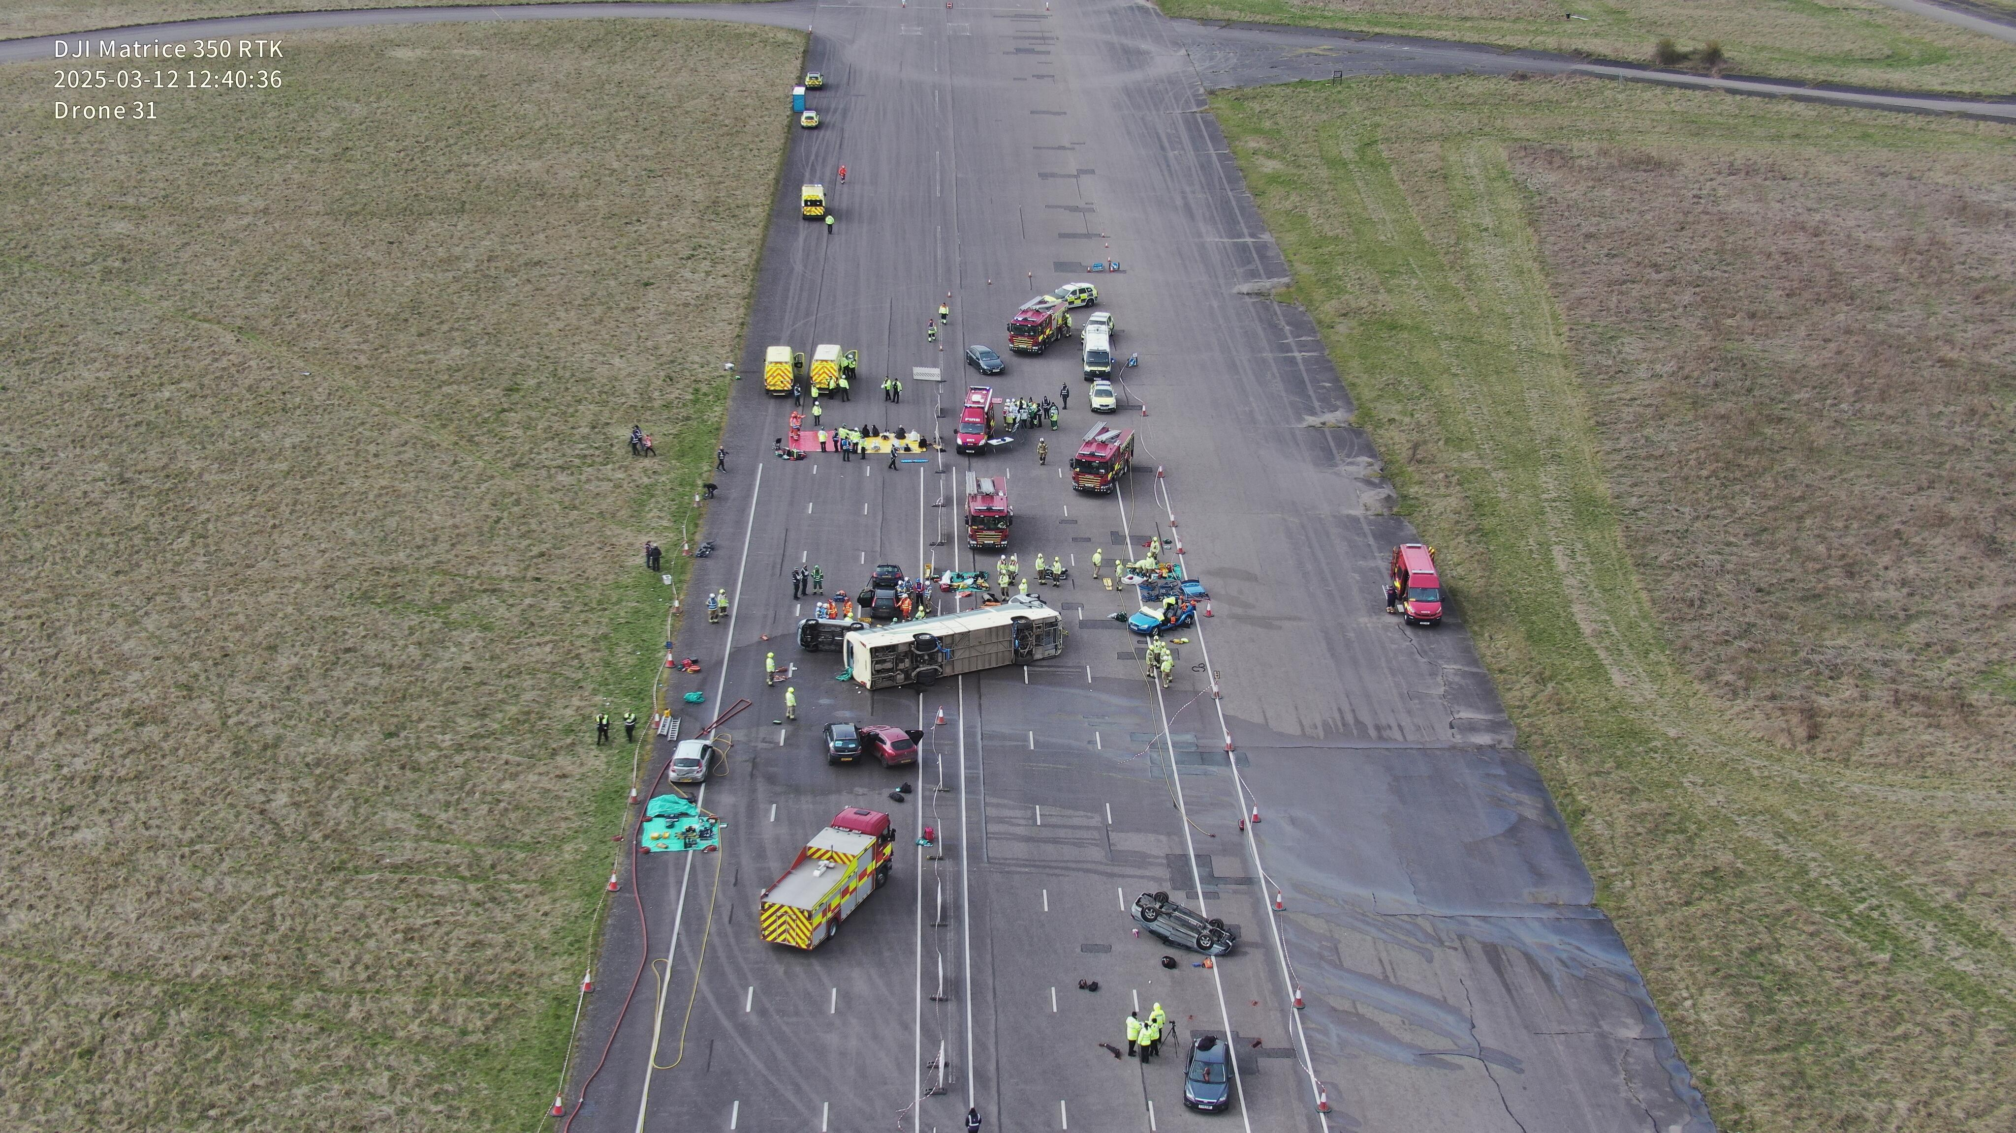
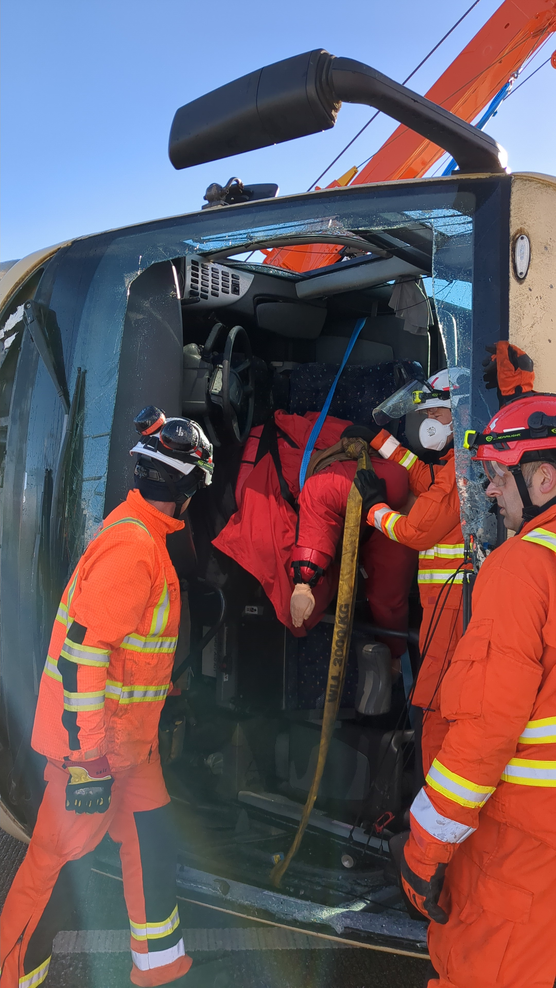
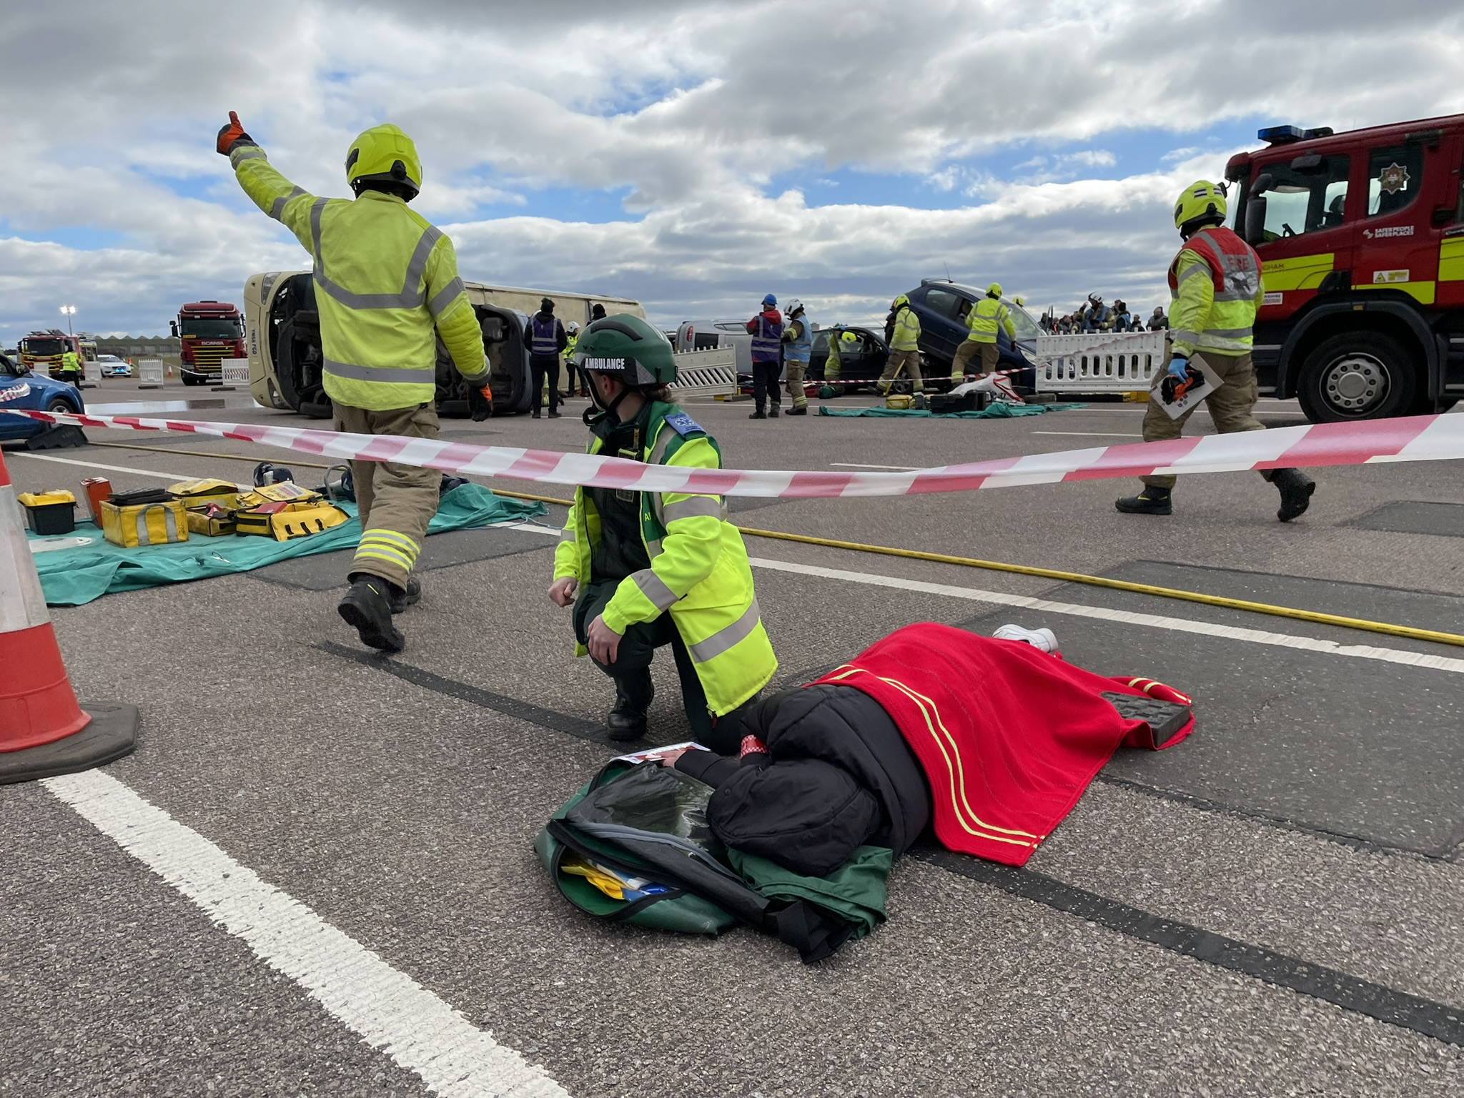
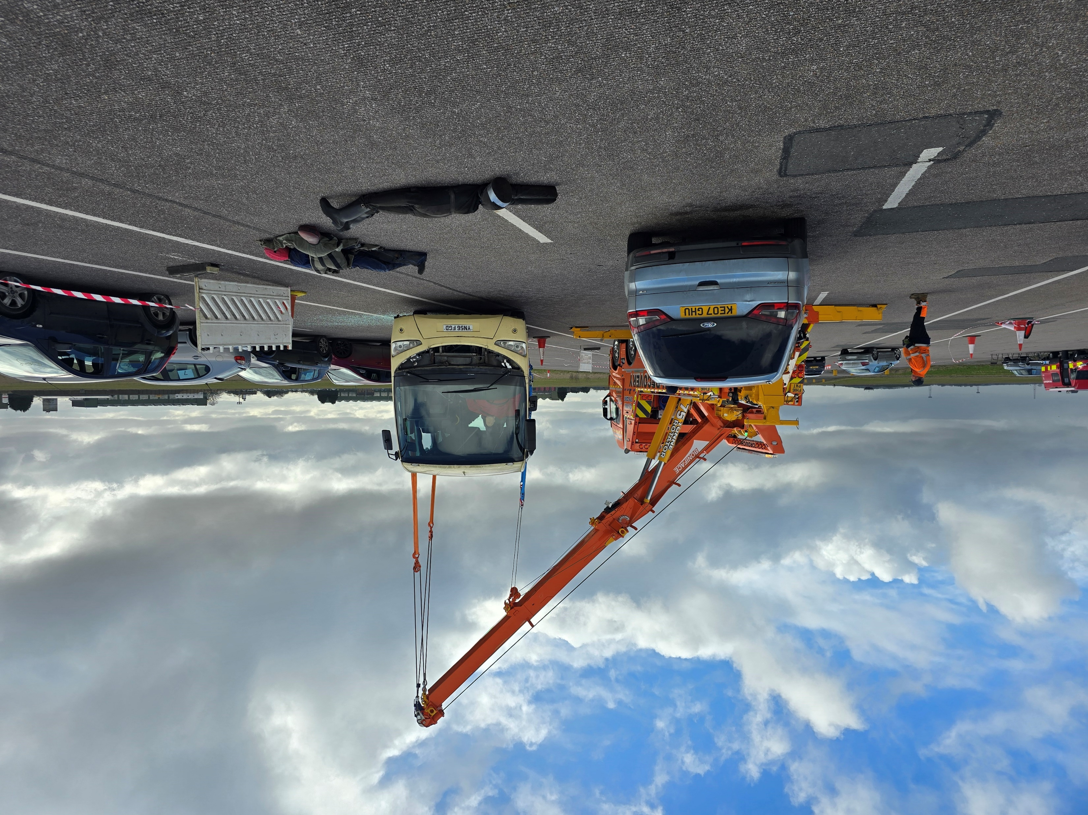

Slide 19
Group exercise
Scenario
A fire breaks out in the school hall during lunchtime (at 12.30pm). ​
Initial Steps​
Staff evacuate pupils, call the fire brigade, activate alarm system. ​
Challenges​
Miscommunication between staff, difficulty in locating some students, confusion around assembly points. ​
Tabletop Discussion​
How would you ensure all pupils are accounted for? ​
How can you improve communication between different staff members during an emergency?​
What does the plan say to do?​
What if a key member of staff was absent on the day?
A child does not have their medication and needs to take it at 2pm

Slide 20
Useful Links https://www.gov.uk/government/publications/emergency-planning-and-response-for-education-childcare-and-childrens-social-care-settings https://www.gov.uk/government/publications/emergency-planning-and-response-for-education-childcare-and-childrens-social-care-settings/vulnerable-children-and-young-people-and-critical-workers https://www.gov.uk/government/publications/protective-security-and-preparedness-for-education-settings https://assets.publishing.service.gov.uk/media/66f124be69fa2ae94de745c9/24.51_CO_EDS_Exercising_Good_Practice_Guidance.pdf https://www.gov.uk/guidance/preparation-and-planning-for-emergencies-responsibilities-of-responder-agencies-and-others

Slide 21
Thank you
Any questions?
Andrea.gardner@leics.gov.uk
07376 487997

