Slide 1
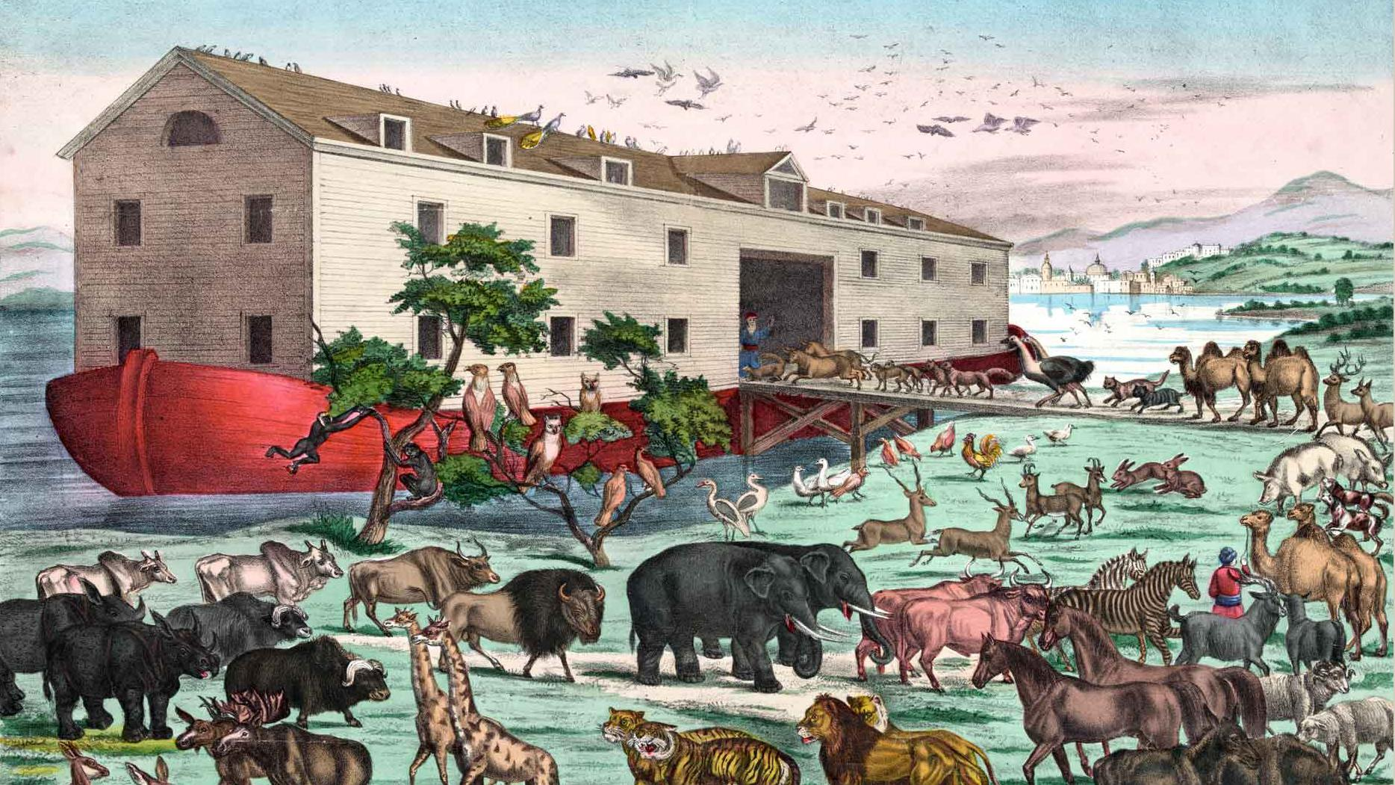





DYNAMIC AND INSPIRATIONAL LEARNING
AND DEVELOPMENT, BUILT AROUND THE
PSYCHOLOGY OF WELLBEING AND HAPPINESS.
TEAM
BUILDING
Victoria Maitland
Laughologist
www.laughology.co.uk
@Laughology

Slide 2




Victoria Maitland – Laughology Facilitator
5 11.5 3
Laughology
Laughology learning
and development
@LAUGHOLOGY
Notes:
Hello, I’m Victoria – laughologist. What do we do? We use the psychology of humour and happiness to enhance positivity and mental health in schools and businesses. Looking at how our brains work.
My Background. Warm up – wiggle hands in air – into next persons laps.
I’m warming you up to test if you have a sense of humour. Its our perception of our world. We are driven by how we feel. Having a laugh at work is helpful. happiness really is important for everyone.
Energy is key, blood circulates better, we breathe more deeply – our brains get the ingredients it needs to function at its best. Well that and water.

Slide 3

WHAT WE’LL COVER:
Investigate how laughter and humour create connection, enhance collaboration and help you work better together
Illustrate how the brain processes information, influences your perception of situations, and how you respond to them
Consider how to flex your communication style
Get to know each other even better
Laugh, connect and celebrate what you achieve

Slide 4
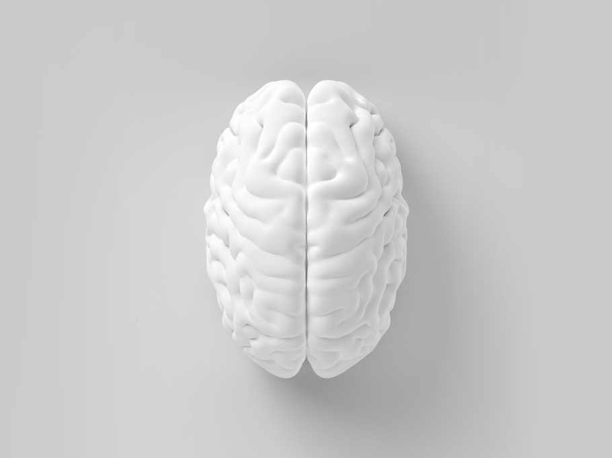

FAST AND SLOW THINKING
FAST
EMOTIONAL
Automatic
Intuitive
Instinctive
Primary
Rapid
Can feel simple
SLOW
RATIONAL
Considered
Effortful
Focused
Secondary
Slower
Can feel difficult

Slide 5
Humour triggers & learned optimism
What makes you laugh?
What are you grateful for?
What do you enjoy?
Notes:
Asking these Qs can help us to re-focus, to get unstuck, to FLIP mood and perspective, build humour muscle and resilience

Slide 6

HUMOUR TO ADJUST THINKING
If you change
the way you look
at things, the things
you look at change
Cat or bird?
Notes:
Learn something new. Take in more info. Marriage competition.

Slide 7


Slide 8


Slide 9
  HOW WE COMMUNICATE
2%
Less than 2% of people have had any formal education on how to listen
We listen to people at a rate of 125 – 250 words per minute but think at 1000 – 3000 words per minute
Notes:
20 mins (Total 45)
We hear automatically, all the time but very few of us properly listen.

Slide 10
WHAT WE HEAR IS OFTEN OPINION NOT FACT.
WHAT WE SEE IS PERSPECTIVE NOT TRUTH.
Notes:
10
We all communicate differently, so clarification is important. Often, when we don’t understand things, our emotions get in the way and we interpret things in our own way. Learning new tasks is challenging and communication can either help or hinder. Use the communication knowledge you have gained as a tool to help you progress. Asking the right questions to ensure understanding can help. Listening to how the person is saying something and observing the whole person when talking is also another technique that will help you understand the person in front of you.
Ask the team what they have learned about themselves and what they might do differently.
Most challenging conversations happen because we aren’t listening properly to one another, or because we are interpreting the situation through our own perspectives.
How can we listen better to save a conversation being challenging or listen to how the person is feeling – Refer back to what builds trust slides
How can you ensure your message has been understood in the right way?
How can you encourage others to listen better?
We tend to listen internally, which means we filter information through our own thoughts and beliefs. Deeper understanding can be achieved through practising observation and focused listening.
ASK BEFORE NEXT SLIDE – How many of each animal did Moses take aboard the arc? - Answer: None, it was Noah
10

Slide 11
  Shifting Focus
CIRCLE
OF CONCERN
CIRCLE OF
CONTROL
REACTIVE
FOCUS
CHANGING
YOUR FOCUS
PROACTIVE FOCUS
Notes:
Arm exercise

Slide 12




GOOD HUMOUR
INGREDIENTS
“
Facial expressions
Body language
Voice, tone & pitch
Types of words

Slide 13
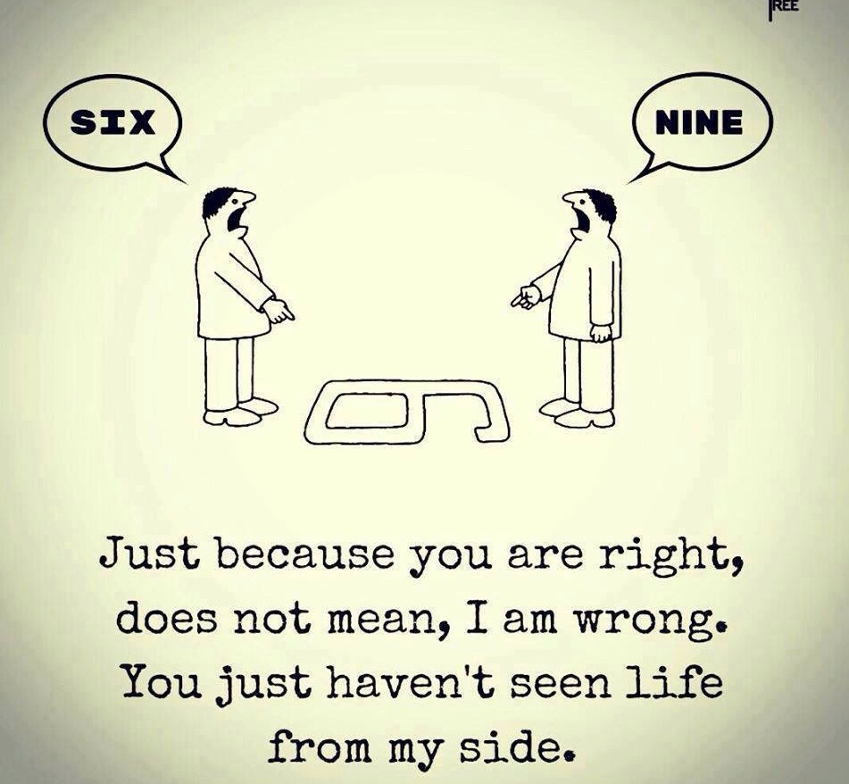
Notes:
12:05 – 5 mins

Slide 14
FEELINGS AND MOTIVATION
“I’ve learned that people will forget what you said, people will forget what you did but they will not forget how you made them feel.”
Maya Angelou, author, activist, campaigner

Slide 15
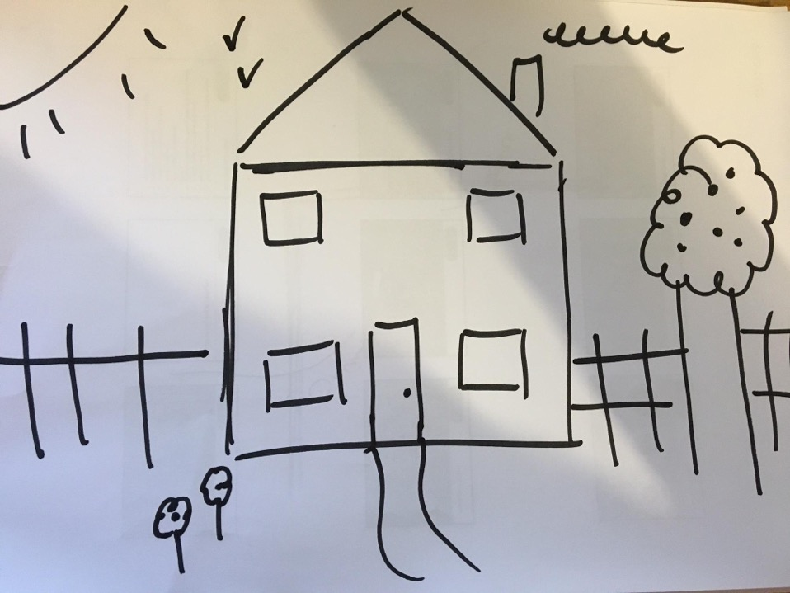
Notes:
Ask the group why they think most people have drawn a similar house. You may hear answers such as: because that’s the way we were taught, that’s what we saw as a kid and that’s a representation of a house. These are all right and the picture they have drawn isn’t wrong, but what could a house look like, if they had used their imagination
If you have time get them to do it again and this time ask them to draw their dream house. When we link what were doing to something of value and purpose we are more likely to be motivated, to push ourselves and go to the nth degree

Slide 16


HUMOUR ENCOURAGES INNOVATIVE THINKING

Slide 17
WHAT
NEXT?
IDENTIFY unhelpful thinking and make a plan to combat one of them
RECOGNISE when you’re focusing on things that are beyond your control, and change your focus
THINK more creatively when you’re faced with a problem
USE humour and laughter to adjust your thinking
Notes:
It’s very easy to come to training days and then go back to the office with good intentions but life gets in the way and we’re all busy. Today will only have a positive impact if we commit to recognising our own and others’ unhelpful language and behaviours and working to FLIP them. What will you do as a result of today?
STOP START CONTINUE
1225/1225

Slide 18


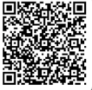
Find out more about how Laughology programmes can help make you and your people happy and productive.
www.laughology.co.uk
info@laughology.co.uk
0844 800 1701
@laughology

