Slide 1
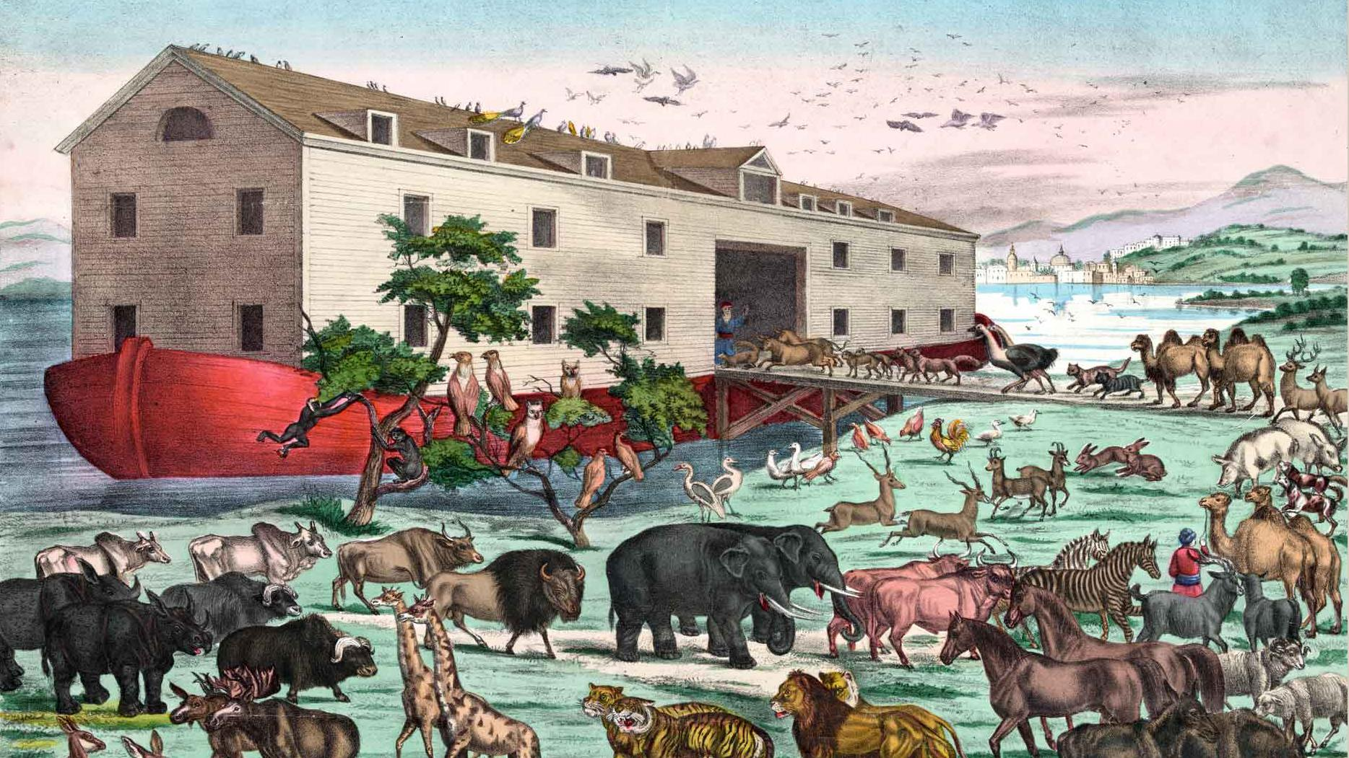



NEGOTIATION & THINKING SKILLS
Victoria Maitland
Laughologist
www.laughology.co.uk
@Laughology

Slide 2


WHAT WE’LL COVER:
Investigate how laughter and humour create connection, enhance collaboration and help you work better together
Illustrate how the brain processes information, influences your perception of situations, and how you respond to them
Consider how to flex your communication style
Get to know each other even better
Laugh, connect and celebrate what you achieve

Slide 3



Victoria Maitland – Laughology Facilitator
Laughology
Laughology learning
and development
@LAUGHOLOGY
Notes:
Hello, I’m Victoria – laughologist. What do we do? We use the psychology of humour and happiness to enhance positivity and mental health in schools and businesses. Looking at how our brains work.
What am I communicating with this exercise – you cant be wrong. It’s fun. Think outside the box.
Lines of order – height, eye colour, birthdays. Two lines? Pass actions.

Slide 4
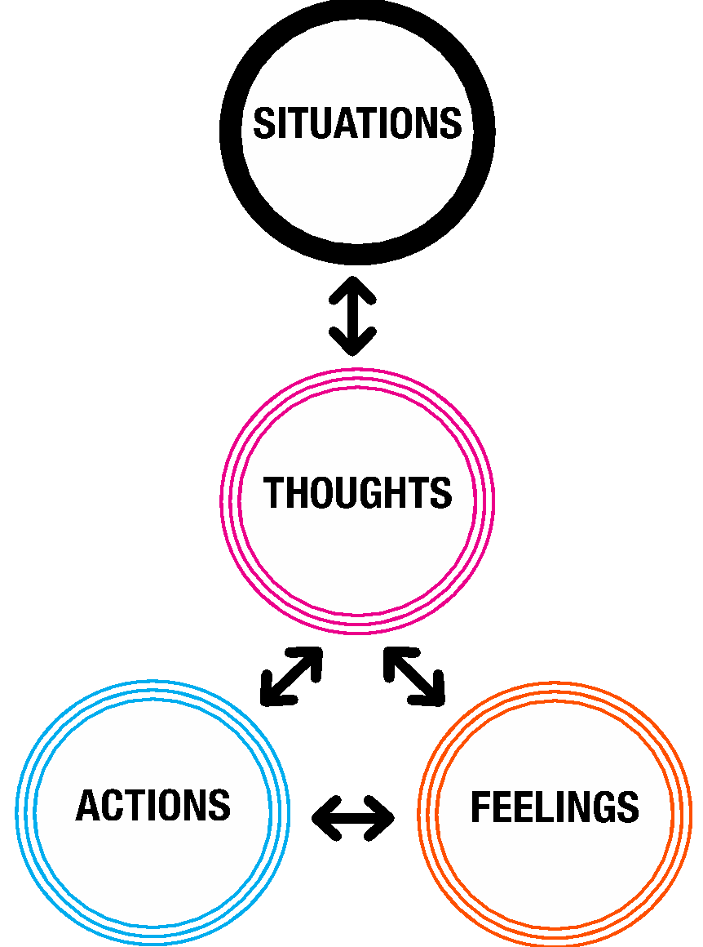


THOUGHT PROCESS
5
Beliefs/
values/
memories
Notes:
Hug exercise
Our brains are jumping to conclusion machines.
Roughly 86 billion neurons in the brain – Roughly 95 to 97% of all decisions we make are based on how we feel.

Slide 5

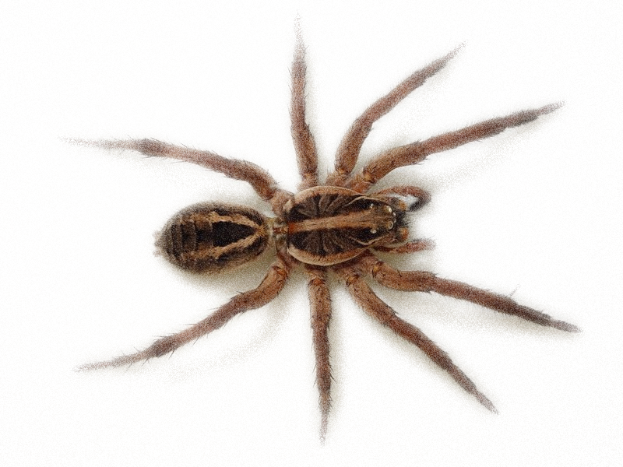

BELIEF AND RESILIENCE
Notes:
Bring up each image and ask for reactions. This exercise is a practical example of the part that real life memories/belief systems and values can have on our thought process

Slide 6
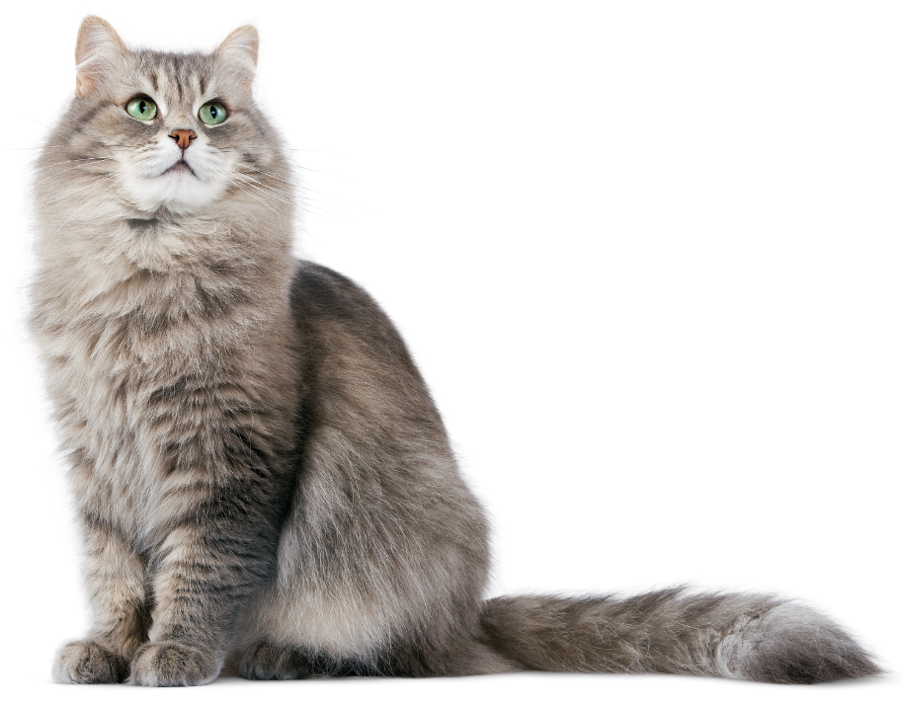
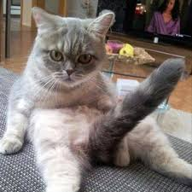
BELIEF AND RESILIENCE
Notes:
These slides show how humour can be a really, effective way to interrupt our thought processes and make us look at things in different ways.

Slide 7
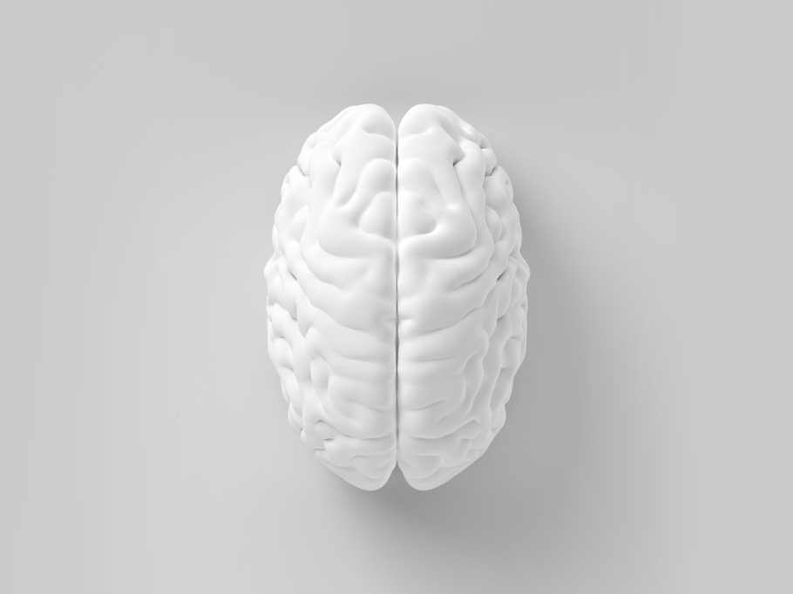

FAST AND SLOW THINKING
FAST
EMOTIONAL
Automatic
Intuitive
Instinctive
Primary
Rapid
Can feel simple
SLOW
RATIONAL
Considered
Effortful
Focused
Secondary
Slower
Can feel difficult
Notes:
Line of actions

Slide 8
  HOW WE COMMUNICATE
2%
Less than 2% of people have had any formal education on how to listen
We listen to people at a rate of 125 – 250 words per minute but think at 1000 – 3000 words per minute
Notes:
20 mins (Total 45)
We hear automatically, all the time but very few of us properly listen.

Slide 9

WHAT IS LAUGHTER?
WHAT IS HUMOUR?

Slide 10

  LAUGHTER
A communication tool to express how we feel and strengthen social interactions.
  The outward energy of humour.
Notes:
10

Slide 11
  HUMOUR
  An aspect of the human mind, a system for processing information
  A way to look at life.
Notes:
11

Slide 12

DOSE OF HAPPINESS
NEUROTRANSMITTERS
Dopamine
Oxytocin
Serotonin
Endorphins
Notes:
Question – Does anyone know what the four naturally occurring neurotransmitters are called?

Slide 13
  EGO STATES
PARENT
ADULT
CHILD
The ego state model
Developed by Eric Berne – psychologist - in 1950
Founder of transactional analysis
Notes:
Dropped a ball over the neighbours fence
Give feedback that you didn’t like the way someone spoke to you
You need to give feedback about someone not being a team player
Someone has body odour

Slide 14
  EGO STATES
- VE
Controlling
Critical
Patronising
Finger-pointing
Rebellious
Tantrums
Difficult
Insecurity
PARENT
ADULT
CHILD
+VE
Keep Safe
Calming
Nurturing
Supportive
Reasonable
Logical
Rational
Not-threatening
Non-threatened
Curious
Playful
Creative
Spontaneity

Slide 15
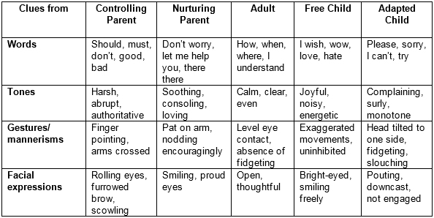
  HOOKS, CUES & CLUES
Notes:
Role plays – parent adult child
Get a ball from next door
Partner hasn’t done the washing up
Boss gives you feedback from work
Parent teacher conversation.

Slide 16
  THE POWER OF PAUSE
Stimulus
Recognise
ego state
Pause
Give yourself time to think
Response
Choose to respond
Notes:
Go with scenarios.

Slide 17
Prepare! Prepare! Prepare!
Prepare yourself - What is the outcome I want?
What use of language do I need to focus on?
Rehearse!
Prepare Others – Inform the person of a chat/meeting.
Help them prepare to avoid conflict
Set an agenda, inform them of the purpose of the meeting
Plan - Is the timing right for a chat?
Do you need to take time out to regroup?
Change the environment or language if you aren’t getting results.
Pass it on - Know when to pass it on
Does someone else need to be involved?
Notes:
Break out room have this convo – set task – don’t do it yet.

Slide 18
  THE WRITTEN WORD
“We regret to inform you that we cannot process your application to register your business name, since you have neglected to provide sufficient information. Please complete ALL sections of the attached form and return it to us."
Notes:
Positive positionings.
Telling off not productive.

Slide 19
  POSITIVE LANGUAGE TO INFLUENCE AND CAUSE ACTION
"Congratulations on your new business. To register your business name, we need some additional information. If you return the attached form, with highlighted areas filled in, we will be able to send you your business registration certificate within two weeks. We wish you success in your new endeavour."
Notes:
Call to action

Slide 20

  MAKING SURE WE’RE ALL OK
I’m not ok, you’re ok
Get away from
I’m ok, you’re ok
Get on with
I’m not ok, you’re not ok
Get nowhere
I’m ok, you’re not ok
Get rid of
Notes:
Noughts and crosses – satisfy the ego – game

Slide 21
FEELINGS AND MOTIVATION
“I’ve learned that people will forget what you said, people will forget what you did but they will not forget how you made them feel.”
Maya Angelou, author, activist, campaigner

Slide 22

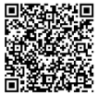

Find out more about how Laughology programmes can help make you and your organisation happy and productive.
www.laughology.co.uk
info@laughology.co.uk
0844 800 1701
www.laughology.co.uk
@Laughology
Notes:
4:30

