Slide 1


Supporting your Whole School in Riding the Ofsted Inspection Wave
Exceptional organizations…
“prioritize the well-being of their people and, in return, their people give everything they've got to protect and advance the well-being of one another and the organization.”
Andy Mellor – National Wellbeing Director – Schools Advisory Service

Slide 2


Andy Mellor
17 years headteacher at St Nicholas C of E Primary School, Blackpool
National President – NAHT 2018-19.
January 2020 became National Wellbeing Director for Schools Advisory Service (4 days)
Notes:
Going to leave a copy of this presentation as a scaffold for further discussion and to aid next steps.
At the end of the presentation there are further slides that I’m not going to cover today but demonstrate the range of support available to staff and pupils with SAS.

Slide 3
This session – preparing to avoid overwhelm
Building a culture that sustains under the most intense of pressure
Sustaining positive wellbeing throughout the inspection itself
What to be aware of post inspection.

Slide 4
The nature of inspection
Intense
High stakes
Pressurised
Stressful
Draining
But why?
A once in every three years opportunity to showcase what you do well.
Potential reputational damage from a “poor” inspection.
Intervention leading to potential loss of autonomy, freedoms and control.
A lack of surety of the consistency from one inspection team to the next.
But what is happening to us mentally and physically?

Slide 5

What is stress?
Stress can be defined as a state of worry or mental tension caused by a difficult situation.
Stress is a natural human response that prompts us to address challenges and threats in our lives.
Everyone experiences stress to some degree. (WHO)
Types of stress
Acute – short term
Episodic – short term but repeated
Chronic – longer term leading to impact on longer term health

Slide 6
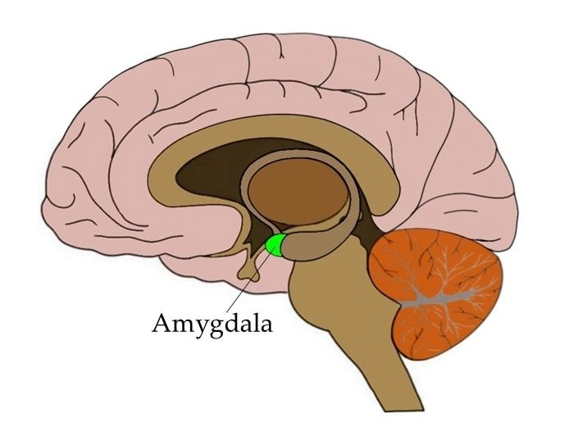
Our physiological response to inspection and “the call.”
“The sentry on guard”
The heart beats faster than normal, pushing blood to the muscles, heart, and other vital organs.
Pulse rate and blood pressure go up.
The person undergoing these changes also starts to breathe more rapidly.
Small airways in the lungs open wide.
This way, the lungs can take in as much oxygen as possible with each breath.
Extra oxygen is sent to the brain, increasing alertness.
Sight, hearing, and other senses become sharper. (Harvard)

Slide 7
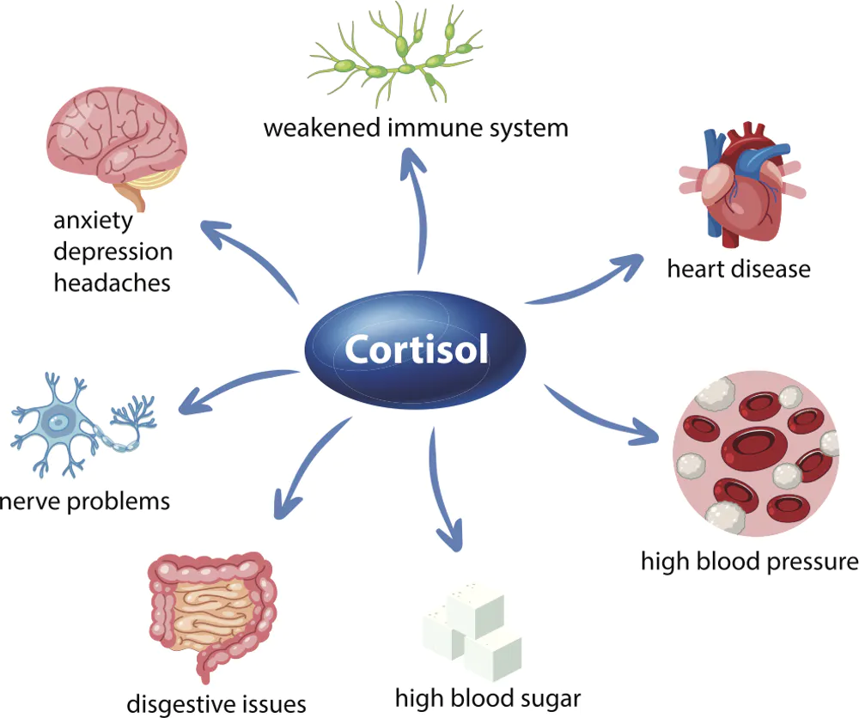
Prolonged exposure to stress
After the initial stress response, if the stress trigger persists, the body starts to produce cortisol
Prolonged exposure to cortisol is harmful to heart cells over the long term
Many school leaders are producing cortisol day after day

Slide 8
How can we physiologically lower harmful levels of cortisol?
Sleep
Rest and relaxation activity
Mindfulness and yoga type activity
Mindful breathing – how does it work?
What have you done for your
wellbeing this week?
(2 mins)
Breathe in for 3 seconds
Hold it for 4 seconds
Breathe out over 5 seconds

Slide 9

What steps can we take in advance of an inspection?
Development of a whole school culture of wellbeing
Knowing where responsibility for wellbeing lies
Starting with an oxygen mask
Planning for better wellbeing
Empathy and relationships
MAP your way to wellbeing

Slide 10

Cakes v Workload – What is wellbeing?
How do we understand and define wellbeing as a school or a trust?
“Wellbeing is the state of being well. It is a state of mental and physical health where an individual can thrive, flourish and be the best version of themselves both personally and professionally.”
Who is responsible for personal wellbeing?
Personal responsibility for: sleep, rest, nutrition, exercise

Slide 11

Starting with an oxygen mask
SLT wellbeing as a counter intuitive concept
Understanding your wellbeing
- Be Well Lead Well
Self care – small things consistently done
How do you role model good wellbeing?
- How is it articulated in school?

Slide 13

Empathy and relationships
Connection
Sharing the space
Listening/relating
Perspective taking
Staying out of judgement
Acknowledgement of their reality
Giving or receiving empathy stimulates a naturally produced hormone called Oxytocin.
Oxytocin inhibits the production of cortisol.
Empathy helps to reduce stress
Empathy is about feeling genuine sorrow but being humble and vulnerable enough to know that you probably can’t say or do anything other than just be there. It’s about human connection.
Empathy is about human connection.

Slide 14
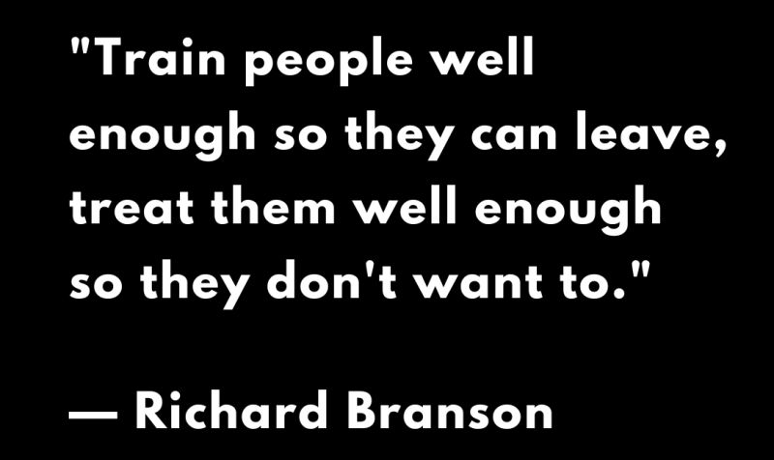


MAP your way to wellbeing
Mastery, Autonomy, Purpose – staff and students
“People who invest in their wellbeing, being the best version of themselves, perform better… it’s not rocket science.”
Began Sept 2012
Dec 2013 – Requires Improvement
March 2016 - Outstanding

Slide 15

How does that look in your context? (5 mins)
Mastery
The opportunity to continually improve leading to greater fulfilment and job satisfaction.
Autonomy
The opportunity, within a framework to utilise your skill and flair to determine how you do your job
Purpose
The extent to which all staff in school feel that they are helping to improve outcomes for young people.

Slide 16
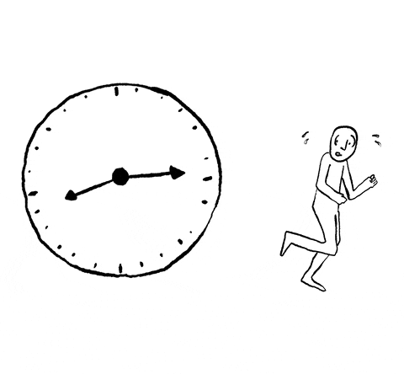
The W word!
Workload – Perspective & pragmatism
Basic Facts
There’s too much to do in the time you’ve got.
Doing that last piece of work is a fallacy. There is no last piece of work. I left work to do on my desk after 32 years of trying to get on top of it.
So
Be content with the fact that you won’t get everything done.
Prioritise what is important and has most impact.
Most importantly, know when to stop.
Trying to get the work done in the time you have, will just lead to stress, pressure, burnout and chronic fatigue.
Working fresher leading to greater effectiveness.

Slide 17

Workplace wellbeing
Ideas for a Wellbeing Focus group?
Quality and safety of the physical environment
What is it like to work in this building?
Is it safe, warm and free from factors that could damage health.
How workers feel about their work
Do you feel engaged, valued and have freedom to make decisions?
How empathetic are leaders and staff more widely?
Working environment
Do you have all the tools and resources to do your job?
Climate at work and work organisation
How top down or bottom up is your organisation?
Is there team coherence around a specified and agreed goal or goals?
How are relationships at work?

Slide 18

During the Inspection
Draw down on your acquired wellbeing and strategies
Check in on those who you might be concerned about and who are struggling
Give those who might need it, including yourself, time to vent
Lunch?
Ensure support staff know how best to support (cleaners, caretaker, and share their story)
Focus on your sphere of control
“Resilience is about planting the roots that will hold us fast in the storms of life.”
Emma Coller

Slide 19
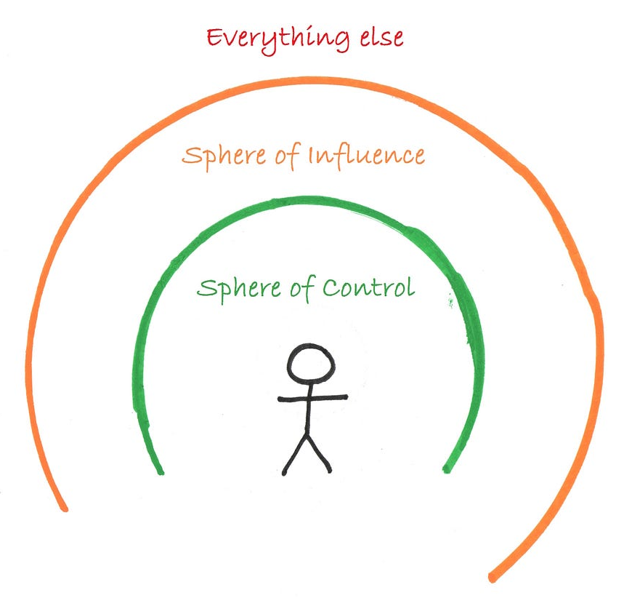
Sphere of control
Be comfortable with the fact that there are some things that you just can’t control and let them go.
Control and plan for your controllables well in advance.
Create capacity for things you might be able to influence or support.

Slide 20
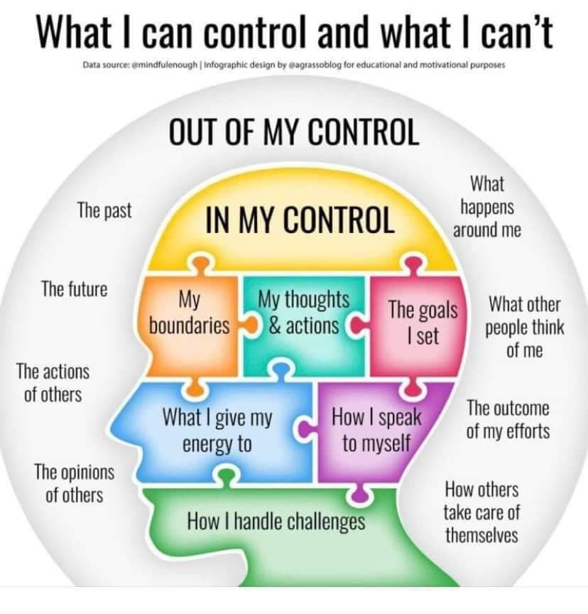
Can you think of examples from your recent experience?

Slide 21

Post Ofsted
Debrief together
Celebrate together
Be aware of those needing picking up
Be aware of the post Ofsted slump absence, lethargy, motivation
Be prepared to wait a little before moving forward again
Ensure your school has services to support health and wellbeing to draw on
https://schooladvice.co.uk/staff-absence-insurance/wellbeing-support

Slide 22

So what comes next?
We can support SAS schools in creating this way forward.
Please do get in touch if we can support.
Creating a plan to help improve day to day wellbeing for everyone in your school community.

Slide 23



Further information
“Wellbeing is important but it’s not just for Ofsted, it’s a year-round commitment to culture change.”
Andy Mellor
National Wellbeing Director
Schools Advisory Service
https://schooladvice.co.uk/
andy.mellor@uk-sas.co.uk
@andymellor64

