Slide 1
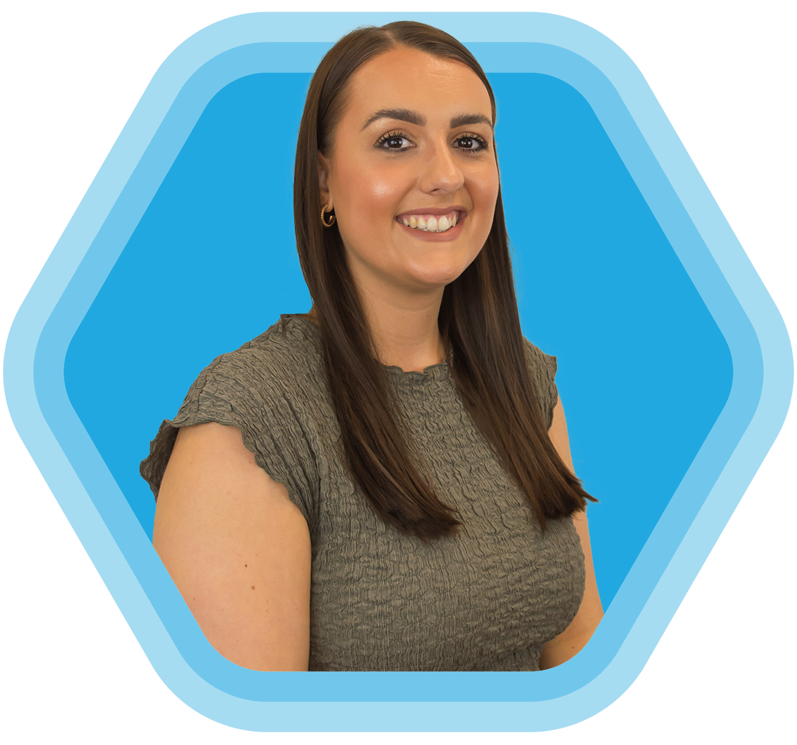
ABLE UPDATE
schooladvice.co.uk Hannah Wharmby

Slide 2
Workshops
Laura Williams
11.30 – 12.30
Managing upwards, getting a seat at the table
14.30 – 15.30
SBL Summer Planning
Chris Whitmore
11.30 – 12.30
Staff Absence Management- Wisdom
and Wellbeing for all
Workshops
Andy Mellor
14.30 – 15.30
Supporting your whole school in riding the Ofsted wave
Notes:
I’m certain the majority of you have heard of us and I know we do already work with a few of you but just in case anyone hasn’t I’ll give you a bit of background SAS.
We have worked within the education sector for over 25 years and currently support over 4,000 schools with absence protection and whole school wellbeing.
Since 1997 we recognised a need for an alternative to the local authority pooled schemes, and so we introduced our comprehensive insurance policies to give schools a full transfer of risk from their budgets.
Since then, education has changed so much over the years and we have evolved our products to meet the needs and budget of all schools and academies. We recognised that absences and wellbeing go hand in hand, and so we were the first provider to introduce whole school physical and mental health support as complimentary with our policies. We first added counselling and physiotherapy support for staff, and as it has evolved, we have invested heavily in preventative measures such as mindfulness, weight management and our 24hr GP helpline to name a few.
I think you will agree that since the pandemic, now more than ever, wellbeing is at the forefront of everyone’s minds…

Slide 3
Reminders
Book your Nurse Health Screen Day!
Pupil Counselling
Every SAS Policy includes 1 referral for Pupil Counselling
Current Clients
Staff Counselling
Our counselling support for your staff includes unlimited sessions
Notes:
I’m certain the majority of you have heard of us and I know we do already work with a few of you but just in case anyone hasn’t I’ll give you a bit of background SAS.
We have worked within the education sector for over 25 years and currently support over 4,000 schools with absence protection and whole school wellbeing.
Since 1997 we recognised a need for an alternative to the local authority pooled schemes, and so we introduced our comprehensive insurance policies to give schools a full transfer of risk from their budgets.
Since then, education has changed so much over the years and we have evolved our products to meet the needs and budget of all schools and academies. We recognised that absences and wellbeing go hand in hand, and so we were the first provider to introduce whole school physical and mental health support as complimentary with our policies. We first added counselling and physiotherapy support for staff, and as it has evolved, we have invested heavily in preventative measures such as mindfulness, weight management and our 24hr GP helpline to name a few.
I think you will agree that since the pandemic, now more than ever, wellbeing is at the forefront of everyone’s minds…

Slide 4
Are You Reviewing Your Cover?
Come and say hello!
VISIT OUR STAND
Recommended by the DfE through the CPC framework
Notes:
https://schoolleaders.thekeysupport.com/staff/employment-wellbeing/staff-leave-and-absence/staff-sickness-absence-statistics/
https://www.derbyshiretimes.co.uk/news/people/teacher-sickness-22-worst-affected-schools-in-derbyshire-as-rising-absence-levels-reflect-the-harsh-reality-of-the-workplace-4686751

