Slide 1
Managing Upwards:
Getting A Seat At The Table
Laura Williams
4th March 2025

Slide 2
Who Am I?
School Business Leadership Coach and Trainer
Host of ‘School Business Leadership’ Podcast
1-1 coaching, online SBL Coaching Community, sender of Tuesday emails
Affiliate Coach with Schools Advisory Service, Executive Editor of Education Executive magazine
Previous roles include: LGB Clerk, PA to the Head, HR Officer, Office Manager, SBM, COO, CFO, Company Secretary, Governor & Trustee

Slide 3
Hidden Barriers
Over explaining
Apologising unnecessarily
Letting others interrupt
Rambling
Using permission seeking language
Emotional tone

Slide 4
Clarity Not Volume
One breath rule
Lead with the headline
Silence is power

Slide 5
Holding Your Ground
Broken record rule
Push back without defensiveness
The power of pause
Timing is everything
Ask, don’t tell
Make it known

Slide 6
What Isn’t Said
Eye contact
Posture
Tone of voice
Gestures
Self-awareness

Slide 7
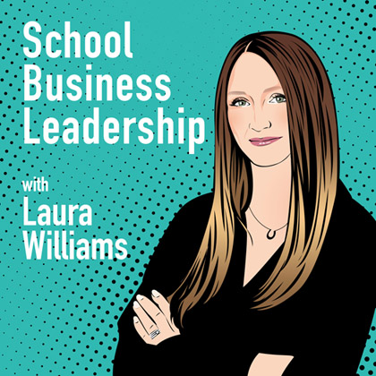
Contact and Further Support
School Business Leadership Podcast – Apple, Spotify, Google, Amazon
Social Media: @lauraljbusiness – Facebook, Instagram, Twitter, LinkedIn
Website: www.ljbusinessofeducation.co.uk
SBL Coaching Community – www.sblcoachingcommunity.co.uk

