Slide 1
How to Create Clear Boundaries and Thrive as a School Business Manager
With Educational Wellbeing Coach and Supervisor, Gemma Drinkall

Slide 2
What will you take away from this session?
A clear understanding of the 4 types of boundaries you need to thrive in school business leadership, namely physical, mental, emotional and identity boundaries.
A list of bespoke activities that will help you to thrive in school business leadership.
A set of tools you can use to manage your workload effectively.
Notes:
advise the headteacher and governors on financial policy
manage the school budget
order goods and services and pay suppliers and contractors
keep accounts up to date for inspection
oversee the maintenance of school buildings
recruit, train and manage school support staff
make sure school security and health and safety policies are followed
develop the school's marketing and communications strategy
manage the school's administrative systems
report to the headteacher, governors, and local authority and government departments

Slide 3
Hello!
My name is Gemma Drinkall
I help educators to create clear boundaries so that they can thrive in education.
Notes:
Give brief history of work

Slide 4
BOUNDARIES
ENABLE AND EMPOWER YOU TO PROTECT AND PROMOTE YOUR WELLBEING.
They are the red tape you surround yourself with to protect yourself from the pressures of work so that you can thrive in and out of school.

Slide 5
There are 4 Different Types of Boundaries

Slide 6
Leaving school on time
Enjoying a lunchbreak
Putting your laptop away at home

Slide 7
Is it in your job description?
Digital detox before bed
Making a note of things that are worrying you

Slide 8
Reflecting on what is in your Circle of Control
Having a safe space to offload
Journaling about difficult experiences

Slide 9
You deserve love, happiness and kindness, from others AND yourself
Who or what are the most important things to you?
At the end of the day, it is just a job
Notes:
Each type of boundary is underpinned by the next one.
When you give yourself permission to switch off from school, you can put in those clear physical boundaries.
When you can let go of challenging emotions, you can give yourself permission to switch off from school.
When you identify yourself outside of your job role, you can let go of the work with greater compassion.

Slide 10
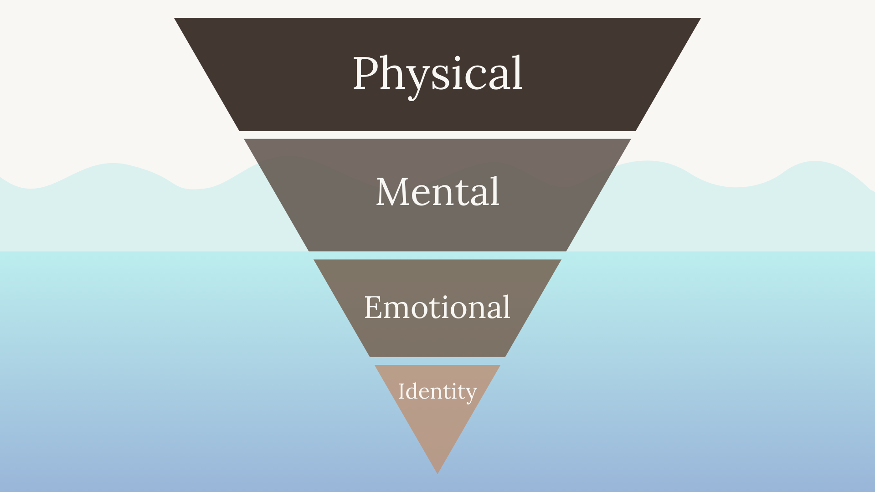
Notes:
The more challenging forms of boundaries are less visible in day-to-day life.
Having a coach or supervisor to work with you alongside these can make your boundaries more impactful.

Slide 11
B.O.U.N.D.A.R.I.E.S. Framework
B - Boundaries protect your work-life balance
O - Own your needs
U - Understand that you can only pour from a full cup
N - No is a safe word
D - Dance in your own teacher awesomeness
A - Awareness is key
R - Reduce your workload
I - Identity begins with you
E - Expectations must be realistic
S - Students thrive when you thrive

Slide 12
Awareness is Key

Slide 13
What do you spend the most time, energy and focus on?
Notes:
One way that you can become even more greatly aware of your mental and emotional boundaries is to become aware of what you spend the greatest amount of time, energy and focus on. We can explore this through the Circle of Control

Slide 14
What is in your Circle of Control?
2. WHAT WORRIES ME BUT I HAVE LITTLE OR NO EFFECT ON?
1. WHAT OFTEN PLAYS ON MY MIND? WHAT WORRIES ME?
3. WHAT CAN I INFLUENCE?
4. WHAT DO I HAVE CONTROL OVER?

Slide 15
What do you spend the most time, energy and focus on?
Aim to focus your energy on what you can control.
For example, your own thoughts and actions.
You may have no control or only influence in other areas such as, school budget or staffing challenges.

Slide 16
Owning your needs and Pouring from a full cup

Slide 17
DEFINE YOUR NON-NEGOTIABLES
Your non-negotiables are activities, people, habits, emotions, events that energise you
They help you to acknowledge what you need to thrive and fill your own cup first.
What may you need before, during and after school?

Slide 18
Reducing your workload

Slide 20
When are you working at your best?
What type of work helps you to be in flow?
What kind of environment do you experience?
What helps you to settle into the task?
What is it like when you are in flow?

Slide 21
Which tasks get you bogged down?
What may help you to just get it done?
Set the scene
No disruptions – WFH?
What do you have to look forward to afterwards?

Slide 22
Notice what you have
DONE

Slide 23
What steps can you take to manage your workload effectively?
Before adding a task, ask yourself:
To what extent does this serve my school?
To what extent does this serve me?
What may be the biggest gain or biggest negation?

Slide 24
What steps can you take to manage your workload effectively?
Use time limits to your advantage!
Parkinson’s Law: “Work expands to fill the available time”
Pomodoro it
And enjoy a short break too

Slide 25
What steps can you take to manage your workload effectively?
Review what you have achieved and what you would still like to do
Have daily/weekly/termly reviews where you check in with your priorities.
What went well?
What didn’t go so well?
What could be even better for next time?

Slide 26
What would be the impact of reducing by 10% the standards you set for yourself?

Slide 27
Recap
There are many pressures in school.
However, creating clear boundaries will help you to thrive in your work.
When you own your needs and pour from a full cup, you and your colleagues benefit.
There are tools which will help you to manage your workload.

Slide 28
Thank you for engaging!
Please complete the feedback form to tell me what you loved and what you would like to see more of in the future!

