Slide 1
Moving feeds your positive mental health Charm Daley

Slide 5
Brain
Neural Peptide
Body
Hormones

Slide 6
SEROTONIN
ENDORPHIN
HAPPY HORMONES
DOPAMINE
OXYTOCIN

Slide 7
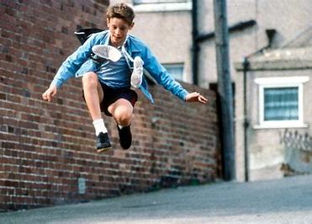

Slide 9
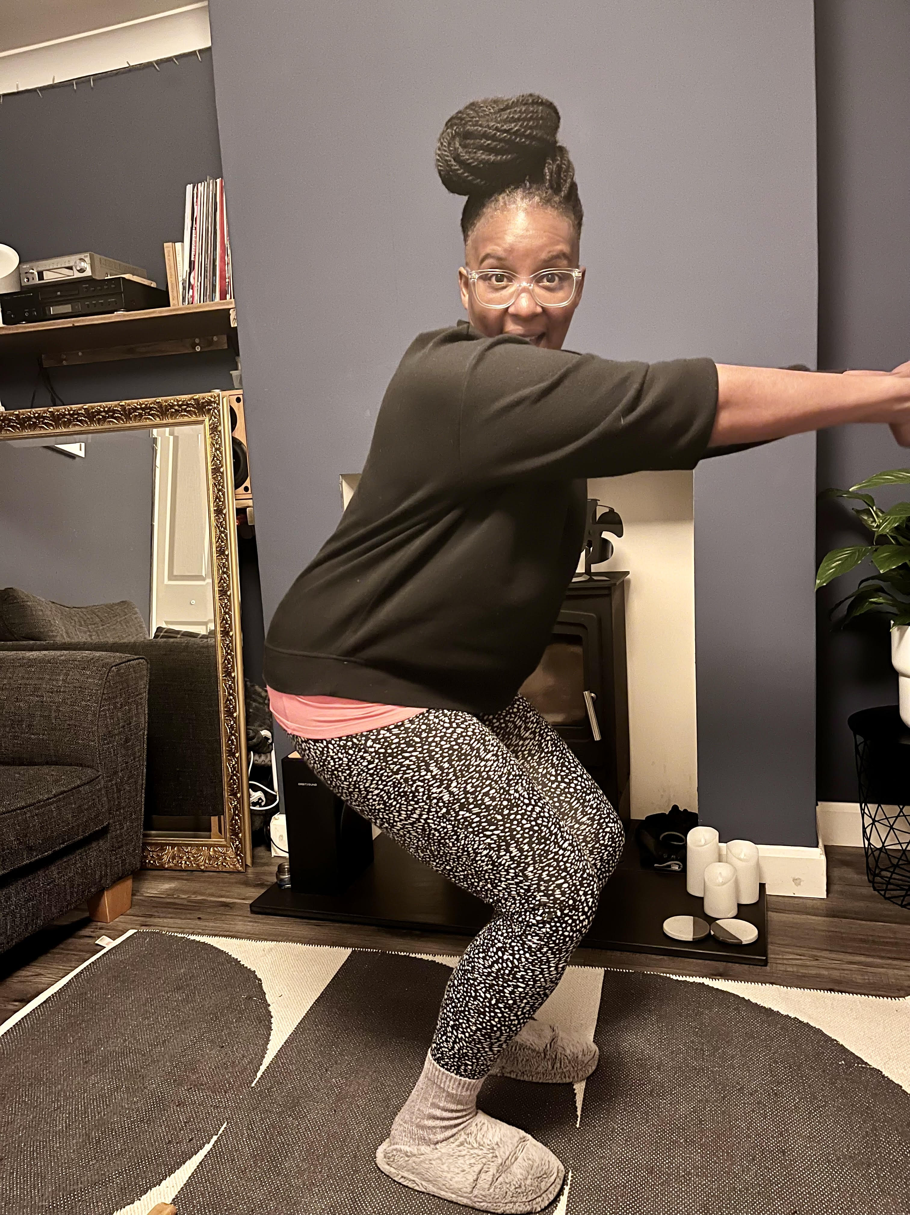

Slide 11
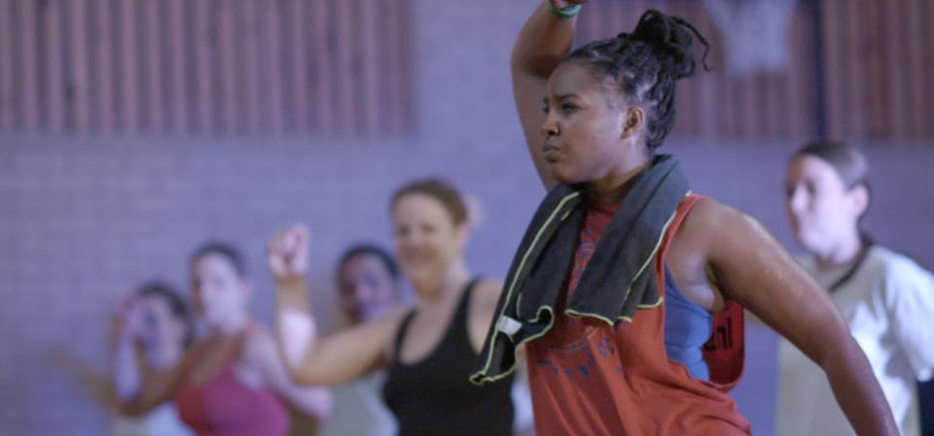

Slide 12
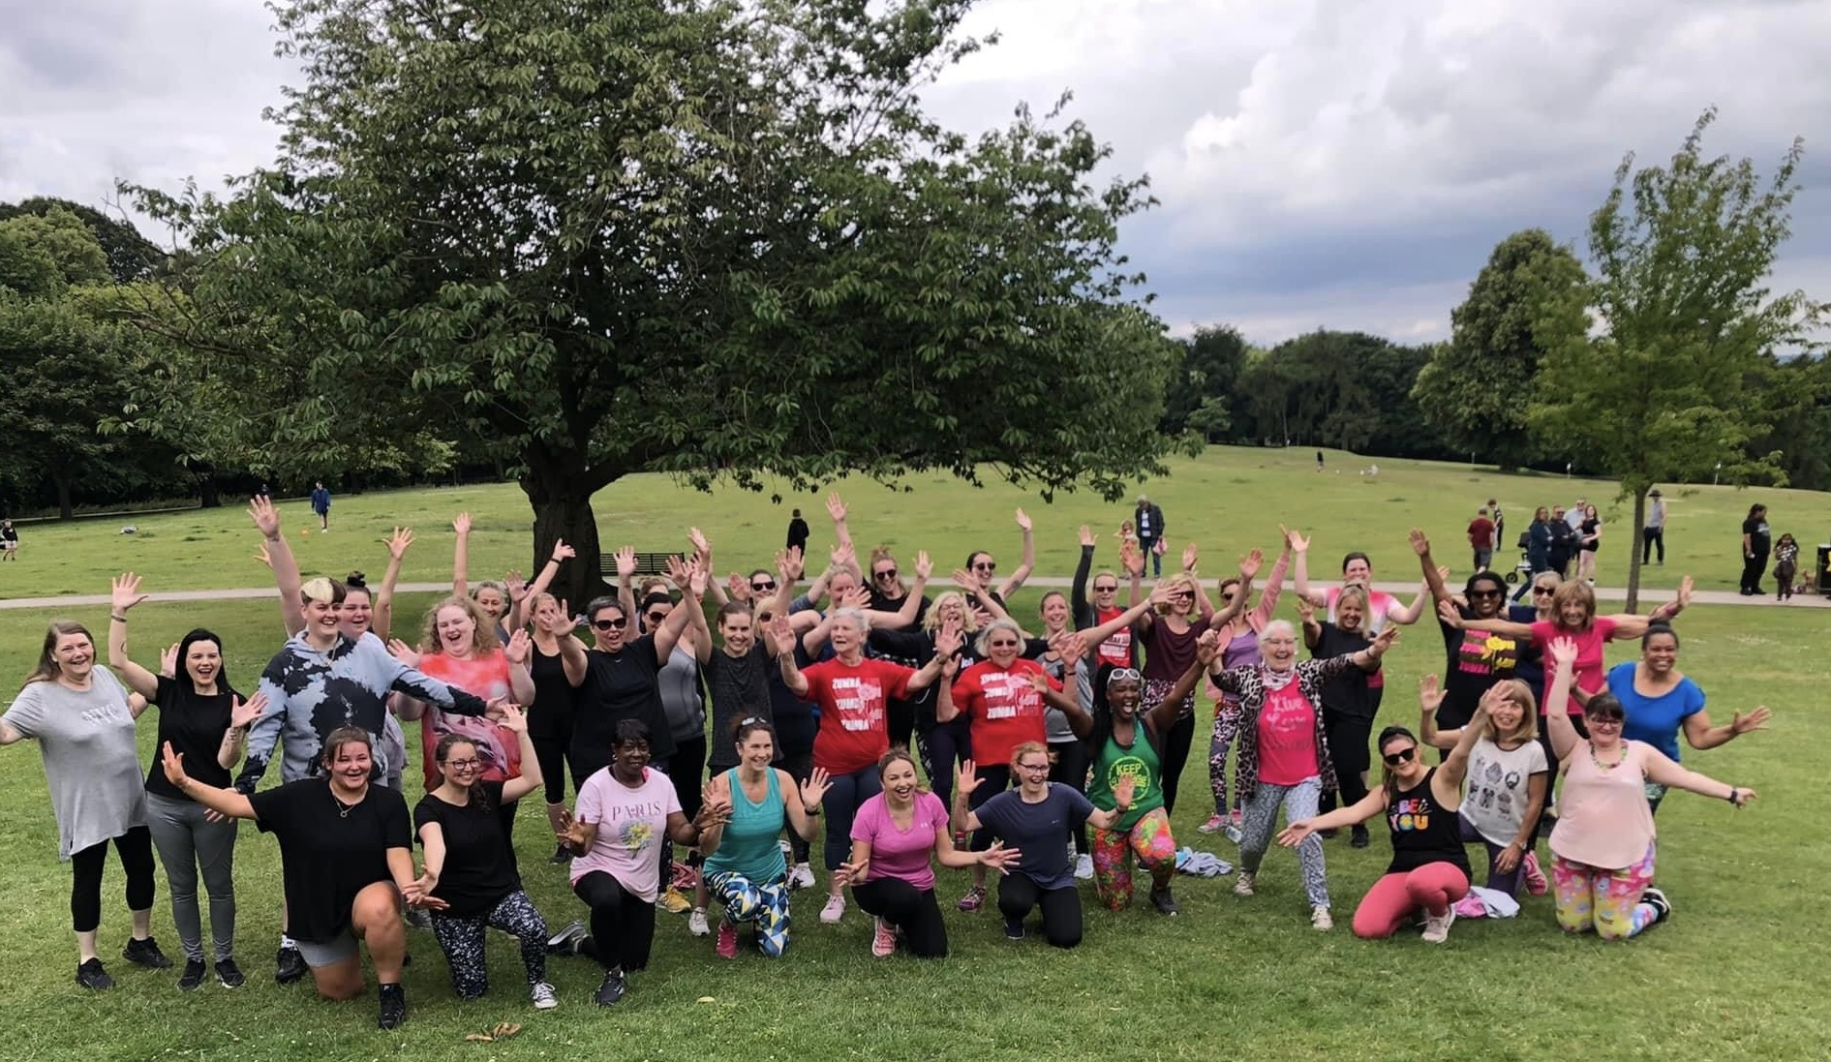

Slide 13
“When we move together, we notice our similarities, we see people like us, we inspire and motivate each other. Don’t underestimate the power of moving, because when we move together, we can connect on a deeper universal level”

Slide 14
Charm Daley
Zumba With Charm
charmedfitness@gmail.com

