Slide 1
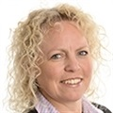
Education Mutual
Owned by schools and operated solely for the benefit of schools.
Managing Workplace Sickness Absence Effectively & Confidently
Tracey Gray
01623 287840
Info@educationmutual.co.uk

Slide 2
Agenda
Setting expectations: employee and employer’s role in managing and minimising absence
Communication
Preparing a check list for the call
Interviewing the absent employee
Setting the tone and asking the right questions
Red flags
How to get the best out of Occupational Health and or GP Communications
How Education Mutual can support
Job retention v Sickness Absence Management - Supporting a returning employee
Workplace return
Graduated Return To Work (GRTW)
Flexible hours
Dealing with difficult situations
The essentials of Sickness Absence Management - such as:
Absence management policies
Robust, but fair procedures
Time planner for communication
Escalation procedures
Health assessment
Preventive measures (Link EM, GP/Counselling etc)

Slide 3
Setting expectations:
Employee and employer’s role in managing and minimising absence

Slide 4
Communication:
Preparing a check list for the call
Interviewing the absent employee
Setting the tone and asking the right questions
Red flags

Slide 5
How to get the best out of:
Occupational Health
GP Communication
How Education Mutual can support

Slide 6
Job retention v Sickness Absence Management - Supporting a returning employee
Workplace return
Graduated Return To Work (GRTW)
Flexible hours

Slide 7
Dealing with difficult situations

Slide 8
The essentials of Sickness Absence Management - such as:
Absence management policies
Robust, but fair procedures
Time planner for communication
Escalation procedures
Health assessment
Preventive measures such as EMs GP service, counselling, Occupational Health and Physio

Slide 9
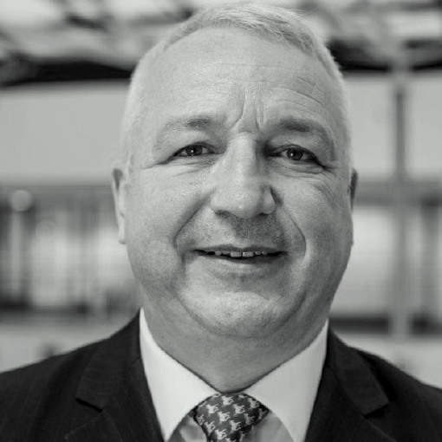
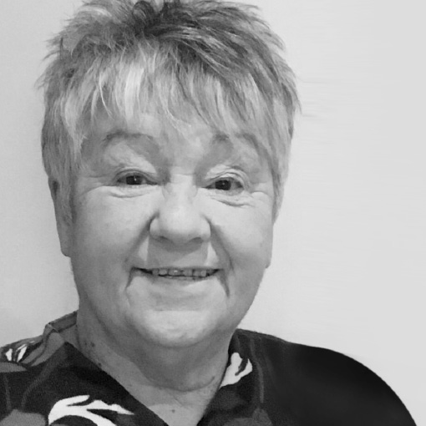
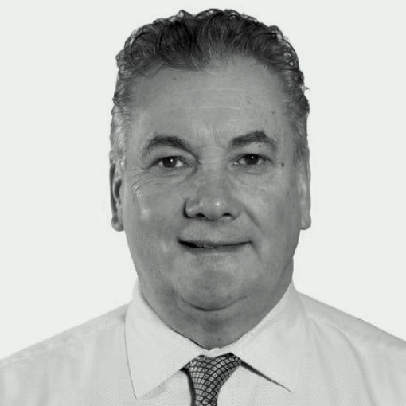
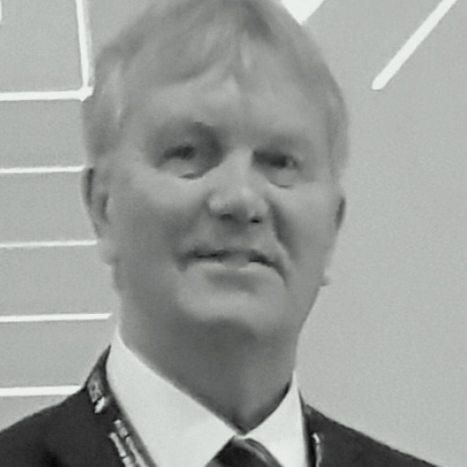
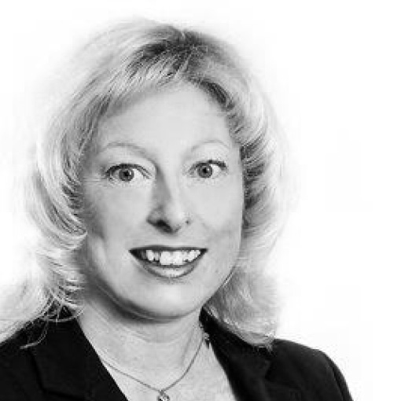
Director
Rose Wilcox
Director
Andy Brown
Executive School
Business Leader,
St Marks RC
Primary School
OBE CEO Ad Astra MAT
Chairman
Nick Hurn OBE
Bishop Wilkinson
Catholic Education Trust
Vice Chair
Sir Ken Gibson
Company Secretary
Louise Levy
Executive Head Teacher,
Harton Academy
COO Bishop Wilkinson
Education Trust

Slide 10
98%
99%
99%
of members are
happy
with their membership.
of members gave us a
good service
rating.
of members said
we are
responsive

Slide 11
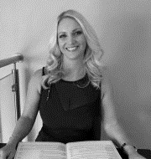
Let’s chat
Tracey Gray
01623 287840
Info@educationmutual.co.uk
Kelly Potton
01623 287840
kelly@educationmutual.co.uk
01623 287 840 | educationmutual.co.uk

